Slide 1
Regional Nutrients Reduction Strategy and
National Pilot in Thailand
Mahesh Pradhan
COBSEA Coordinator

Slide 2

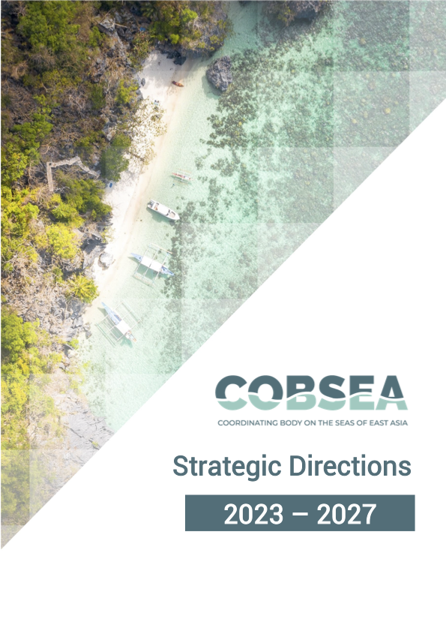
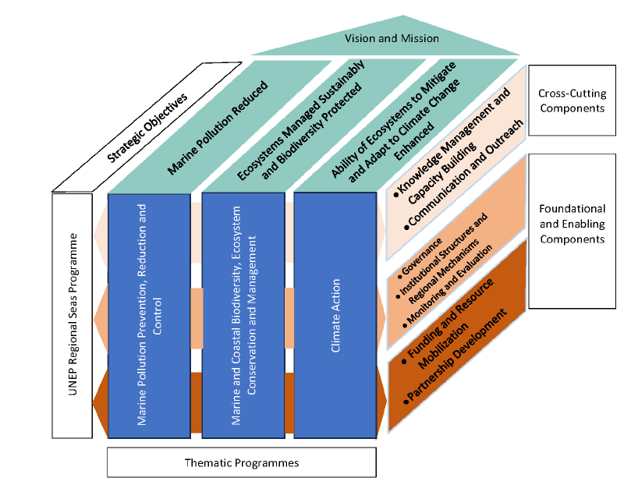
COBSEA Strategic Directions 2023-2027
Priority Areas 2023-2027: Plastic Pollution and Marine Litter, including Microplastics, from Land- and Sea-based Sources
Priority Areas 2023-2027: Nutrients, sediments and wastewater

Slide 3
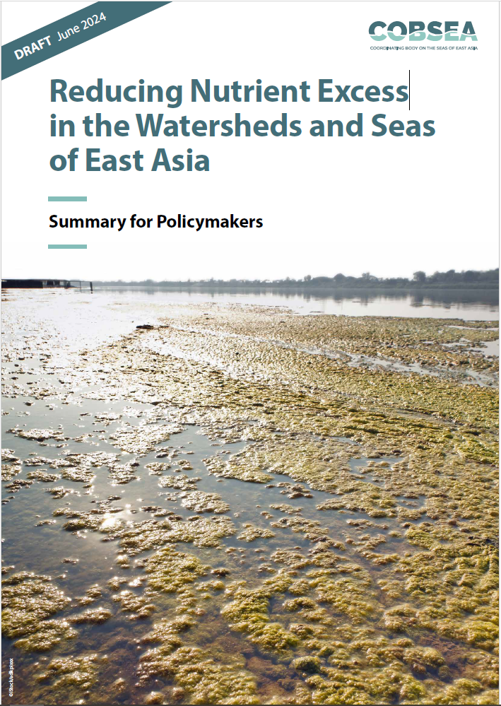
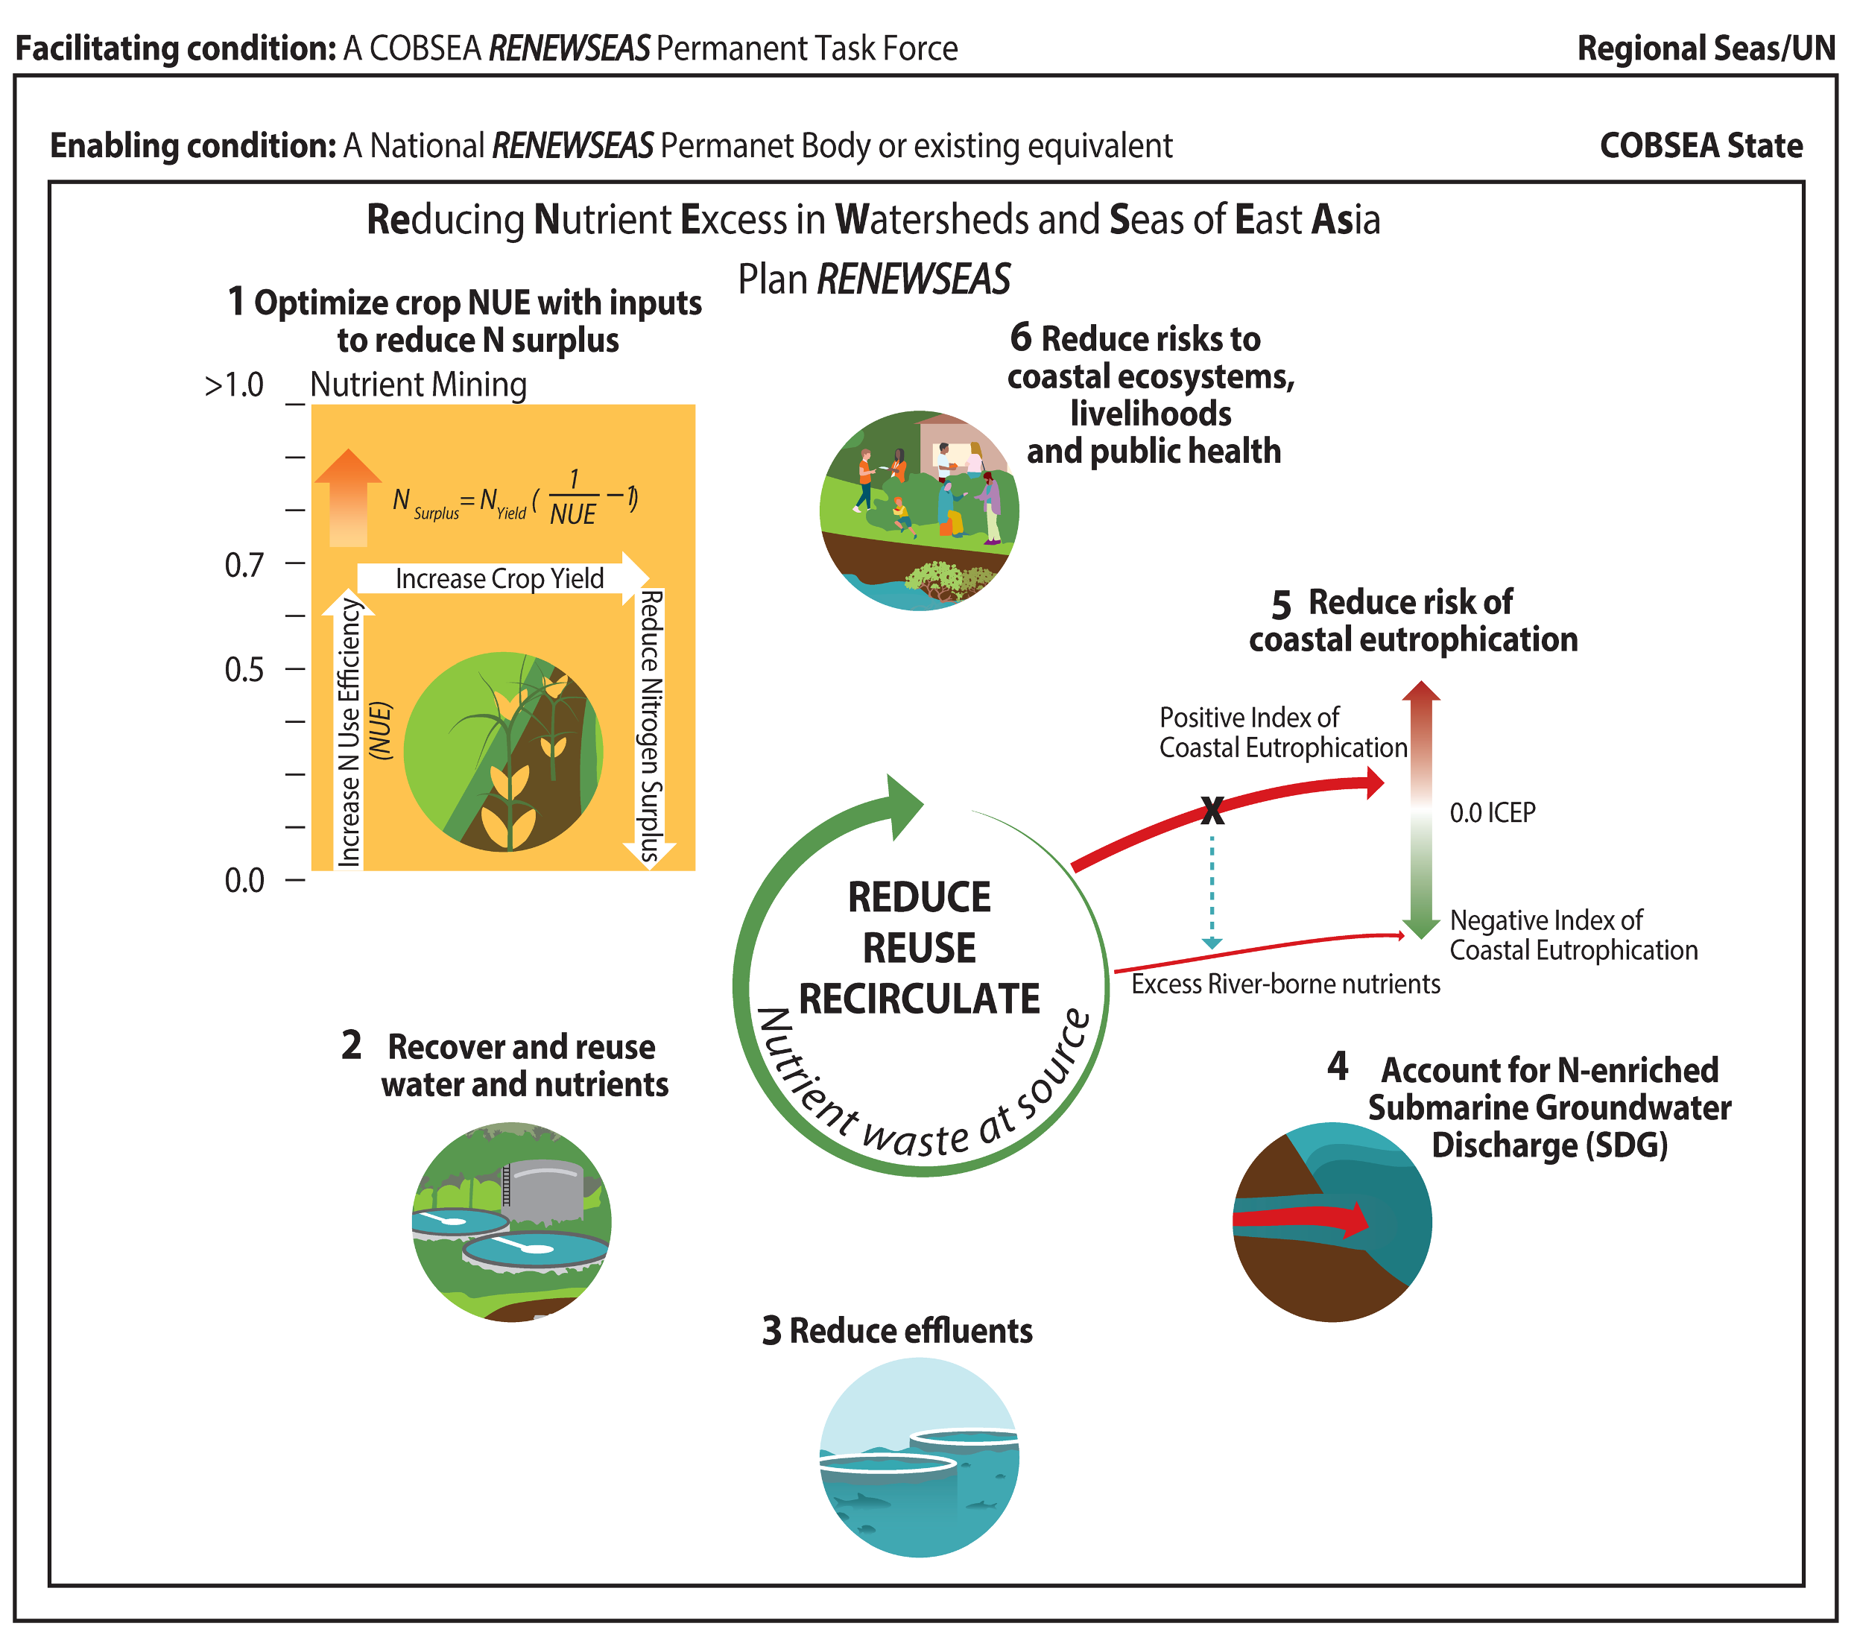
COBSEA RENEWSEAS

Slide 4

Global Environment Facility
Clean and Healthy Oceans Integrated Programme:
Thailand Child Project

Slide 5
Global CHO IP
OBJECTIVE
to address marine hypoxic zones by curbing coastal pollution from agriculture, industrial and municipal sources through policy and regulatory measures and infrastructure investments combined with nature-based solutions
Component 1: “Building awareness and knowledge to stimulate action and informs decision-making”:
Component 2: “Enhancing policy and investment frameworks to incentivize pollution mitigation”
Component 3: “Upscaling best management practices to showcase effective solutions”
Component 4: “Executing monitoring, evaluation and coordination to enhance program performance impact”

Slide 6
From Global to National
Clean and Healthy Oceans Integrated Programme Global Project
Bay of Bengal
Maldives (UNEP)
Sri Lanka
South China Sea
Thailand (UNEP)
Viet Nam
Caribbean
Venezuela
Mexico
Trinidad and Tobago (UNEP)
Panama
St. Kiits and Nevis
Grenada
Red Sea
Jordan
Black Sea
Moldova
Humbold Current
Peru
Agulhas Current
Madagascar
Large Marine Ecosystems
Child Projects
Thailand (UNEP)

Slide 7
Sub-Committee on Nutrient Pollution Management in Inland and Sea Water
Director General (DG) of Pollution Control Department & DG of Department of Marine and Coastal Resources
Sub-committee: 25 persons
Sub-committee and Secretary: 2 persons
Subcommittee and Assistant Secretary: 2 persons
Responsibilities and Tasks
Set guidelines for studying various information
regarding academic aspects, rules, regulations, standards, etc. relating to the amount of nutrients in inland and sea waters
Propose measures, give suggestions and opinions
Management plans, operational plans and projects, including determining measures, regulations, criteria and operational guidelines for managing the amount of nutrients in surface waters and seas.
Set working groups
Appoint working groups to assist in the work of the Sub-Committee as necessary and appropriate

Slide 8
Thailand CHO IP
PROJECT DESIGN
Goal: Reduce excess nutrients from source to sea in Thailand, particularly in the Gulf of Thailand, resulting in improved marine and coastal health while contributing to regional and global targets, fostering a sustainable blue economy.
Objective: A comprehensive and integrated system in tackling nutrients pollution coming from all sources in Thailand.
Component 1: Solutions to reduce nutrients from source to sea with active engagement by local communities.
Component 2: Policies and implementation frameworks on nutrients pollution management in Thailand.
Component 3: Knowledge and awareness on nutrients pollution at different scales.

Slide 9
Linkages
UNEA Resolutions, SDG14, GBF7 (Global)
Reduce Nitrogen Waste Globally
National Action Plans
Thailand
SubCommittee
GEF CHO IP
Implementation of National Plan on Nutrient Pollution Management
Policies & Implementation Frameworks
Solutions to reduce nutrients
Policies and implementation Frameworks
Knowledge and Awareness
Research Framework
Improved coordination of policies at national, regional, and global (intergovernmental coordination)
RENEWSEAS (Regional) (Regional/National Task Force)
Reduce risk to coastal ecosystems, livelihoods, and public health
Optimize Nutrient Use Efficiency
Recover and reuse water and nutrients
Reduce effluents
Account for N-enriched Submarine Groundwater Discharge
Reduce risk of coastal eutrophication
Reduce risk to coastal ecosystems, livelihoods, and public health

Slide 10


Thank you!

