Slide 1
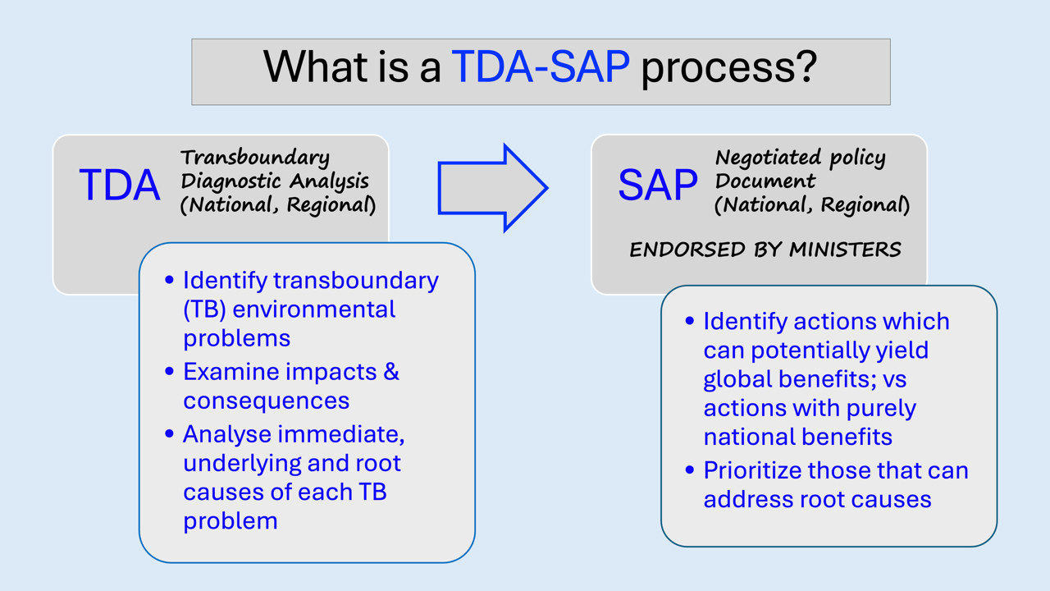
INTRODUCTION OF TDA – SAP PROCESS & POSSIBLE CONTRIBUTION OF RWGS ON HABITATS

Slide 2
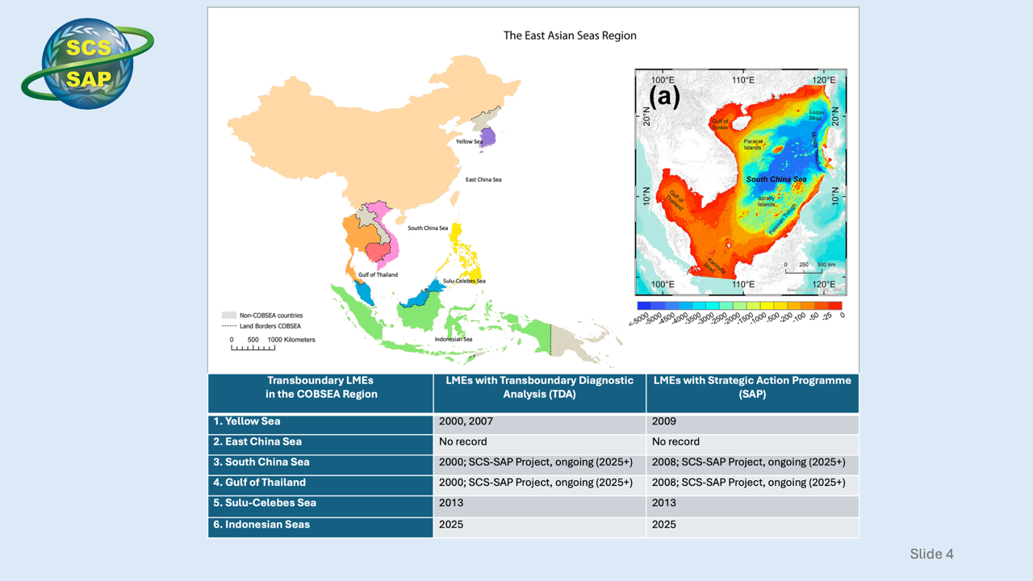

Slide 3
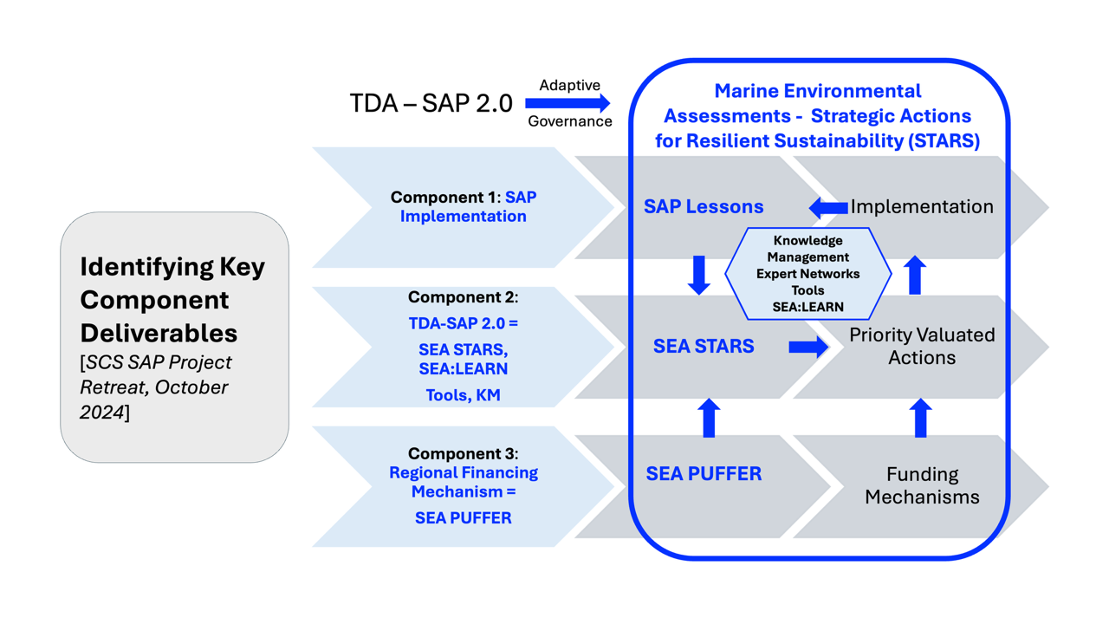

Slide 4
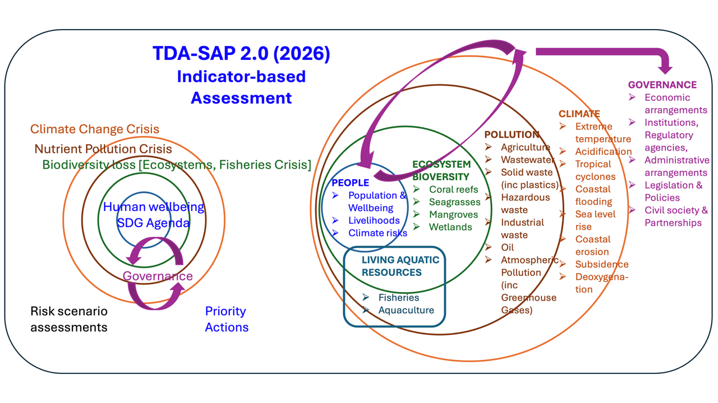

Slide 5
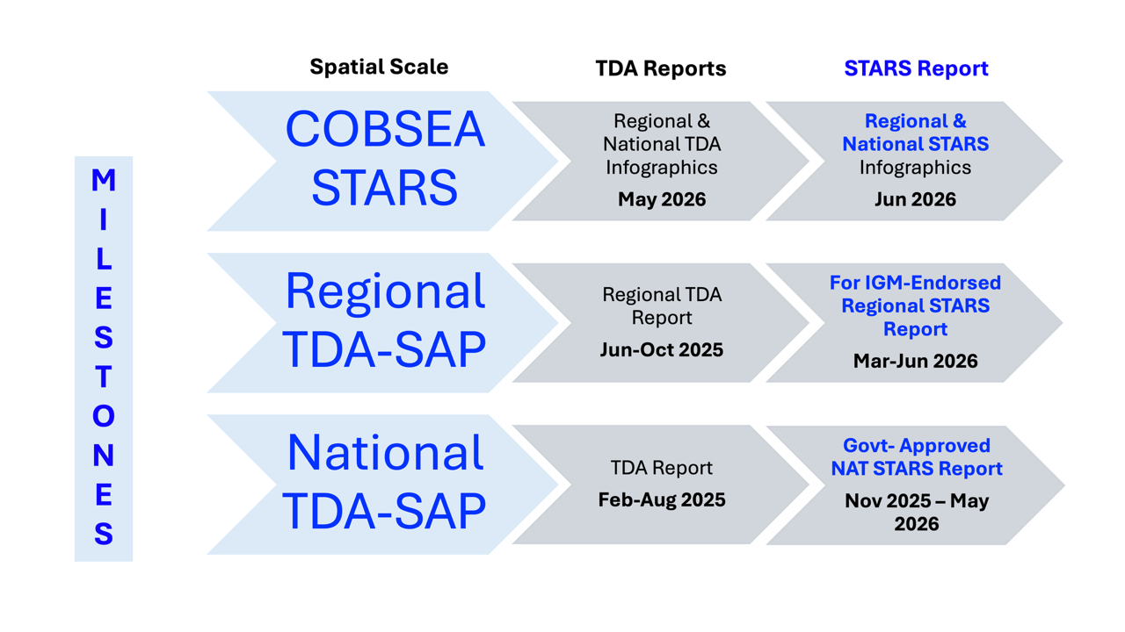

Slide 6
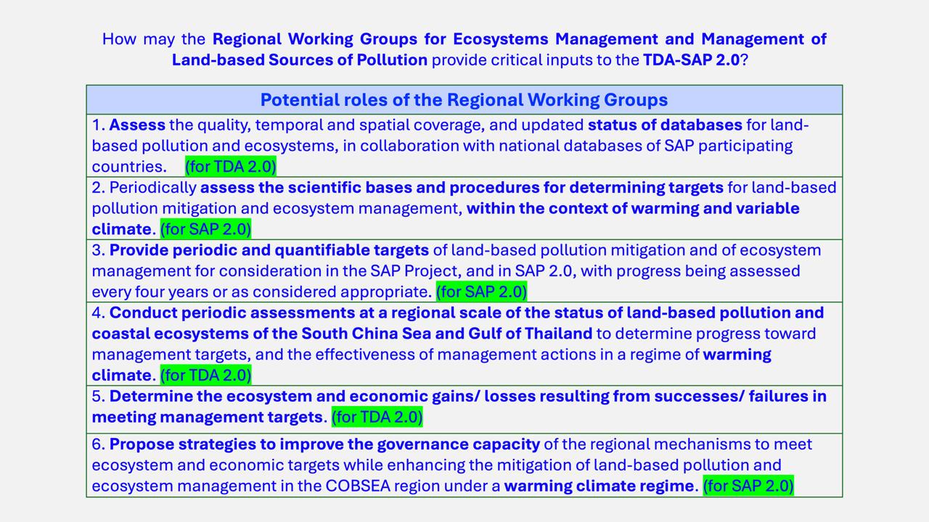

Slide 7
