Slide 1



From strategy to action: Charting the course
for enduring impact and a resilient future for the SEAs
Third Meeting of the Regional Project Steering Committee (PSC)
of the SCS SAP Project
7-8 May 2025, Manila, Philippines
Report on National Activities to Implement the SCS SAP Project
(for the period January 2023 – April 2025)
[Name of Country]
[Name of National Focal Point]

Slide 2

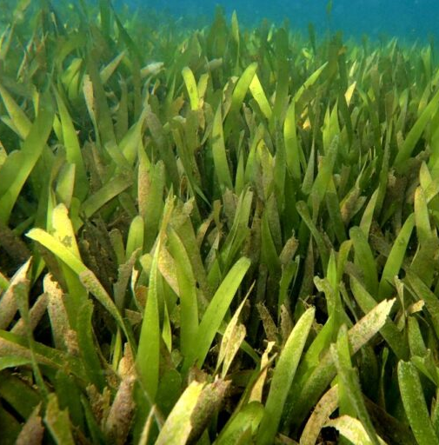

3rd SCS SAP
PSC Meeting:
From strategy to action: Charting the course for enduring impact and a resilient future for the SEAs

