Slide 1


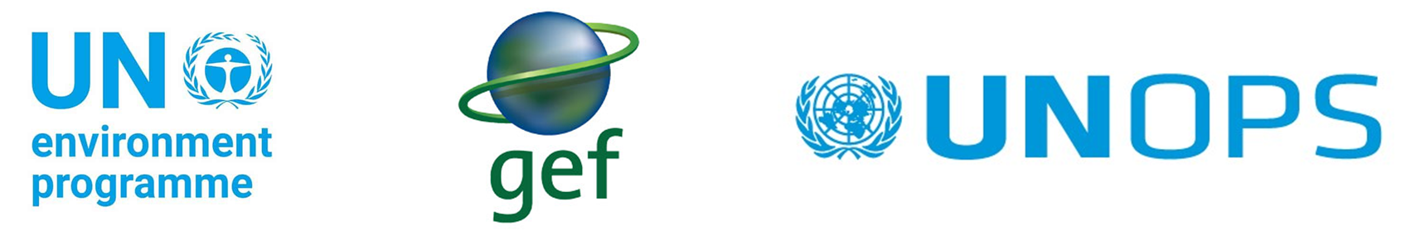
Implementing the Strategic Action Programme for THE SOUTH CHINA SEA AND GULF OF THAILAND (SCS SAP) Project
Third Meeting of the Regional Project Steering Committee (PSC)
of the SCS SAP Project
7-8 May 2025, Manila, Philippines
Report on National Activities to Implement the SCS SAP Project
(for the period January 2023 – April 2025)
Viet Nam
Viet Nam Environmental and Marine Science Institute, Ministry of Agriculture and Environment

Slide 2

National set-up of the project
National leading agency: Viet Nam Environmental and Marine Science Institute, Ministry of Agriculture and Environment
National focal point: Dr. Nguyen Le Tuan, General Director, Viet Nam Environmental and Marine Science Institute
National technical focal point: Dr. Nguyen Thi Phuong Mai, Deputy General Director, Viet Nam Environmental and Marine Science Institute
Specialized Executing Agencies (SEAs) & Focal Points
Mangrove SEA & Focal Point: Assoc.Prof.Dr. Le Xuan Tuan, Department of Ecology, Faculty of Biology, VNU University of Science
Coral Reef SEA & Focal Point: Dr. Cao Van Luong, Institute of Marine Resources and Environment
Seagrass SEA & Focal Point: Dr.Nguyen Dang Ngai, Institute of Marine Resources and Environment

Slide 3
Coastal Wetland SEA & Focal Point: Assoc.Prof. Dr. Le Xuan Tuan, Department of Ecology, Faculty of Biology, VNU University of Science
Land-based Pollution SEA & Focal Point: Dr. Nguyen Anh Tuan
Economic Valuation expert: Dr.Tran Thi Thu Ha

Slide 4
Key national meetings (IMC/NSC, NTWGs) related to SCS SAP Project during January 2023 – April 2024
Title of the meeting | Location & Date | No. participants | Key outputs
Preparation national TDA report technical meeting | Ha Noi, 27th February 2025 | 12 | Share information and documents, as well as the requests from the regional expert group during the TDA development process, with a focus on exchanging and sharing information regarding data requirements, the roadmap for report preparation, and the list of data classified as state secrets
Online technical meetings with regional experts in order to prepare regional TDA report
Technical meetings in order to finalize project documents and PCA | More than 10 technical meetings |  | Project document was approved by Ministry of Agriculture and Environment’s Leader

Slide 5
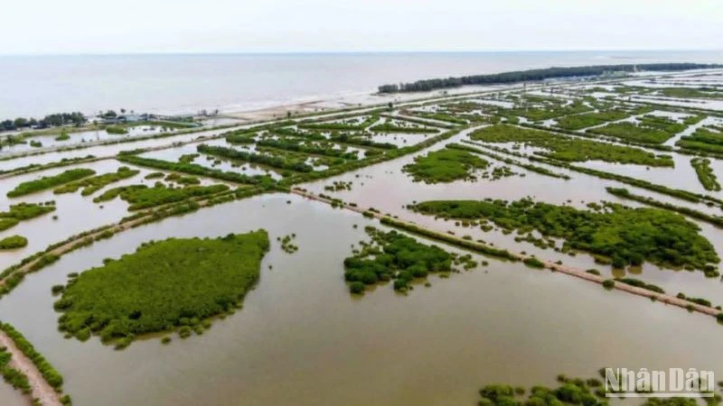
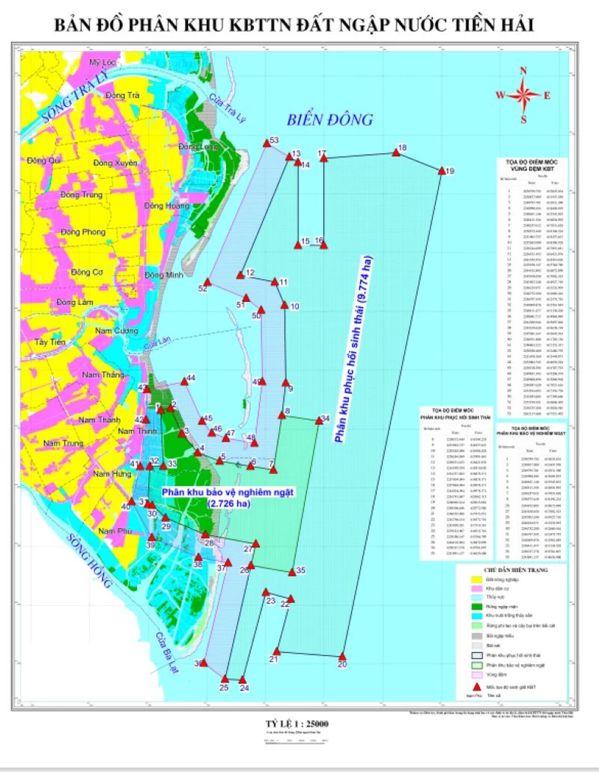
Highlights of key achievements in Implementing the SAP on habitats (mangroves, coral reefs, seagrass beds & coastal wetlands) during 2023 – April 2025 [project funded and co-financed)
Newly established or upgraded Protected Areas:
Tien Hai Wetland Protected Area was established in August 2024. The total area of the Protected Area is 12,500 hectares, including:
Strictly Protected Subzone: 2,726 hectares
Ecological Restoration Subzone: 9,774 hectares
The Tien Hai Wetland Nature Reserve is located at Tien Hai District. To the north, it borders the Tra Ly estuary area and the planned Con Vanh–Con Thu service urban area; to the south, it borders the Ba Lat estuary and the same planned urban area. To the west, it adjoins the planned high-tech aquaculture zone, the Con Vanh–Con Thu service urban area, the land reclamation zone, and the planned Dong Chau coastal urban zone; to the east, it borders the East Sea
Notes:
Mặc dù Dự án chưa chính thức được thực hiên tại Việt Nam, các hoạt động xây dựng các khu bảo tồn vẫn được thực hiện bằng nguồn tài trợ của quốc tế/ nguồn của chính Việt Nam. Với thời lượng trình bày có hạn tôi xin phép trình bày một số ví dụ điển hình mới được thành lập trong thời gian qua

Slide 6
Highlights of key achievements in Implementing the SAP on habitats (mangroves, coral reefs, seagrass beds & coastal wetlands) during 2023 – April 2025 [project funded and co-financed)
The Cu Lao Cham Nature Reserve was established in February 2024.
The Cu Lao Cham Nature Reserve, located in Hoi An City, Quang Nam Province, is classified as a Nature Reserve. It was established based on the former Cu Lao Cham Marine Protected Area, with the addition of natural forest ecosystems on the islands. This aims to promote integrated management and connectivity among forest, marine, and coastal ecosystems.
The Cu Lao Cham Nature Reserve is located in Tan Hiep Commune, Hoi An City, Quang Nam Province, with a total area of 23,530 hectares, is divided into functional zones: the Strict Protection Zone, the Ecological Restoration Zone, the Service–Administration Zone, and a buffer zone. The reserve includes a system of seven islands: Hon Lao, Hon Cu, Hon Kho, Hon La, Hon Dai, Hon Mo, and Hon Tai
The Cu Lao Cham Nature Reserve possesses extremely diverse and abundant natural resources. Its special-use forest contains over 624 identified species of vascular higher plants, many of which are classified as endangered, rare, or of medicinal value (365 species are of medicinal use). Notably, 52 plant species are prioritized for conservation and listed in the Vietnam Red Data Book, Government Decree No. 06/2019/ND-CP on the management of endangered, precious, and rare forest plants and animals, and the IUCN Red List. These include species such as Acampe ochracea, Argusia argentea (Phong ba), Curculigo orchioides (Sâm cau), Cycas rumphii (Thiên tuế), and Madhuca pasquieri (Sến mật). In addition, there is rich diversity of mammals, birds, reptiles, amphibians, and insects."
"The marine ecosystem is also highly diverse, featuring seagrass beds, seaweed communities, coral reefs, and valuable marine species such as the ornate spiny lobster (Panulirus ornatus) and the red lobster (Panulirus longipes)

Slide 7
Highlights of key achievements in Implementing the SAP on habitats (mangroves, coral reefs, seagrass beds & coastal wetlands) during 2023 – April 2025 [project funded and co-financed)
Reform of laws and regulations for the sustainable :
Decision No. 1352/QĐ-TTg dated 8th April 2024 approved the National Biodiversity Conservation Planning for the Period 2021–2030, with a Vision to 2050
The overall objective of the Planning is to increase the area, restore, and ensure the integrity and connectivity of natural ecosystems; to effectively manage and conserve wildlife species and valuable genetic resources; and to build and develop a system of nature reserves, biodiversity corridors, biodiversity conservation facilities, areas of high biodiversity, critical ecological landscapes, and important wetlands, thereby contributing to climate change adaptation and the sustainable development of the country
The National Biodiversity Conservation Planning sets specific goals to expand, upgrade, and improve the effectiveness of the management system of nature reserves. It aims to transition 178 existing protected areas (including reclassifying 7 and expanding 27), establish 61 new protected areas, and increase the total area of the national protected area system to approximately 6.6 million hectares.
It also seeks to strengthen and develop the system of biodiversity conservation facilities, biodiversity corridors, and important wetlands. This includes transition 13 existing biodiversity conservation facilities, issuing certificates for 9 biodiversity conservation facilities; transitioning 3 existing biodiversity corridors, establishing 7 new biodiversity corridors; and designating 10 nationally important wetlands.
Notes:
Đáng chú ý

Slide 8
Highlights of key achievements in Implementing the SAP on habitats (mangroves, coral reefs, seagrass beds & coastal wetlands) during 2023 – April 2025 [project funded and co-financed)
Decision No. 1539/QĐ-TTg dated 10th December 2024 approves the Scheme on the expansion and establishment of new marine protected areas, aquatic resource protection zones, and the restoration of marine ecosystems by 2030, aiming to ensure that marine and coastal protected areas cover 6% of the natural marine area of Viet Nam
The overall objective of the Scheme is to effectively manage and protect marine, coastal, and island ecosystems; to increase the coverage of marine and coastal protected areas to about 6% of Vietnam’s natural marine area by 2030; and to contribute to biodiversity conservation, restoration, and protection of critical marine ecosystems. It also aims to ensure the integrity and natural interconnection between terrestrial and marine ecosystems; proactively respond to climate change and sea level rise; and promote the sustainable development of the marine economy in association with ensuring national defense, security, independence, sovereignty, and territorial integrity—moving toward the goal of making Vietnam a strong and prosperous maritime nation
By 2030: Expand, establish, and effectively manage 27 marine protected areas to ensure that the total protected marine area reaches approximately 0.463% of the natural marine area of Vietnam."
"Effectively manage 59 aquatic resource protection zones and 63 temporarily closed fishing areas in the sea, ensuring that the total area designated for the protection of aquatic resources, spawning grounds, and juvenile aquatic habitats reaches approximately 2.303% of the natural marine area of Vietnam

Slide 9
Highlights of key achievements in Implementing the SAP on habitats (mangroves, coral reefs, seagrass beds & coastal wetlands) during 2023 – April 2025 [project funded and co-financed)
Replanting and restoration:
Mangrove Replanting and Restoration
Key Locations: Ca Mau, Ben Tre, Quang Ninh, Ninh Binh, Thanh Hoa
Area Restored: ~2,000 hectares nationally
Implementing Agencies: MONRE, MARD, local DoNREs, and international NGOs (e.g. WWF, IUCN)
Coral Reef Rehabilitation
Locations: Nha Trang Bay, Cu Lao Cham, Phu Quoc, Con Dao
Activities:
  Coral transplantation using nursery techniques
  Deployment of artificial reef structures
  Local dive communities engaged in monitoring
Seagrass Bed Restoration
Areas: Khanh Hoa, Quang Ninh, Nam Dinh
Techniques:
  Transplantation of Enhalus acoroides and Thalassia hemprichii
  Sediment stabilization

Slide 10
Highlights of key achievements in Implementing the SAP on habitats (mangroves, coral reefs, seagrass beds & coastal wetlands) during 2023 – April 2025 [project funded and co-financed)
Replanting and restoration:
Coastal Wetland Rehabilitation
Focus Areas: Red River Delta, Mekong Delta
Activities:
  Hydrological rebalancing
  Invasive species removal
  Salt marsh planting

Slide 11
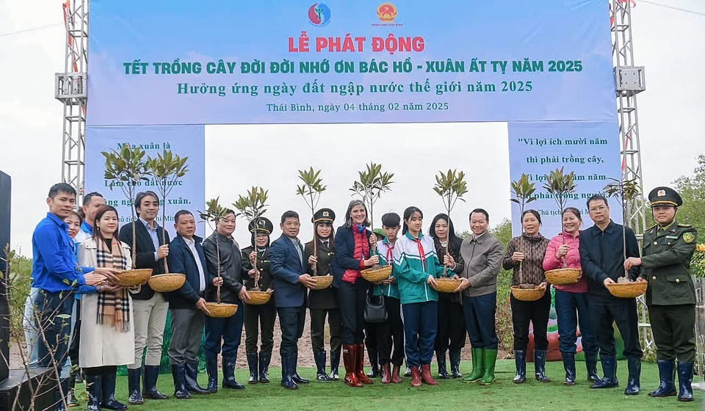
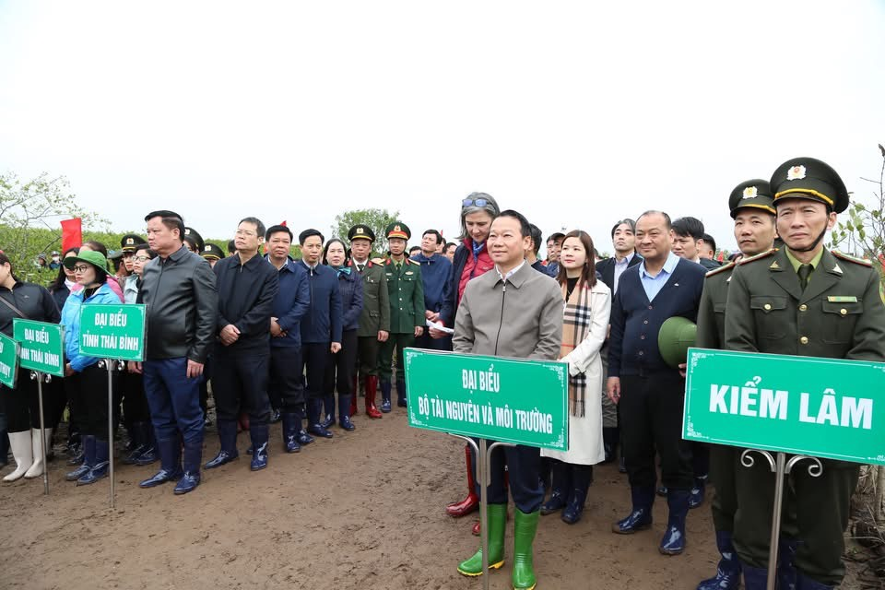
Highlights of key achievements in Implementing the SAP on habitats (mangroves, coral reefs, seagrass beds & coastal wetlands) during 2023 – April 2025 [project funded and co-financed)
Replanting and restoration:
10,000 new trees have been planted in the Thai Thuy Wetland Nature Reserve
February 4th 2025, Minister of Agriculture and Environment Đỗ Đức Duy; Secretary of the Thai Binh Provincial Party Committee ; and representatives of various agencies launched the 'Tree Planting Festival in Eternal Gratitude to Uncle Ho' and celebrated World Wetlands Day 2025 at the Thai Thuy Wetland Nature Reserve. The tree planting launch ceremony was attended by the UNDP Resident Representative in Vietnam, Ms. Ramla Khalidi

Slide 12
Land-based Pollution related activities at national and provincial levels during 2023 – April 2025
Legal and Policy Development
THE NATIONAL ASSEMBLY OF THE SOCIALIST REPUBLIC OF VIETNAM
Law No. 28/2023/QH15 of the National Assembly: Law on Water Resources. Code number, 28/2023/QH15. Date of promulgation, November 27, 2023. Effective date, July 1, 2024
GOVERNMENT
Decision No. 146/QD-TTg dated February 23, 2023 of the Prime Minister promulgating the National Plan for Responding to Waste Incidents for the 2023-2030 Period
Resolution No. 48/NQ-CP dated April 3, 2023 of the Government approving the Strategy for Exploitation and Sustainable Use of Resources and Protection of the Marine and Island Environment by 2030, with a Vision to 2050
Decree No. 22/2023/ND-CP dated May 12, 2023 of the Government amending and supplementing a number of articles of the Decrees related to business activities in the field of natural resources and environment.
Decision No. 1251/QD-TTg dated October 26, 2023 of the Prime Minister approving the Program to Enhance the Capacity for Preventing and Responding to National Environmental Incidents by 2030
Decision No. 29/2023/QD-TTg dated December 19, 2023 of the Prime Minister on the documents, procedures and order for determining investment projects using outdated technology, posing a potential risk of environmental pollution and resource-intensive

Slide 13
Land-based Pollution related activities at national and provincial levels during 2023 – April 2025
Ministry of Agriculture and Environment issued number of regulations, policies in 2023
- Circular No. 01/2023/TT-BTNMT dated March 13, 2023 of the Ministry of Natural Resources and Environment promulgating national technical regulations on ambient environmental quality
- Circular No. 13/2023/TT-BTNMT dated October 16, 2023 of the Ministry of Natural Resources and Environment Technical regulations on monitoring and providing information and data on hydrometeorological monitoring for specialized hydrometeorological stations
- Circular No. 15/2023/TT-BTNMT dated October 30, 2023 of the Ministry of Natural Resources and Environment Regulations on providing and sharing information and data on monitoring natural resources and the environment
- Circular No. 20/2023/TT-BTNMT dated November 30, 2023 of the Ministry of Natural Resources and Environment Promulgating national technical regulations on collection, transportation, storage, recycling, re-use of use and treatment of controlled substances
- Circular No. 22/2023/TT-BTNMT dated December 15, 2023 of the Ministry of Natural Resources and Environment regulating the system of statistical indicators and statistical reporting regime for the natural resources and environment sector
- Circular No. 23/2023/TT-BTNMT dated December 28, 2023 of the Ministry of Natural Resources and Environment amending and supplementing a number of articles of Circular No. 20/2016/TT-BTNMT dated August 25, 2016 of the Minister of Natural Resources and Environment regulating the establishment, exploitation and use of databases on marine and island resources and environment
Notes:
Một số văn bản quy phạm pháp luật

Slide 14
Land-based Pollution related activities at national and provincial levels during 2023 – April 2025
Programs and Campaigns
Vietnam Clean Rivers Program 2023–2025 – Targeting river basins flowing to coastal areas (Red River, Dong Nai, etc.).
Organize annual marine environmental protection activities on World Oceans Day
Monitoring and Assessment
Strengthening national monitoring system for riverine discharge to the sea.
Satellite and UAV-based mapping of polluted estuaries (via VASI and VNSC).
Pilot use of digital platforms for industrial wastewater tracking.

Slide 15
Land-based Pollution related activities at national and provincial levels during 2023 – April 2025
Provincial-Level Actions (Examples)
Quang Ninh
Upgrading wastewater treatment systems in Ha Long city.
Monitoring domestic wastewater in tourist areas (UNDP-CC project).
Da Nang
Smart sensor networks for drainage monitoring.
“Zero Plastic Waste in Son Tra” campaign with schools and hotels.
Khanh Hoa
Integrated coastal water quality monitoring funded by ADB.
Control of shrimp farm effluents in Van Ninh District.
Ho Chi Minh City / Long An
Strict enforcement on industrial discharge to the Soai Rap river system.
EIA re-assessments for major industrial zones affecting coastal water.
Soc Trang & Bac Lieu
Pilot treatment of agricultural runoff using constructed wetlands.
Awareness raising with shrimp-farm cooperatives on chemical overuse.

Slide 16
Economic valuation related activities at national and site levels during June 2021 – April 2025
Key study- National ecosystem assessment Report of Viet Nam, 2022. The main key findings of the Report:
- Natural Capital Underpins National Development: Vietnam’s ecosystems—forests, wetlands, marine and coastal systems—are crucial for economic growth, poverty reduction, and climate resilience. However, these assets are under increasing pressure from land-use change, pollution, overexploitation, and weak governance
- Significant Biodiversity Decline: Vietnam is among the world’s biodiversity hotspots, but it has experienced serious biodiversity loss. Drivers include agricultural expansion, unsustainable aquaculture, infrastructure development, and illegal wildlife trade. This loss directly impacts ecosystem services and human well-being
- Need for Intergrated Policy and Governace Reform: The report emphasizes strengthening policy coherence, institutional coordination, and data sharing across sectors. It calls for mainstreaming ecosystem services into national development planning and promoting community-based and science-informed decision-making for sustainable management

Slide 17
Summary of the progress in development of National TDA
1. Team Formulation
Lead organization: VEMSI
Team for Socioeconomics and Climate-related threats: VNU
Team for Pollution: VEMSI (03 staff) and D4C3 (03 consultants)
Team for Ecosystems: VNU, Ha Noi
Team for Fish, Fisheries and Aquaculture: MEA & VNU, Ha Noi
Team for Governance: MEA
Drafting Team: VEMSI, MEA, other relevant Stakeholders and Experts
2. Start literature review and data collection
Period: Data from 2014 to 2024
Sources: Scientific journals and research publications;Reports from government agencies such as the Ministry of Agriculture and Environment (MAE) and provincial Departments;Data from international organizations (Mekong River Commission, UNEP;UNDP, WB, WWF, IUCN, ….); Monitoring data from the National quality monitoring network and provincial; monitoring programs; Others
Limitations:
Data gaps: no/limited data for areas of concerns, insufficient data for regions and time periods, spatial coverage limitations, uncertainties in inventory data, v.v…;
Methodological differences/uncertainties: across different monitoring programs, regions, affecting data comparability and risk assessment
Limited information on key pollutants: only data for some indicators and some areas; lack of emerging contaminants that are not routinely monitored, …
Incomplete source information: difficult to establish definitive causal relationships, ..

Slide 18
Issues and Challenges
Present the issues and challenges encountered in implementing the SAP and actions taken to address it since the 2nd PSC meeting (December 2022)
Delay in Project Approval
Issue: The Project was not approved by the Vietnamese Government during 2023 – April 2025 due to complicated national approval procedures and the Project is identified as Confidential Project delayed the approval and implementation process
Impact: No project activities were conducted at the field level during this period under this Project.
Goverment Restructuring Issue: Comprehensive restructuring of ministries in Vietnam, including the merger of MONRE and MARD into the Ministry of Agriculture and Environment; merger of provinces
Impact: Delayed assignment of responsibilities and focal points in prvinces
Data Gaps and Technical Challenges in TDA Development
Issue: Limited availability of updated and spatially consistent data for marine ecosystems, land-based pollution, and fisheries.
Challenges Identified: Gaps in time-series and location-specific data (e.g., emerging pollutants).Inconsistencies across national and provincial datasets. Limited information on socio-economic and governance indicators.

Slide 19
Lessons Learned
Present the lessons learned in implementing the SAP at the national level
The outputs need to balance between finance, time and workload. Example: With the expected products of TDA being huge, but the time and finance for this activities are limited.
Existing programs can be leveraged: Despite no direct funding, Vietnam successfully SAP aligned goals with ongoing national programs (e.g., marine spatial planning, MPA expansion, plastic pollution control).
Data harmonization remains a challenge: Fragmented, outdated, or inconsistent data remains a barrier to national-level assessment.
There needs to be flexibility in implementation and financial mechanisms depending on the specific regulations of each country.
Project communication activities play a very important role in attracting local and community participation in project activities.

Slide 20
Recommendations
Present recommendations to further the implementation and achievement of the SAP targets
For countries that receive late approval, in addition to having to speed up activities to ensure the achievement of expected outputs, an extension is also needed. In the case of Vietnam, we propose an extension until the end of 2027.
Vietnam is currently undertaking the revision of the Law on Marine Resources and Environment and wishes to receive support from the Project to draw on successful experiences and best practices for the amendment process
It is necessary to identify the key data to be collected in the TDA to ensure timeliness and financial suitability.
Consider a suitable financial mechanism for Vietnam under time constraints

Slide 21
Conclusions
Overall summary of efforts and achievements in implementing the SAP including funding and implementing agencies and partners
The legal system on management and protection of marine ecosystems and marine reserves in Vietnam is gradually being improved.
Despite the late approval, Vietnam has used domestic resources to carry out many activities to ensure the project's objectives.
National working groups and technical groups have been established. The working groups and technical groups have been proactive in carrying out activities despite not having received project funding.
The efforts of the VEMSI project preparation team, together with the support from the project management agencies, represent one of the key achievements for implementing the project in Vietnam.

Slide 22
Conclusions
Ways forward to achieve SAP targets during SCS SAP Project in next 2 years
Accelerate Implementation Following Government Approval
Speed up for sign PCA
Prepare documents for financial approval and domestic bidding plan
Formalize working groups, technical groups
Strengthen Data Collection and Technical Capacity
Prioritize targeted data collection to address critical gaps identified during National TDA development (e.g., emerging pollutants, socio-economic indicators, marine biodiversity).
Standardize and harmonize data collection methodologies between national and provincial levels.
Invest in capacity building and coordination among technical teams to improve analysis of ecosystem trends and pollution sources.
Enhance Institutional Coordination Amid Restructuring: Clearly define the roles and responsibilities of stakeholders in the context of restructuring ministries and provinces.
Monitor Progress and Report Transparently: Develop a robust Monitoring & Evaluation framework with clear indicators tied to SAP targets.Ensure transparent reporting of progress, challenges, and lessons learned to PSC and UN Environment Programme (UNEP).

Slide 23
THANK YOU FOR YOUR ATTENTION!

