Slide 1
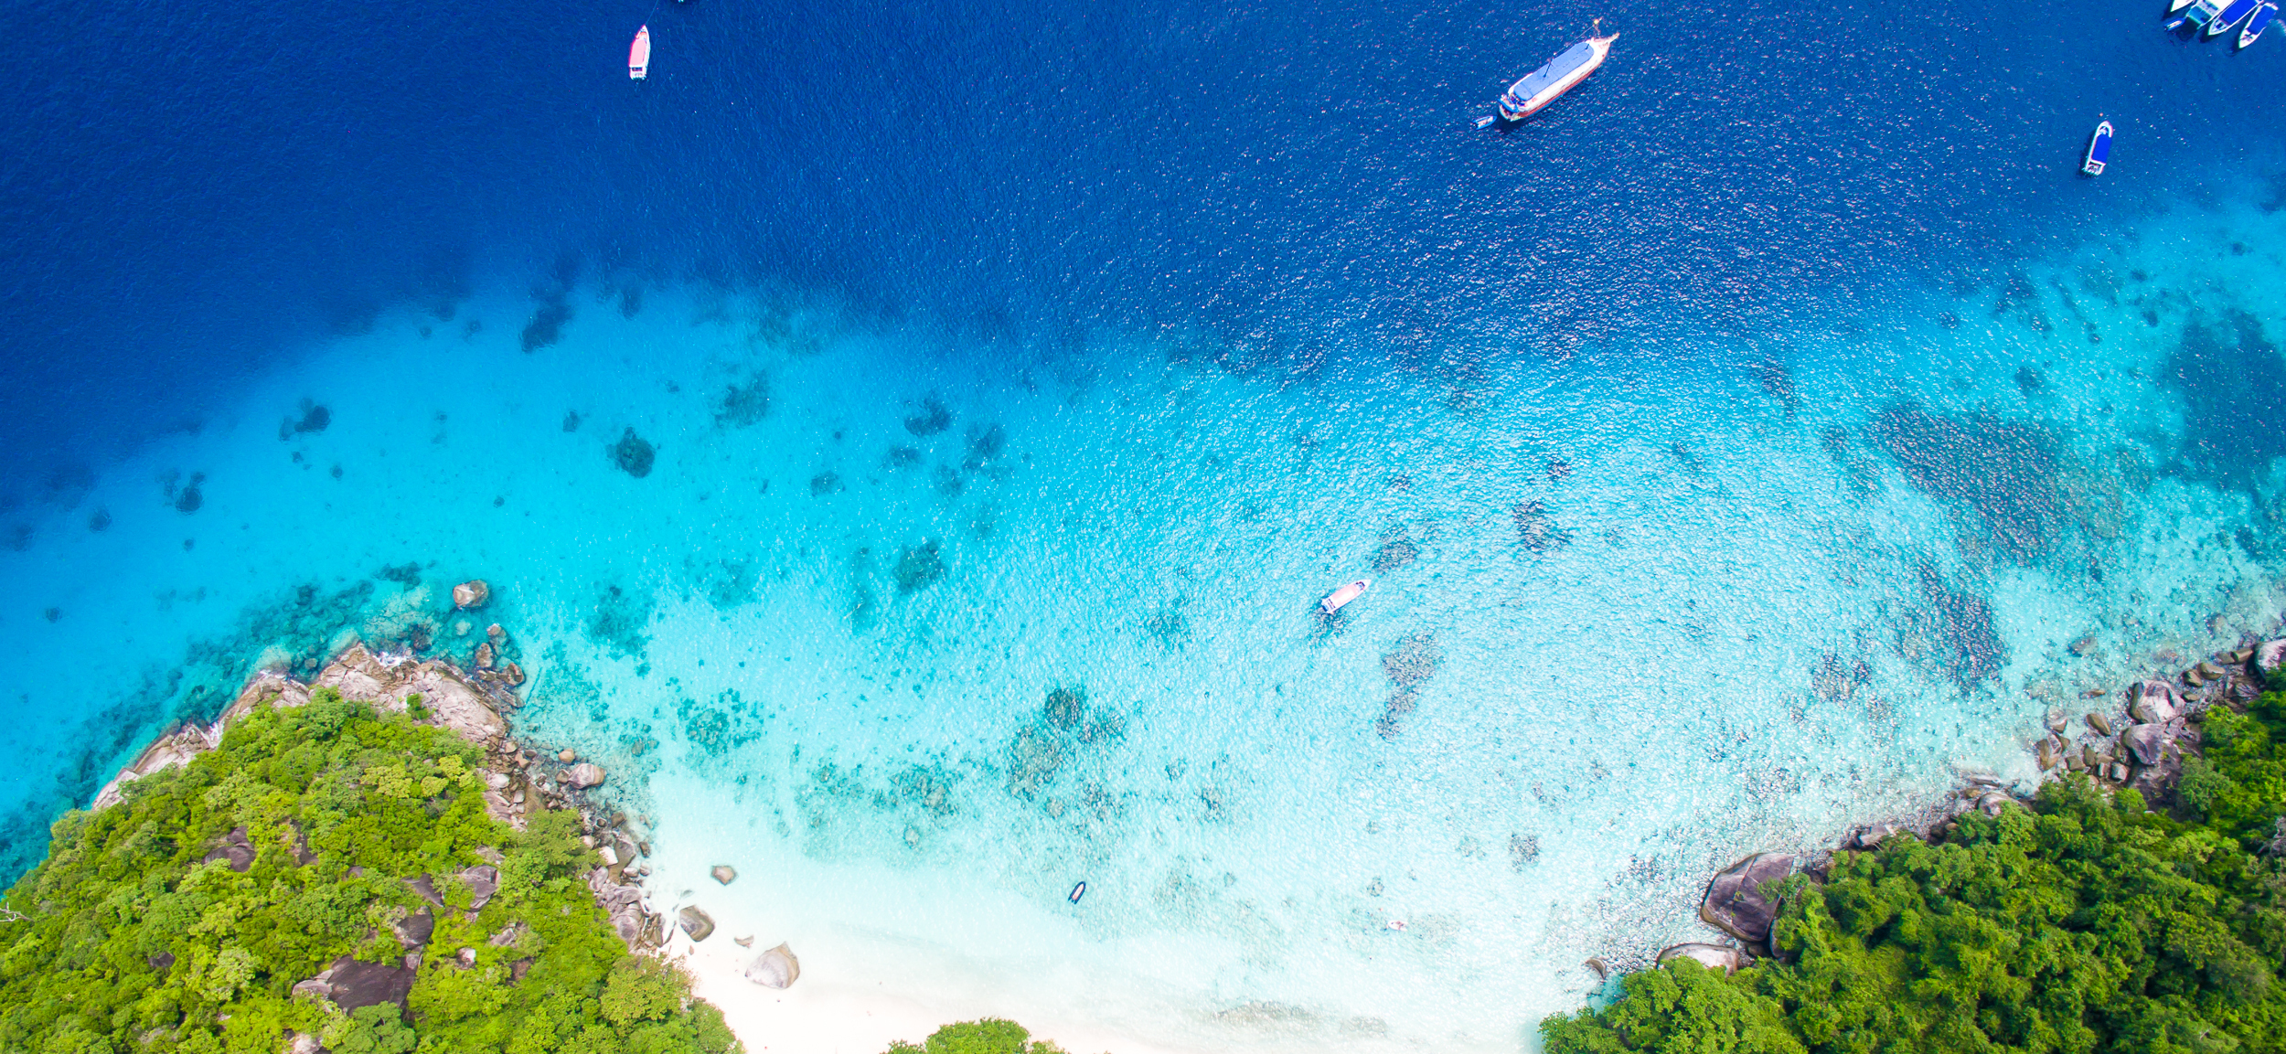


Implementing the Strategic Action Programme for THE SOUTH CHINA SEA AND GULF OF THAILAND (SCS SAP) Project
First Meeting of the Regional Scientific and Technical Committee (RSTC)
of the SCS SAP Project
17-19 October 2022, Bangkok, Thailand
SAP IMPLEMENTATION ACHIEVEMENTS 2008-2021
Cambodia
General Directorate of Natural Protected Areas

Slide 2

Presentation Outline
Introduction
Evaluation of Achievements
Mangroves: SAP Targets and Summary of Achievements
Coral Reefs: SAP Targets and Summary of Achievements
Seagrass: SAP Targets and Summary of Achievements
Wetlands: SAP Targets and Summary of Achievements
Issues and Challenges
Lessons Learned
Recommendations
Conclusions

Slide 3
Introduction
Cambodia developed the NAPs for habitat and land-based pollution management for the SCS Project and has conducted a series of activities in implementing the SAP and NAPs since 2008
MoU committing to implement the SAP was signed in August 2016 by Director General of the General Directorate of Administration for Nature Conservation and Protection (predecessor General Directorate of Natural Protected Areas - GDNPA), MoE
National Implementation Report (NIR) for SCS SAP developed, covering the four habitats, mangrove, coral reefs, seagrass and wetlands
The SAP targets focus on
  Replanting some 2,500 ha of degraded mangrove land,
  Sustainable management of seven archipelagos of coral reef habitats, four sites of seagrass, and one site of wetlands
Notes:
NAPs = National Action Plans
SAP = Strategic Action Programme
MoE = Ministry of Environment

Slide 4
Evaluation of Achievements on Mangroves
Regional output | SAP 2008 targets (ha) | Achievements (ha) during 2008-2021
 |  | Prey Nob District | Butom Sakor National Park | Peam Krasop Wildlife Sanctury
1.1.1 Declaration of 57,400 ha of mangrove as National Parks and Protected Areas | - | 9,351 | 9,127 | 15,500
1.1.2 Designation and plans for the management of 166,600 ha of mangrove as non-conversion, sustainable use areas | - | N/A | 9,127 | 15,500
1.1.3 Reform of laws and regulations for the sustainable use of 602,800 ha of mangrove forest | 49,900
1.1.4 Replanting of 21,000 ha of deforested mangrove land | 2,500 | N/A | N/A | N/A
1.1.5 Biodiversity increased for 11,200 ha of mangrove forest via enrichment planting | - | N/A | N/A | 15,500
1.1.6 Monitoring of management effectiveness | - | N/A | N/A | N/A
At least 14 projects with estimated fund over USD 4.2 million sourced from different partners/donors for mangrove activities during 2008-2021

Slide 5
Evaluation of Achievements on Coral Reefs
Site Names | Reef area (ha) managed in 2008 | SAP target area (ha)* | Total area (ha) ** managed until 2021 | Capacity (high, medium, low) | Management approach (ha) | Management tools (ha) | Monitoring (ha)
Koh Kong archipelago |  |  |  | Low | 73 | N/A | N/A
Koh Sdach archipelago |  |  | 423 | Medium | 423 | 423 | 260
Koh Rong archipelago |  |  | 426 | High | 426 | 426 | 255
Koh Takiev archipelago | 293 |  |  | Low | 293 | N/A | N/A
Koh Tang archipelago |  |  |  | Medium | 439 | N/A | N/A
Prek Ampil |  |  | 953 | Low | 953 | 953 | 467
Koh Pouh archipelago |  |  | 52 | High | 52 | 52 | 52
Total | 293 | 2,258 | 1,854 |  | 2,659 | - | 1.034
Several projects/initiatives implemented for coral reefs including the Fisheries Refugia since 2008, with a total estimated fund of some USD 3.41 million

Slide 6
Evaluation of Achievements on Seagrass
Regional Output | Kep Beach & Koh Tonsay archipelago | Kampot Beach | Chroy Pros | Koh Rong | Total
1.3.1 Twenty seagrass areas totaling 26,036 ha under sustainable management with supporting laws and regulations | 3,095 | 1,500 | 2198 |  | 6,793
1.3.2 Amended management plans for 7 existing MPAs with significant seagrass areas, to include specific seagrass-related management actions and policy, legal and institutional reforms | N/A | N/A | N/A
1.3.3 Designation of 7 new Marine Protected Areas focusing on seagrass areas identified in the prioritized listings of the SCS Project | 3,095 |  |  | 92 | 3,187
1.3.4 Established mechanism for monitoring seagrass habitat management | 3,095 | 1,500 |  | N/A | 4,595
Several projects/initiatives implemented for seagrass activities including the Fisheries Refugia, with a total estimated fund of some 3.41 million since 2008

Slide 7
Evaluation of Achievements on Coastal Wetlands
Regional Output | Koh Rong | Total
1.4.1 Integrated management plans developed and under implementation for at least 2 lagoons (21,818 ha), 10 estuaries (639,418 ha), 5 tidal flats (96,903 ha), 1 peat swamp (45,700 ha) and 1 non-peat swamp (9,808 ha) | 12,000 | 12,000
1.4.2 Declaration of wetland areas with protection status (i.e. non-hunting area, nature reserves, protected areas, Ramsar Sites) | 12,000 | 12,000
1.4.3 Adoption of a regional monitoring scheme and its national implementation | 12,000 | N/A
Several projects and initiatives with the estimated funding of USD 5.3 million from different sources for wetland activities implemented during 2008-2021

Slide 8
Key progress of the SCS SAP project
Developed National Implementation Report (NIR) of the four habitats: mangrove, coral reefs, seagrass and wetlands
Updated members of SAP coordination (IMC, NTWG, SEAs, NC)
Signed Project Cooperation Agreement (PCA) between UNOPS and MOE on SCS SAP implementation dated 12-Sep-2022 Developed Detailed Annual Workplan Plan and Budget
Forming project management team and recruitment of consultants
Notes:
National Inter-Ministry Committee (IMC), the National Technical Working Group (NTWG), the Specialized Executing Agencies (SEAs) and the National Committees.

Slide 9
Issues and Challenges
Insufficient law, regulations and guidelines related to marine habitats to meet the current management needs
Law enforcement remains limited
Lack of effective guidelines for sustainable coastal management
Land encroachment in the coastal areas
Coastal and marine pollution
Climate change impacts
Lessons Learned
Establishment of new protected areas (i.e. MNP, MFMA)
Integrated coastal management/ Co-management
Community engagement in the protected area management
Mangrove forest eco-tourism
Notes:
SEA = Social Ecological Assessment
MNP = Marine national Park
MFMA = Marine Fisheries Management Area

Slide 10
Recommendations
Update regulations and law related to the four marine habitats to meet the current management needs
Encourage local engagement and promote ecotourism sites where possible
Support to updating official data on the status of the habitats for effective management decisions
Conclusions
The Royal Government of Cambodia is highly committed and cooperates in the SAP implementation
Several good progress made for the SAP targets from Cambodia
Cambodia is in a good position ready for the SCS SAP implementation over the next 2 years

Slide 11

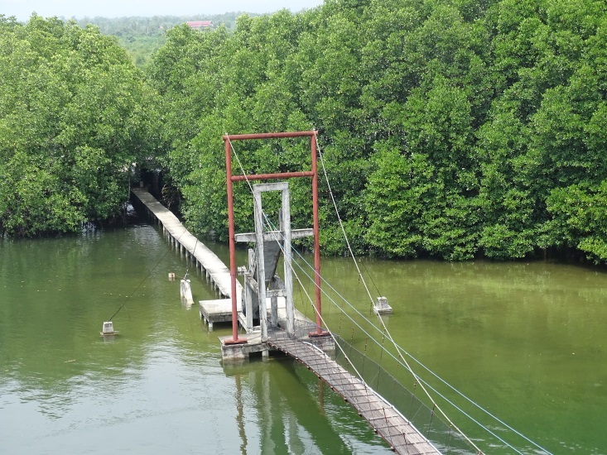
Thank your Attention

