Slide 1

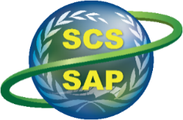

Implementing the Strategic Action Programme for THE SOUTH CHINA SEA AND GULF OF THAILAND (SCS SAP) Project
Second Roundtable of Local Representatives
of the SCS SAP Project
17 September, 2025, Jakarta, Indonesia
MAINSTREAMING NATURAL CAPITAL INTO SUSTAINABLE DEVELOPMENT POLICIES:
SPATIAL ECOSYSTEM SERVICES VALUATION APPROACH APPLIED FOR COASTAL MANGROVES
IN THE MEKONG DELTA OF VIETNAM
Tran Thi Thu Ha – Vietnamese Academy for Forest Science

Slide 2

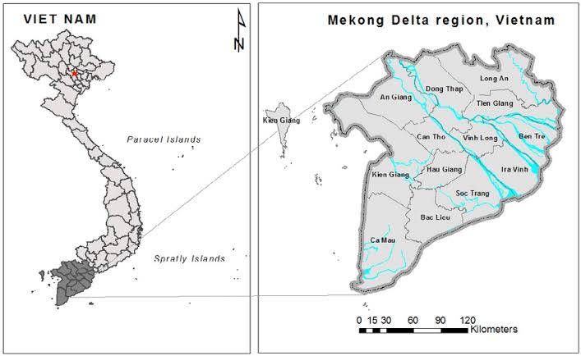
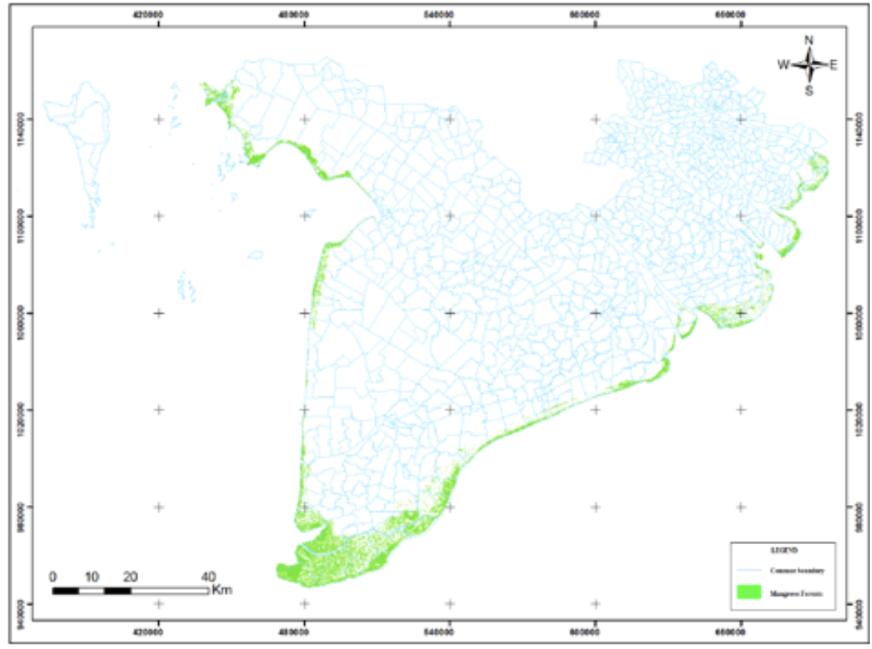
MEKONG DELTA AND ITS MANGROVE ECOSYSTEMS
Mekong Delta
  Located in the southernmost part of Vietnam, comprising of 14 provinces
  Total area: 40,000 km2
  Population: 18 million
  Main economic activities: agriculture (often referred as the rice bowl of Vietnam)
  Mangroves in Mekong Delta
  Total area: > 90,000 ha (60% of mangrove area in Vietnam)
  Distributed along delta’s 6 coastal provinces (predominantly in Ca Mau province)
  Facing decreasing trend of due to aquaculture expansion and coastal erosion

Slide 3

WHY WAS SPATIAL ECOSYSTEM SERVICE VALUATION APPROACH ADOPTED?
Ecosystem services are benefits that ecosystem provided to people
Ecosystem services values (the contribution of ecosystem services to human well-being) is often unrecognized
Spatial ecosystem services valuation approach was developed and successfully piloted by the ADB in the Central Highlands of Vietnam in 2017
The approach provides a tool to better understand the distribution, dynamics and values of ecosystem services, assisting local management authorities in maximizing benefit values of ecosystem

Slide 4
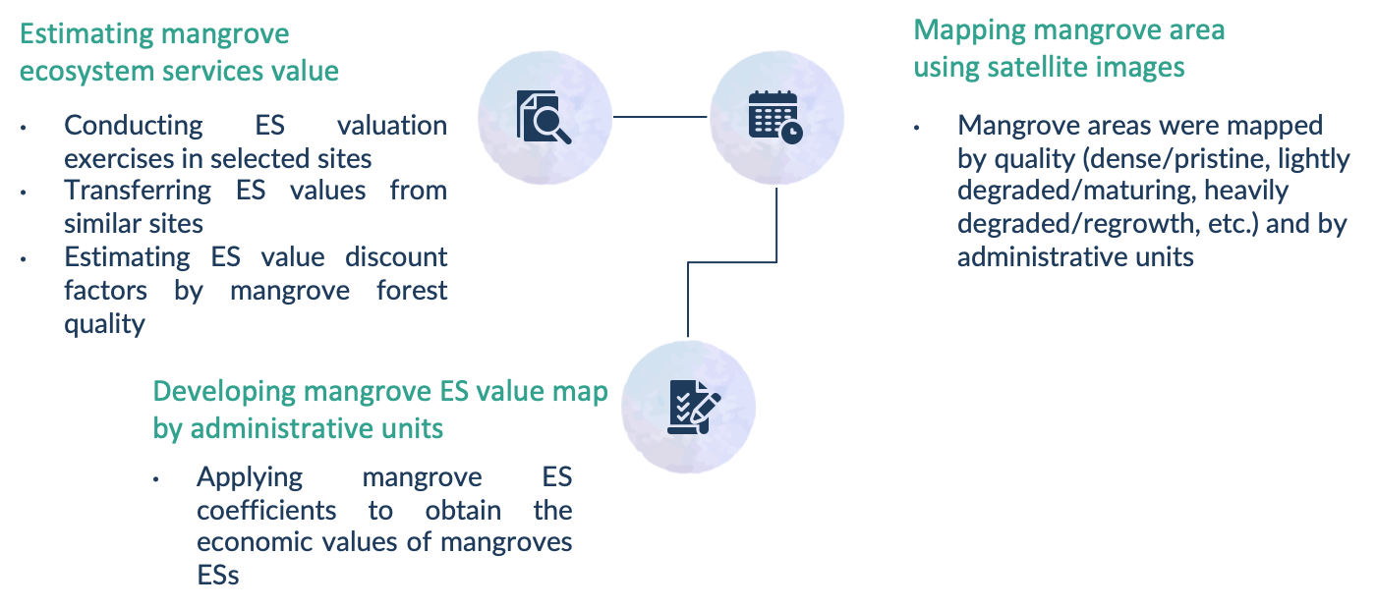
METHODOLOGY

Slide 5
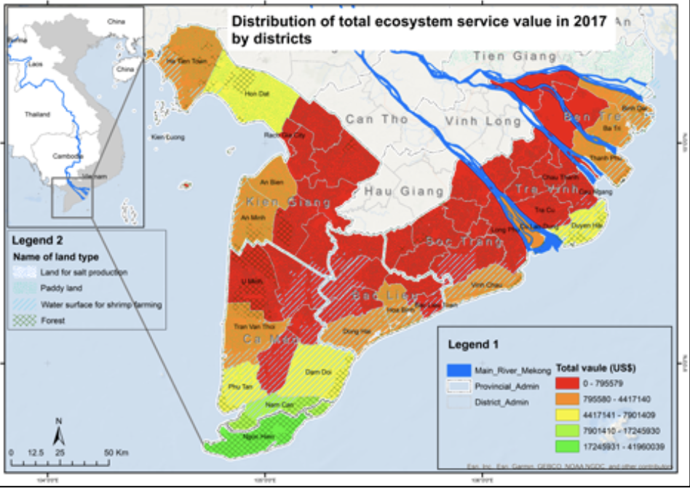
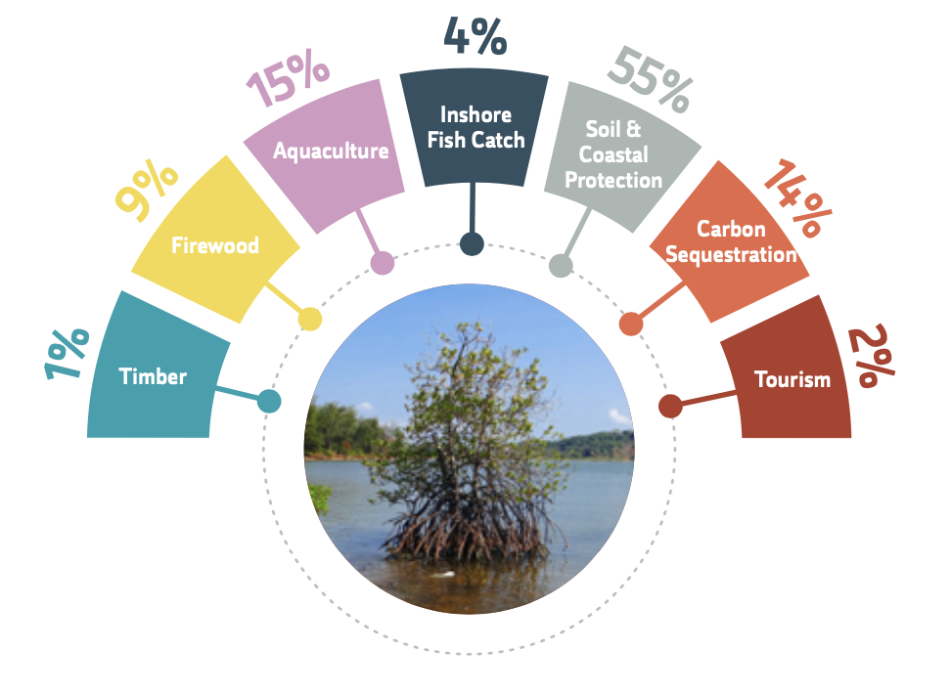
KEY OUTPUTS
Total economic values of mangroves in Mekong Delta is US$126 million (or US$862 per ha) per year (in 2017)
Share and annual values of mangroves ecosystem services (in 2017)
Spatial distribution of mangrove ecosystem services values (in 2017)

Slide 6
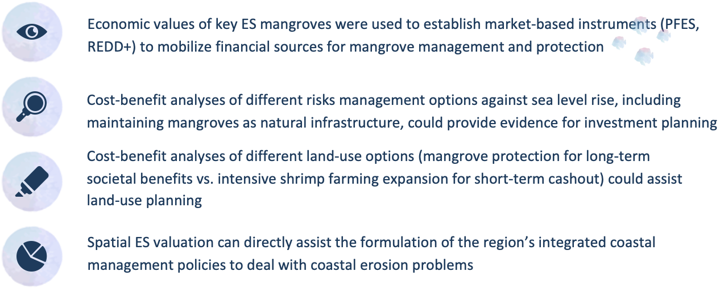
OPPORTUNITIES OF USING SPATIAL ECOSYSTEM SERVICES APPROACH FOR SUSTAINABLE DEVELOPMENT IN MEKONG DELTA

