Slide 1
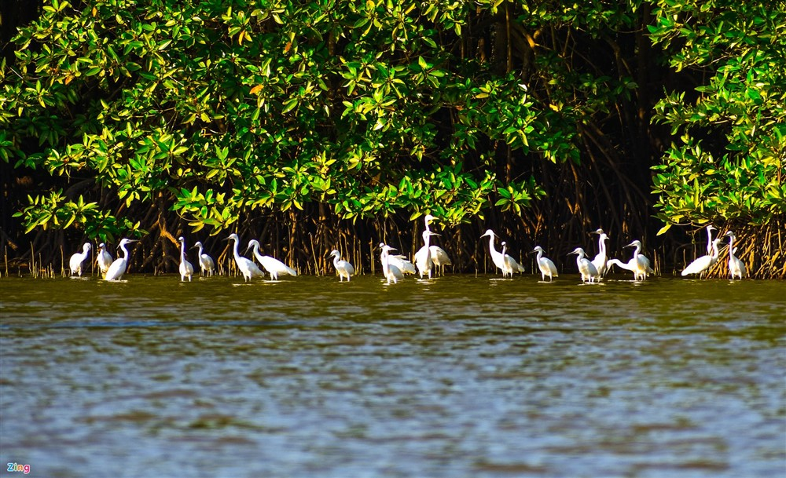
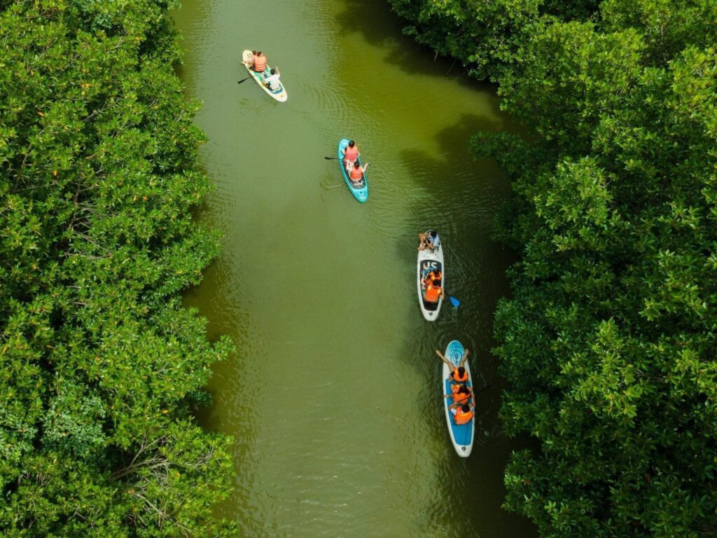
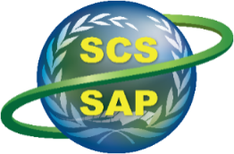
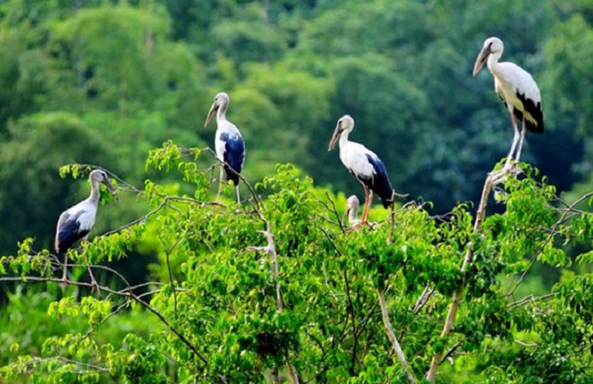
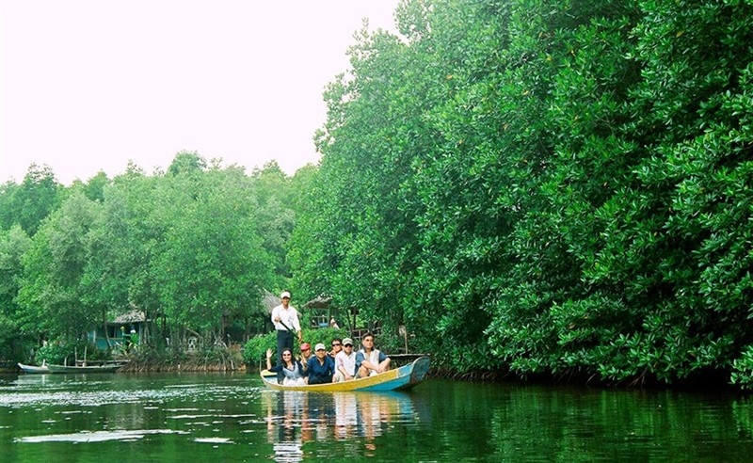
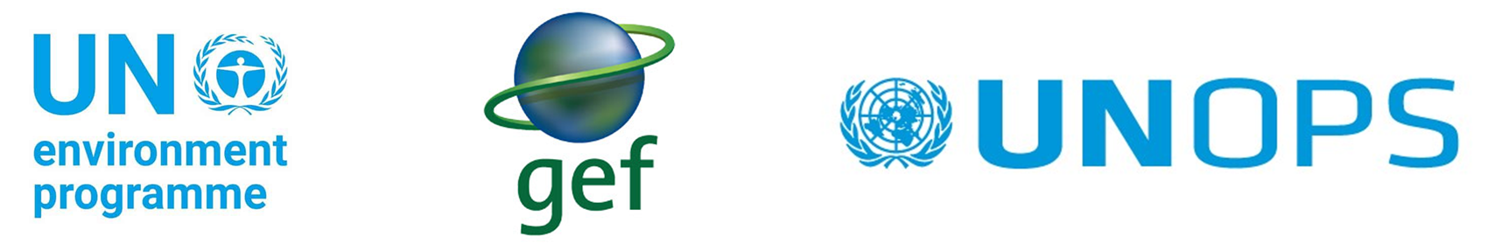
Implementing the Strategic Action Programme for THE SOUTH CHINA SEA AND GULF OF THAILAND (SCS SAP) Project
Second Roundtable of Local Representatives
of the SCS SAP Project
17 September, 2025, Jakarta, Indonesia
Chart on Practices and Lessons Learnt at the Thi Nai Lagoon Nature Reserve, Vietnam
Gia Lai province, Vietnam
Presenter : Dr. TRAN VAN VINH

Slide 2
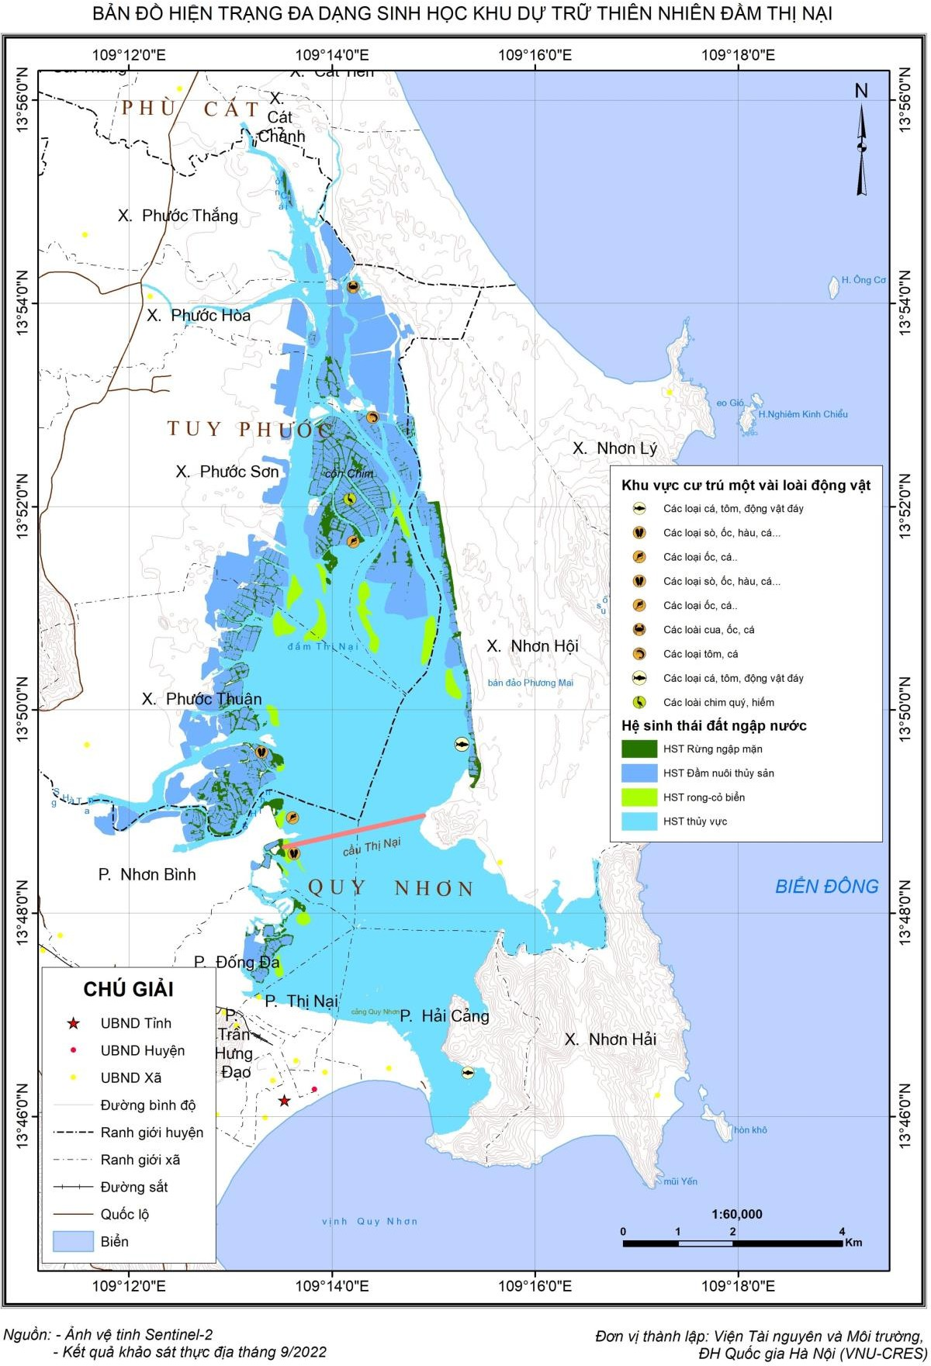
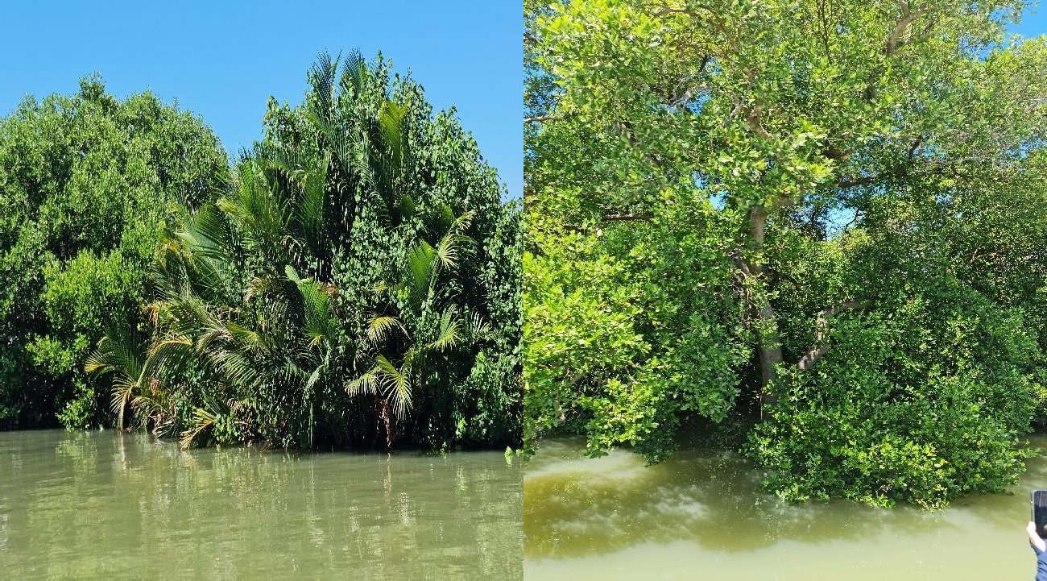
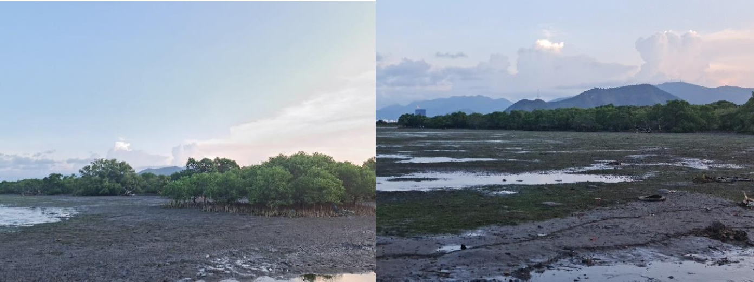
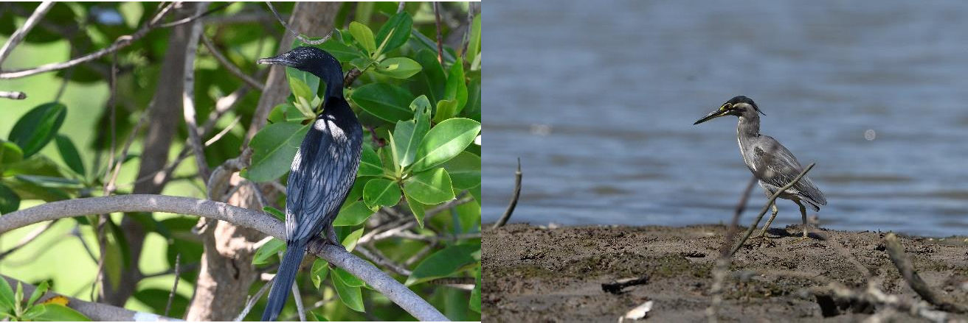
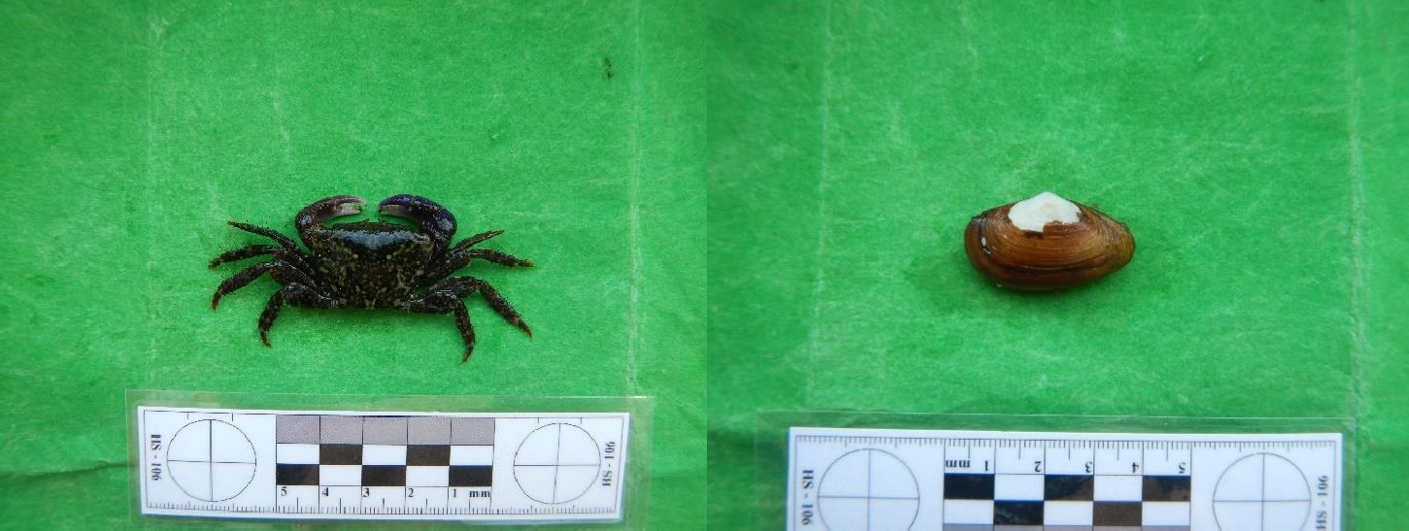
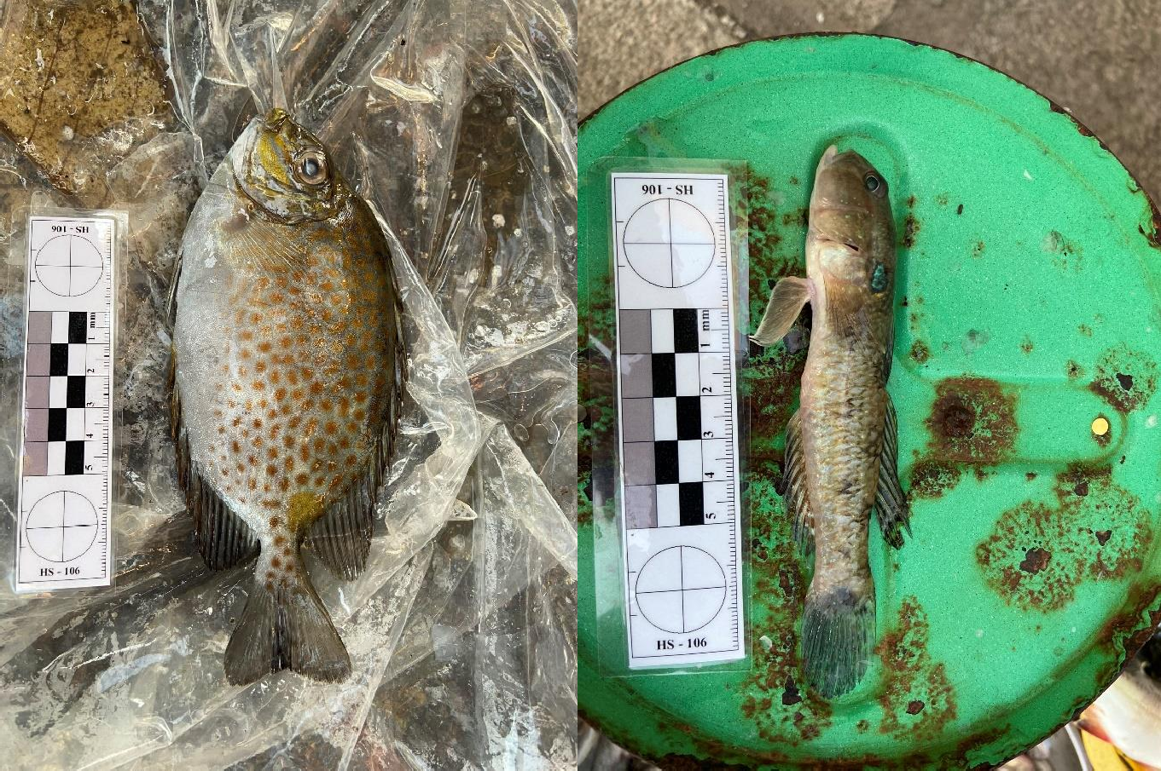
I. Site introduction
Current Status Map of Biodiversity in Thi Nai Lagoon Nature Reserve, Vietnam
Location: Coastal wetland in Gia Lai Province, Central Viet Nam.
Habitats: Mangroves (864.5 ha), seagrass beds (~500 ha), tidal flats, estuarine wetlands.
Total area: 5,000 ha
Population: >20,000 households living around the lagoon
Indigenous/Specific features: Traditional fishing villages, salt-making, aquaculture under mangrove canopy
Critical habitats: Mangroves: 864.5 ha, Seagrass beds: 500 ha, Tidal flats & mudflats: ~2,000 ha
Main economic activities: Capture fisheries, aquaculture, salt-making, small-scale ecotourism.
Threats: Habitat loss, aquaculture pollution, overfishing, climate change impacts (sea-level rise, storms).

Slide 3
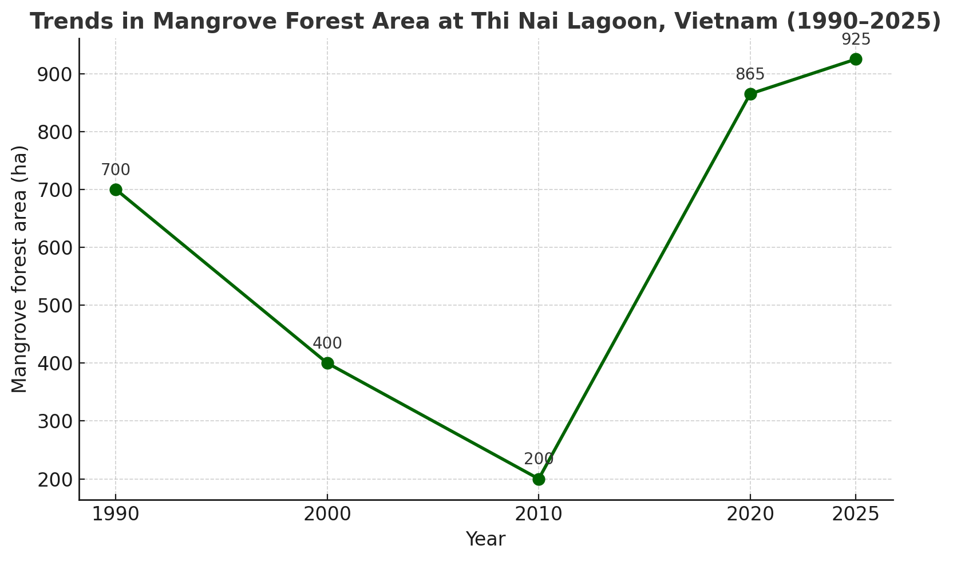
II. Highlights of Key Activities (2008–2023)
1. Baseline Survey and Status Assessment
Comprehensive baseline survey of ecosystems conducted during 2022–2023.
Remaining mangrove forest area is approximately 864,5 ha.
Seagrass meadows have diminished to roughly 500 ha.
2. Development of a Community-Based Management Model
Establishment of local community forest protection groups.
Pilot initiatives on ecological aquaculture (shrimp–crab farming under mangrove canopy).
Support for traditional small-scale fisheries and promotion of OCOP-certified local products.
3. Habitat Restoration and Conservation
Afforestation and assisted natural regeneration of 300 ha of mangrove forest.
Designation of a 200 ha migratory bird conservation zone to protect critical habitats.
4. Ecotourism Promotion and Sustainable Livelihoods
Development of ecotourism tours featuring mangrove exploration and migratory bird watching.
Tourist arrivals recorded an average annual growth rate of approximately 15% during 2022–2023.
Period | Area (ha, estimated) | Key Characteristics
Before 1975 | ~1,000 ha (natural) | Extensive natural mangroves along the lagoon; provided critical habitats for waterbirds and fisheries.
1990 | ~700 ha | Significant decline due to land conversion for settlements, agriculture, and aquaculture ponds.
2000 | ~400 ha | Peak degradation caused by shrimp farming expansion; only fragmented patches of mangroves remained.
2010 | ~200 ha | Nearly complete loss of natural mangroves; only small scattered stands survived.
2020 | ~864.5 ha | Comprised of 5 ha natural stands, 59.5 ha concentrated plantations, and ~800 ha scattered plantations (~1 million trees). Recovery mainly through restoration projects supported by GEF and national programs.
2025 (estimated) | ~900–950 ha | Continued increase through restoration and replanting (2021–2025); however, forest quality remains low, dominated by scattered plantations with limited ecological function.

Slide 4
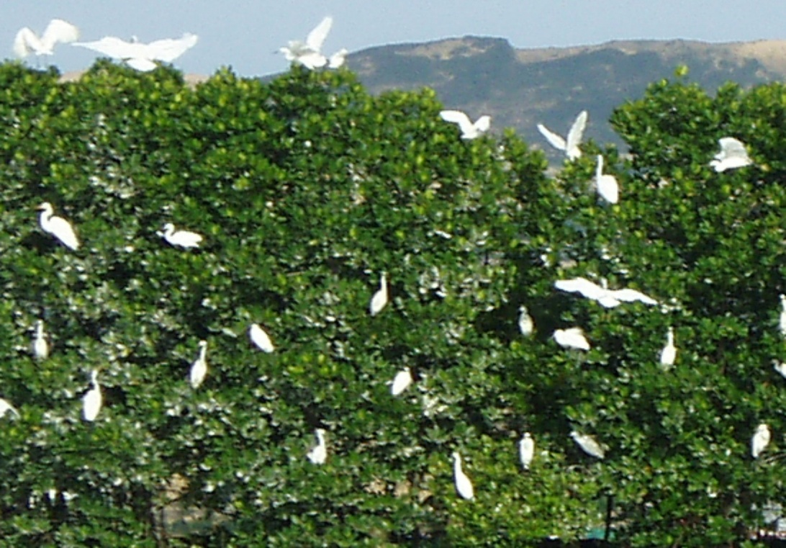
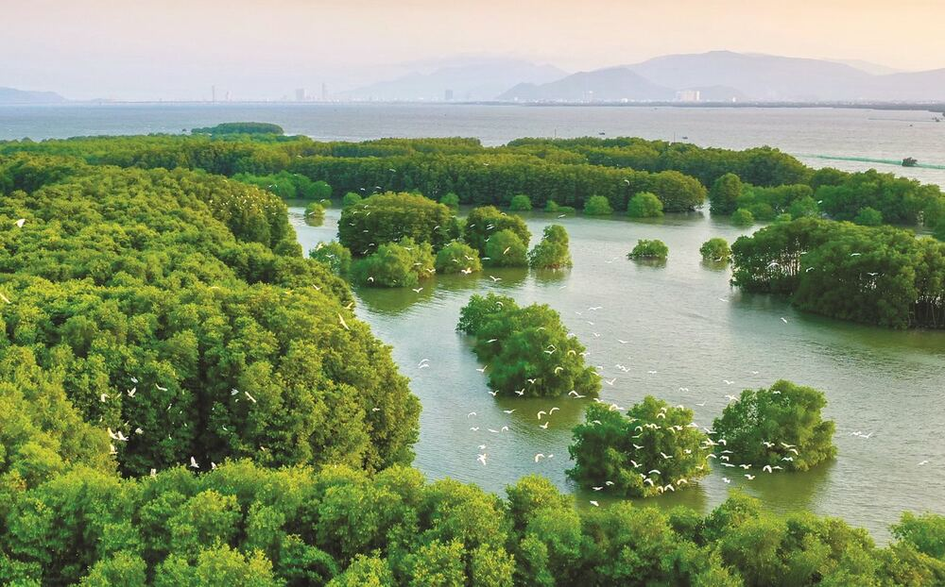
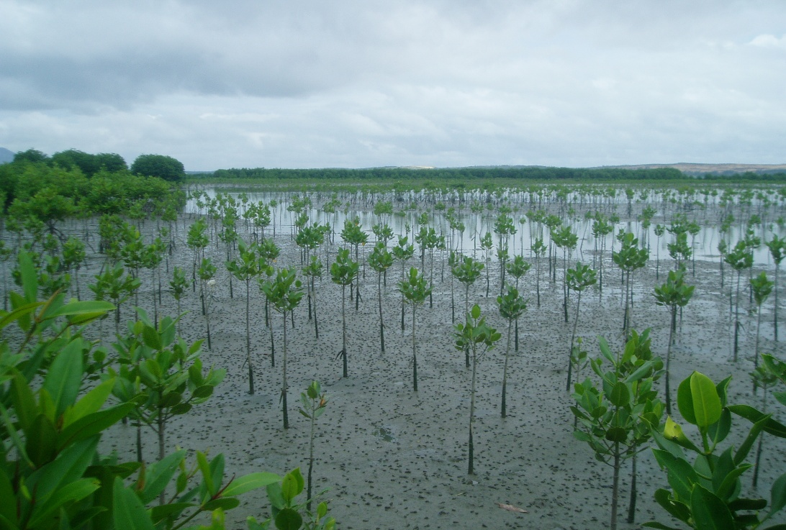
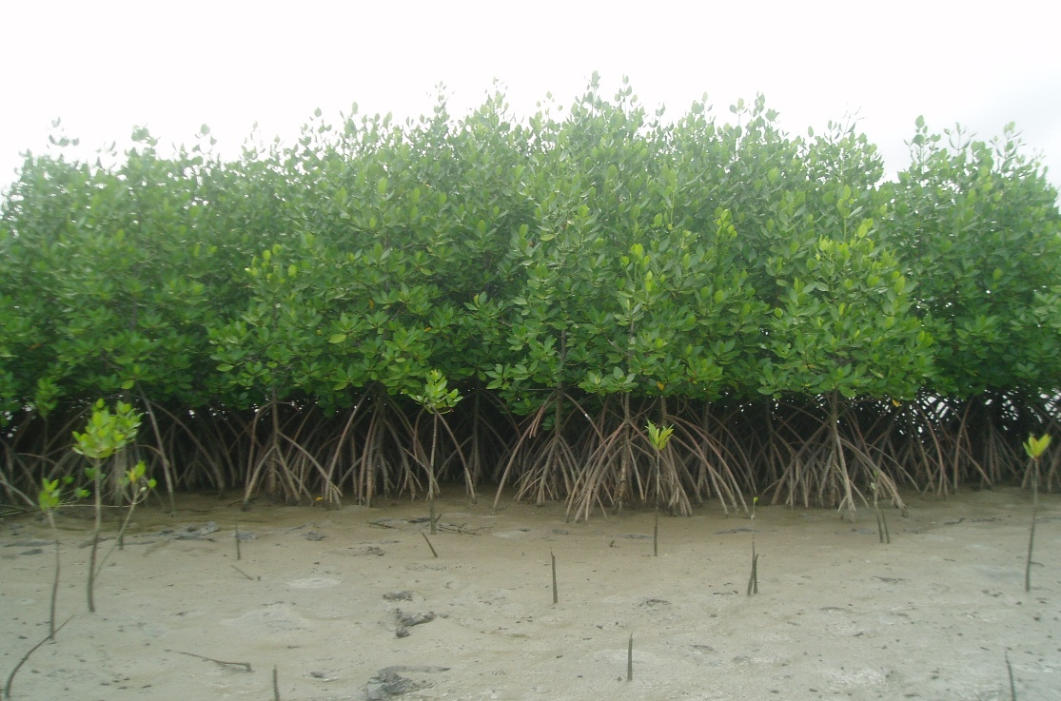
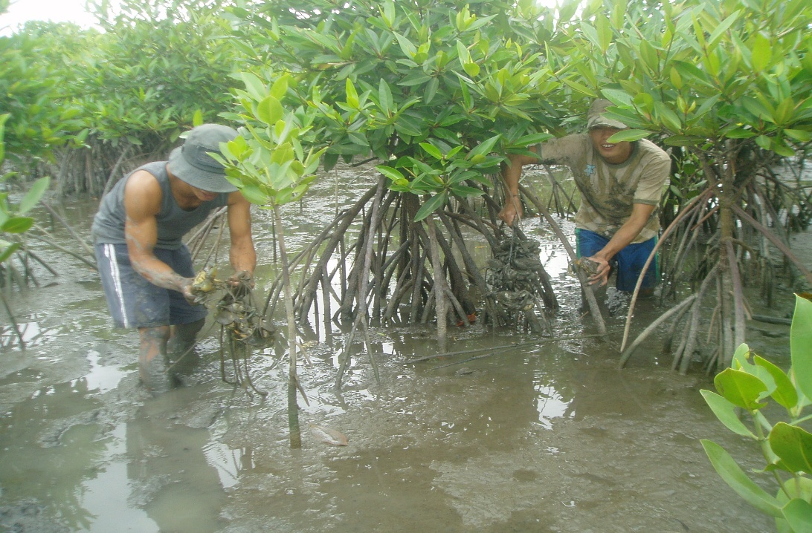
III. Highlights of key achievements
Policy and Institutional Support
Strong directives from the central government down to local authorities have provided the legal and institutional foundation for conservation.
2. Community Participation
Establishment of community-based management models, with the involvement of fishing villages, women’s unions, and youth associations.
3. Resource Mobilization
Financial and technical support from government, NGOs (WWF, IUCN), development partners, and eco-tourism investors.
4. Scientific and Technical Collaboration
Universities, research institutes, and private enterprises contribute expertise in restoration and sustainable aquaculture.

Slide 5
IV. Lesson learnt
 | Challenges | Solution
(1) | Habitat degradation due to overexploitation and unsustainable aquaculture. | Promote eco-friendly aquaculture & strengthen law enforcement.
(2) | Limited community awareness and livelihood alternatives | Combine conservation with livelihood development (e.g., mangrove-based aquaculture, community tourism).
(3) | Fragmented management across sectors. | Introduce co-management and integrate conservation into provincial planning.
(4) | Funding sustainability | Mobilize diverse sources – international donors, ecotourism, public-private partnerships.
V. Future Prospects and International Cooperation
Looking ahead, Thi Nai Lagoon aims to double its mangrove coverage to 2,000 ha while ensuring sustainable livelihoods for local communities. This ambitious target requires stronger international partnerships.
We call upon the SCS SAP Project and global partners to:
• Provide technical assistance in mangrove ecosystem monitoring and restoration.
• Mobilize financial resources for large-scale rehabilitation projects.
• Support capacity-building programs for local communities, particularly women and youth.
• Facilitate knowledge exchange across the South China Sea region.

Slide 6
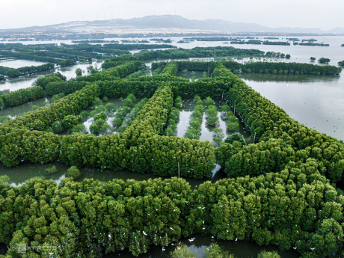
Thank you for your attention

