Slide 1
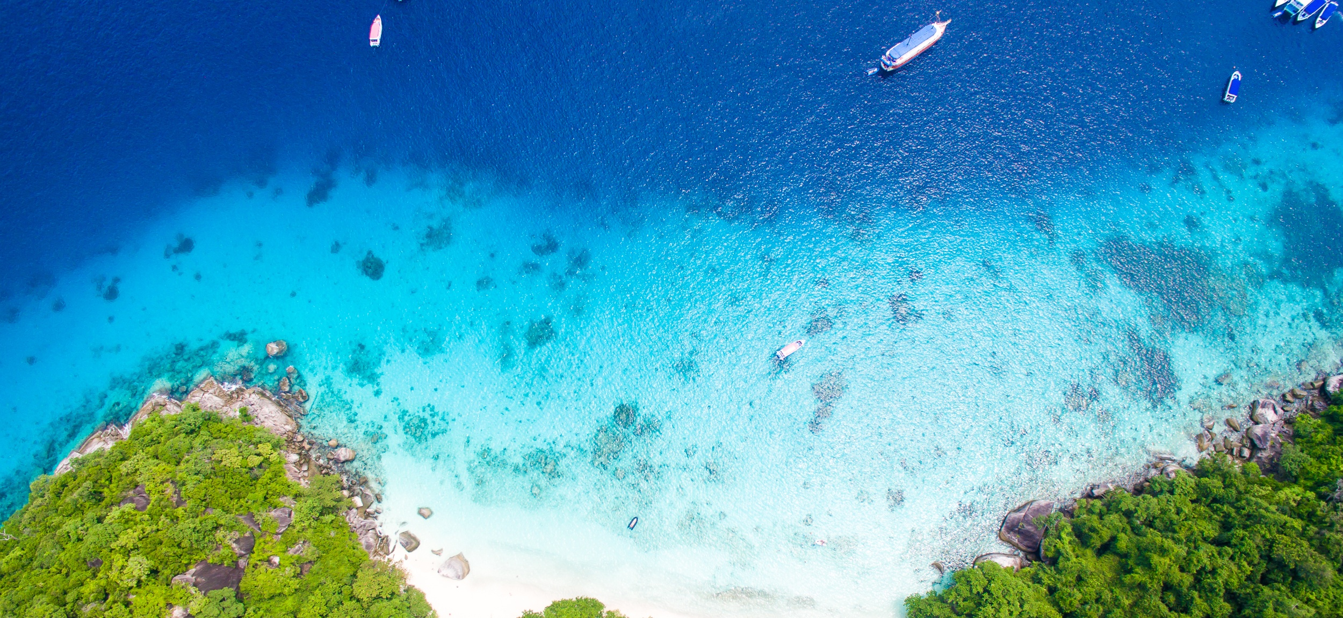


Implementing the Strategic Action Programme for THE SOUTH CHINA SEA AND GULF OF THAILAND (SCS SAP) Project
Second Roundtable of Local Representatives
of the SCS SAP Project
17 September, 2025, Jakarta, Indonesia
Chart on Practices and Lessons Learnt at the Site/local Level
[Guangxi Shangkou Mangrove Ecological National Nature Reserve & China]
[QIN xudong, Director, Guangxi Shankou Mangrove Ecological National Nature Reserve Management Center]
Notes:
尊敬的各位专家，大家早上好，我来自中国，是广西山口红树林生态国家级自然保护区管理中心主任秦旭东。
首先，感谢主办方的邀请！按照会议安排，我就广西山口红树林保护区的保护管理实践向大家与大家交流。

Slide 2
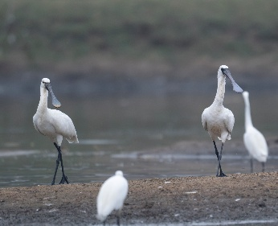
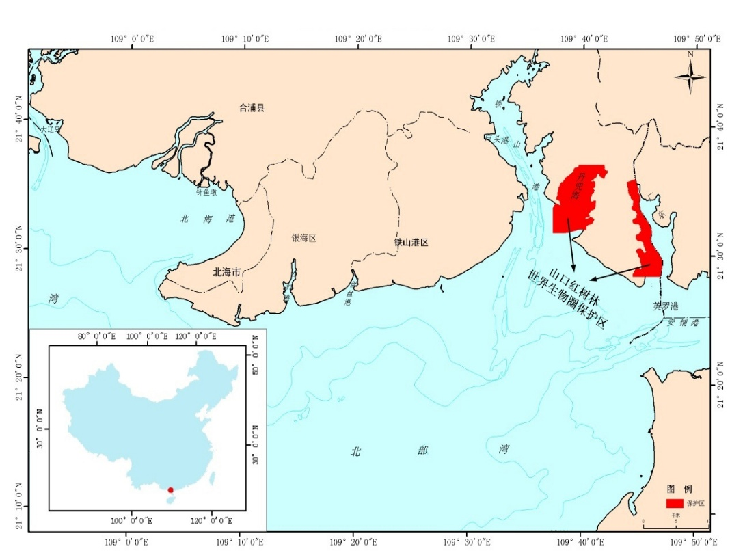
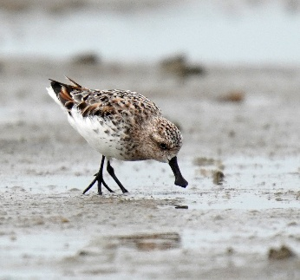
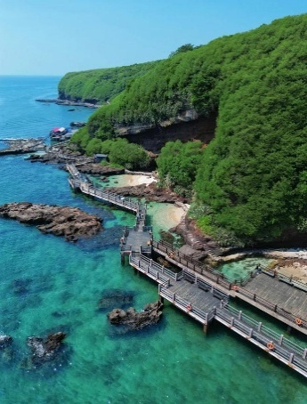
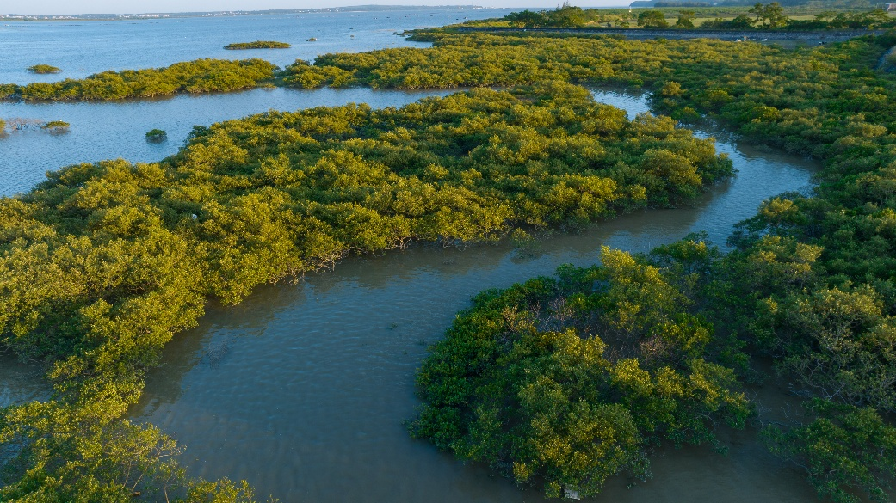
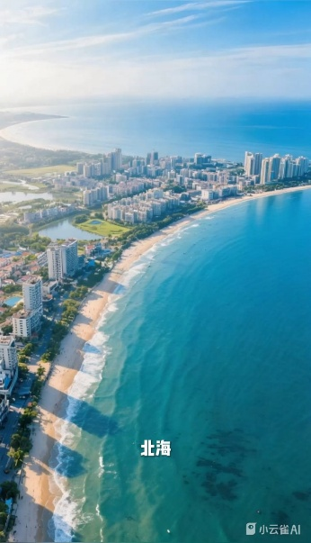
About my site
Total area (ha) and population
  The total area of the reserve is 8003 hectares (ha); the population around the reserve is over 80,000, and the population living within the reserve is 4,200.
Specific indigenous feature, if any
  The primary conservation targets are mangroves and their ecosystems.
Area (ha) of critical habitats (Mangroves; Coral Reefs, Seagrass Beds, Tidal flat…)
  Mangroves 876 ha；
Main economic activities
  Aquaculture, eco-tourism, nature education, etc.
Threats to coastal habitats
  Spartina alterniflora invasion.Derris invasion.iseases and pests
Environment concerns
  Pollution,alien plant invasion, etc.
Map of the reserve Location
mangrove community
Notes:
保护区主要保护对象为红树林及其生态系统；保护区属是全球36个生物多样性热点地区之一，保护区是红树林、海草床和盐沼场等三大海洋高等植物生态系统的共同保留地。

Slide 3
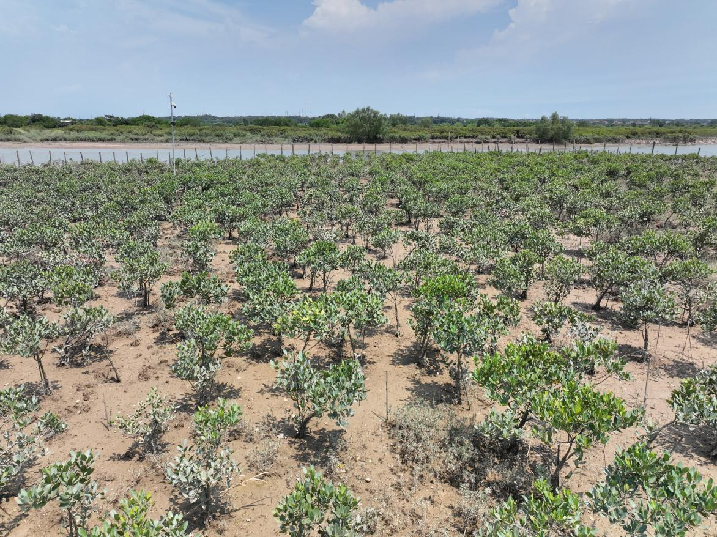
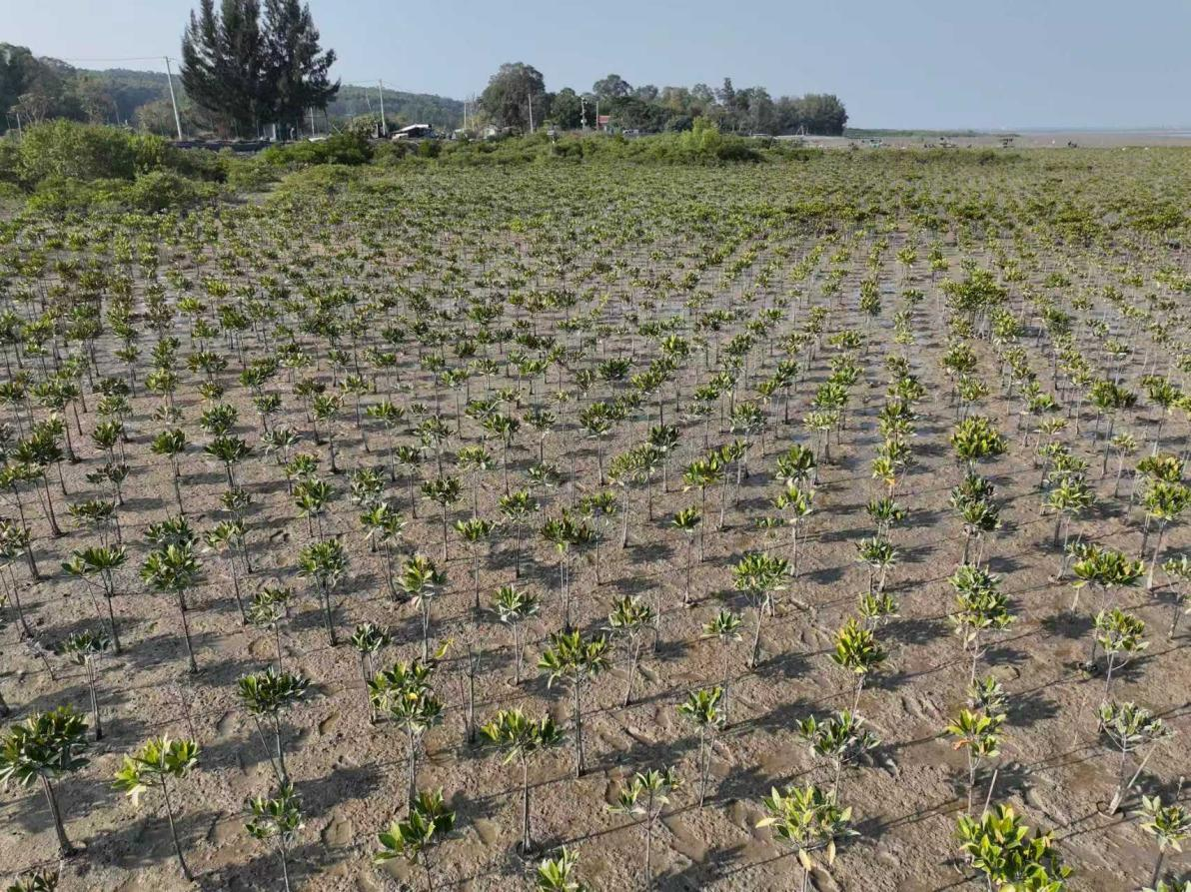
Highlights of key activities for conservation & sustainable use of coastal habitat and/or fisheries & land-based pollution management
Management of Coastal Habitats for Protection and Sustainable Utilization
From 2020 to 2025, a special action plan for mangrove protection and restoration was implemented:
Replanting 115 ha of mangroves
Restoring 326 ha of mangroves
Controlling Spartina alterniflora over 322 ha
Providing ecological compensation for 347 ha of habitats.
Mangrove Replanting

Slide 4
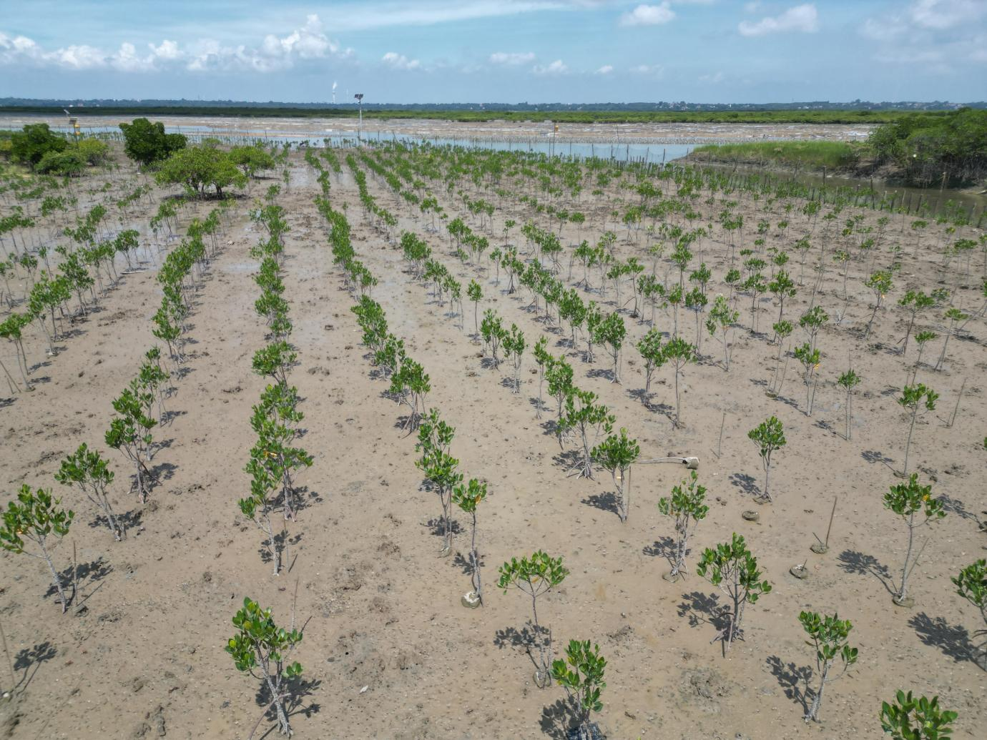
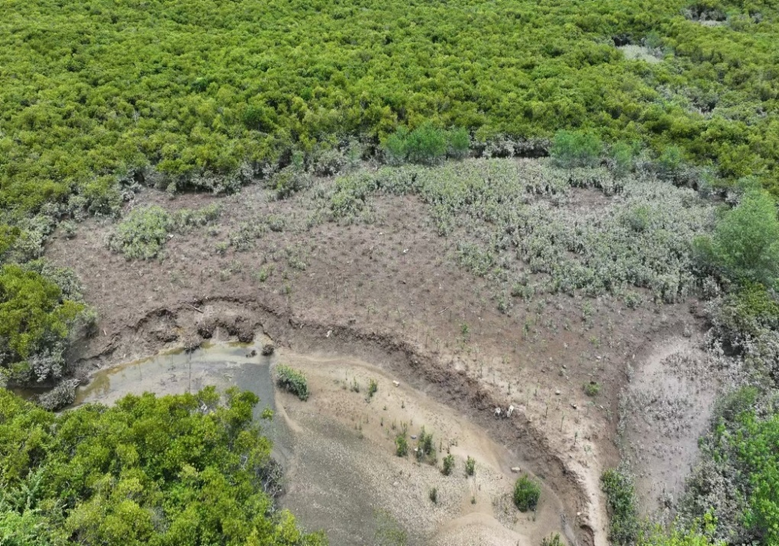
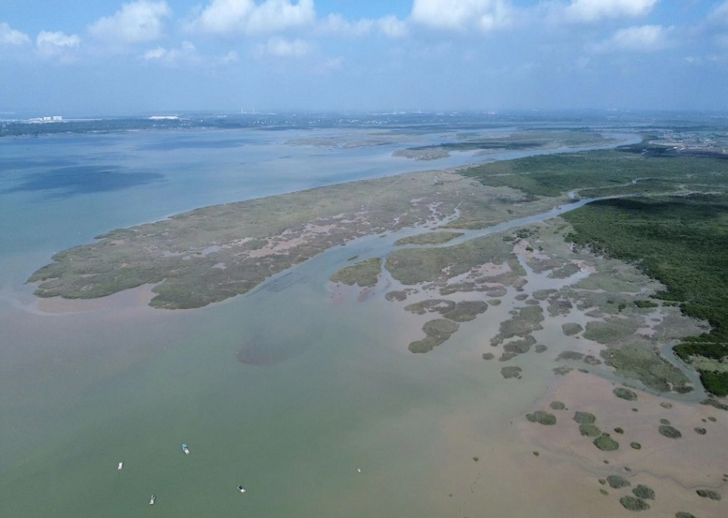
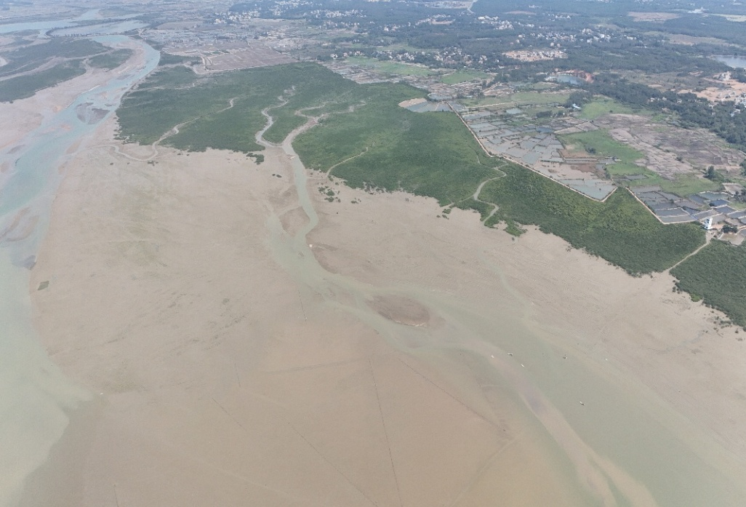
Mangrove Restoration
Spartina alterniflora Control
Pre-Control
Post-Control

Slide 5
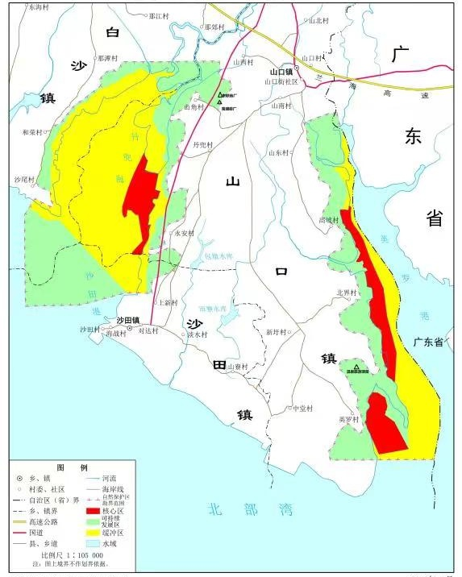
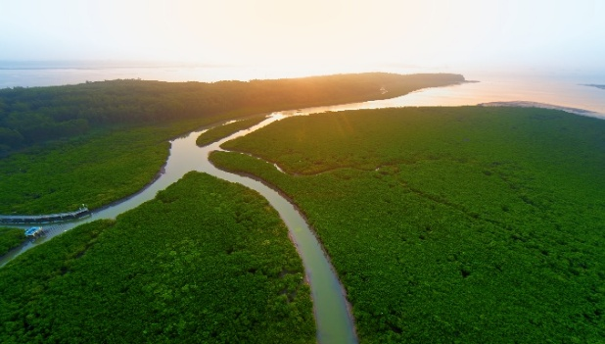
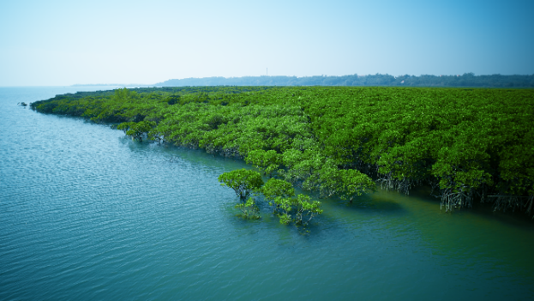
Highlights of key achievements
1/ Establishment and management of Protected Areas (PAs) of all categories (nature reserve, sanctuary, fisheries management, community-based, Ramsar site…)
The Guangxi Shangkou Mangrove Ecological National Nature Reserve, located in Beihai City, Guangxi, China, was established in 1990 with the approval of the State Council. It joined the World Network of Biosphere Reserves in 2000 and was listed as an internationally important wetland in 2002.
The reserve focuses on protecting the mangrove ecosystem, covers a total area of 8,003 hectares, and is divided into three parts—core area, buffer zone, and sustainable development area (experimental area)—each subject to distinct management requirements.
Notes:
保护区是1990年经国务院批准建立的海洋类型保护区。2000年加入世界生物圈保护区网络，2002年加入国际重要湿地名录，是中国红树林保护区中唯一一个同时拥有世界生物圈保护区和国际重要湿地两块牌子的“双料”保护区。

Slide 6
Highlights of key achievements
2/ Approval and implementation of plans for sustainable resources management & use, and land-based pollution management
In May 2022, the Implementation Plan for Guangxi's Special Action Plan for Mangrove Protection and Restoration (2020-2025) was issued and implemented. The reserve then carried out the establishment of 115 ha of mangrove replant, 326 ha of mangrove restoration, and 347 ha of habitat ecological compensation. Compared with the 2018 scientific survey:
  Species of birds increased from 242 to 253 species
  Including 8 national first-class and 38 national second-class key protected bird species
  Species of benthic organism from 378 to 424 species,
  Species of nekton from 68 to 137 species.
In April 2025, the Guangxi Biodiversity Conservation Strategy and Action Plan (2025-2035) was issued, to strengthen the comprehensive protection of typical ecosystems, national key protected wildlife, endangered wildlife and their habitats.
3/ Reform of laws/regulations or management approach for ecosystem sustainable use and land-based pollution prevention
In 2018, issued the Management Measures for Guangxi Shangkou Mangrove Ecological National Nature Reserve , establishing a systematic protection framework for the reserve to ensure the safety and sustainable development of its ecosystem.
In 2021, issued the Guangxi Mangrove Resource Protection Plan (2020-2030) to further strengthen the protection and management of mangrove;
In 2022, issued the Implementation Plan for the Special Action Plan for Mangrove Protection and Restoration in Guangxi (2020-2025), which clarifies the responsibilities of government departments at all levels for mangrove resource protection and management, and improves the level of mangrove protection and restoration.

Slide 7
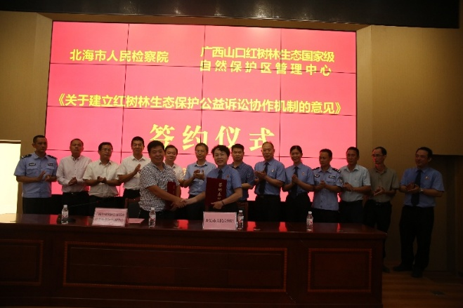
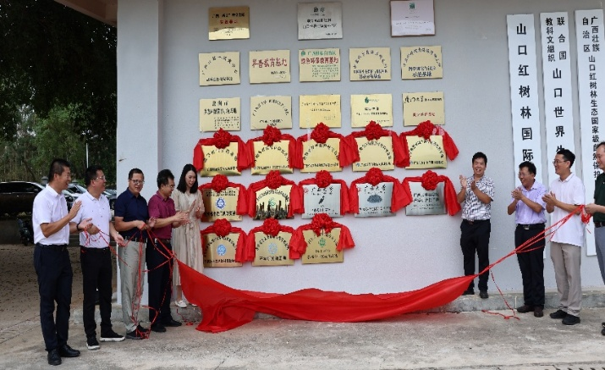
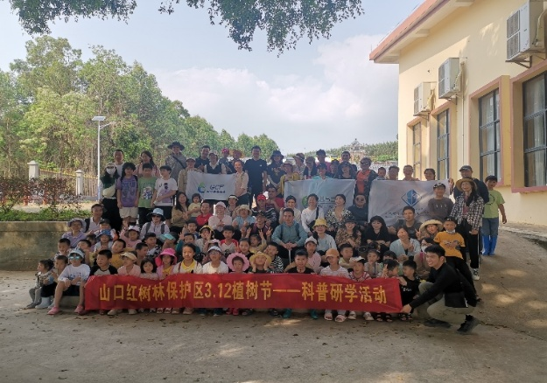
Highlights of key achievements
4/ Engagement of related stakeholders
Local Government departments:
  Bureau of Natural Resources, formulating plans and policies about protection and restoration.
  Bureau of Ecology and Environment, undertaking supervision of the mangrove ecological environment and coordinate the resolution of eco-environmental issues in mangrove protection and restoration.
  Bureau of Forestry, Coordinating and supervising the management of mangrove protection work, organizing mangrove resource surveys and evaluation, and undertaking mangrove protection and restoration.
  Bureau of Agriculture and Rural Affairs, undertaking the protection and restoration of aquatic animals and fishery resources.
NGOs: voluntarily organize activities of mangrove protection publicity and education.
Scientific research institution:
  Conducting fundamental research, monitoring and restoration technology research on mangrove ecosystems,
  Participating in formulating plans and standards related to mangrove protection and restoration.
Public Interest Litigation
Scientific Cooperation
Publicity Activities

Slide 8
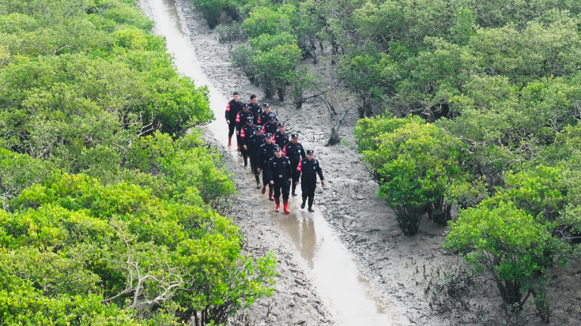
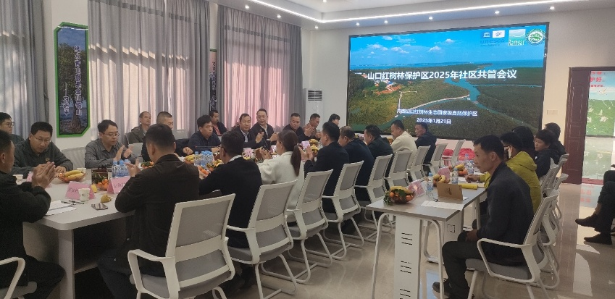
Highlights of key achievements
5/ Enforcement mechanism and effectiveness
Engaging multiple departments to establish a mangrove ecological protection mechanism and a collaborative mechanism for mangrove public interest.
Multiple departments establish a mangrove ecological protection mechanism and a collaborative mechanism for mangrove public interest litigation;
Seting up mangrove ecological police offices;
Establishing community co-management committees;
Forming a "forest chief + police chief + procurator-general + local government departments + community + others" co-management network.
6/ Financial mechanism for sustaining conservation and management
The reserve have a total investment of over 200 million yuan for mangrove protection and restoration
Funded by central marine ecological restoration funds, central forest reform and wetland subsidy funds, central budgetary funds, and other sources.

Slide 9
Lesson learnt (challenges and solution to address challenges)
Challenges
  Due to global climate change, urban expansion, environmental stress, human activities and more, mangrove conservation faces high pressure.
  Rational utilization approaches for mangrove resources are limited.
Solution to address challenges
  Innovate pathways for ecological product value realization to boost community economic income:
    Developing "mangrove +" characteristic economy, create high-value-added products;
    Building mangrove study bases;
    Establishing mangrove ecological compensation funds;
    Feeding back carbon sink trading proceeds and tourism income to communities in proportion.
  Explore the application of new technologies in mangrove conservation:
    Deploying automatic drone inspections, regularly monitor mangrove growth, water quality changes and biodiversity data;
    Establishing a digital management platform.

Slide 10
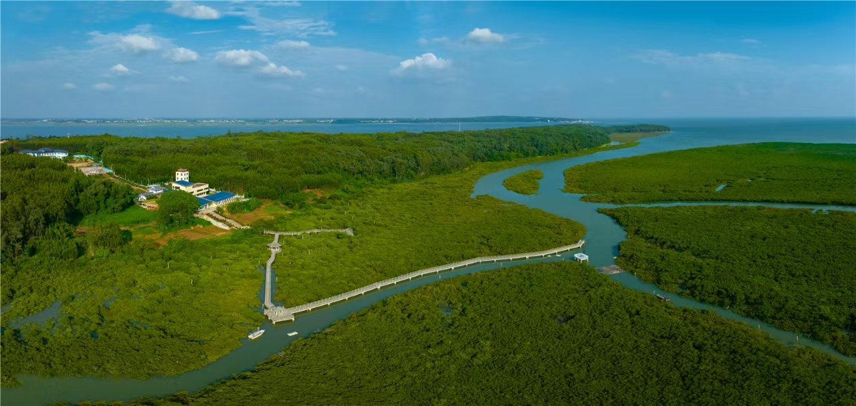
THANKS！

