Slide 1



Implementing the Strategic Action Programme for THE SOUTH CHINA SEA AND GULF OF THAILAND (SCS SAP) Project
Second Roundtable of Local Representatives
of the SCS SAP Project
17 September, 2025, Jakarta, Indonesia
BATU AMPAR MANGROVE SITE-INDONESIA
Ahmad Faisal Siregar/Site Manager

Slide 2

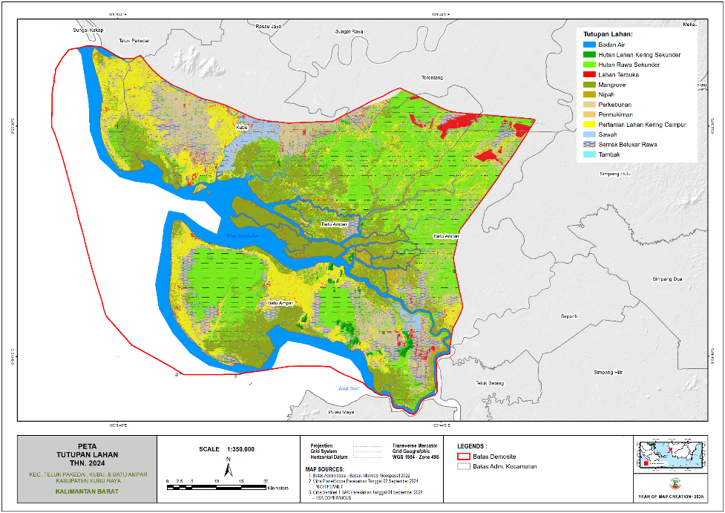
Mangrove Batu Ampar site-West Kalimatan Province, Indonesia
Total mangrove area (+ 65,585 ha/655,85 km²) and population 17,689 peoples (3 village priority: Batu Ampar, Kubu and Nipah Panjang Village)
Approximately 33,235 ha of protected forest, 26,000 ha of production forest and 6,000 ha of other land use areas.
Main economic activities : Fisheries, Charcoal industry
Threats to coastal habitats: Mangrove cutting for charcoal raw materials, land conversion, limited management institutions and human resources, and various other challenges.
Environment concerns: Habitat degradation
BATU AMPAR MANGROVE MANAGEMENT
FOR MULTI PURPOSES USE

Slide 3
Highlights of key achievements
1/ Establishment and management of Protected Areas (PAs) of all categories
An area of ​​59,585 ha mangrove Batu Ampar is maintained as forest areas (protected and production Forest) to support environmental protection and various sustainable uses, such as fishing areas and other non-timber forest products (tourism, palm leaf roofs, mangrove fruit, biodiversity, etc.). This is reinforced by:
Decree of the MoF: No. 733/Menhut-II/2014, September, 2nd, 2014 regarding Forest Areas and Water Conservation of West Kalimantan Province.
Decree of the MoEF: No.6630/MENLHK-PKTL/KUH/PLA.2/10/2021, Oktober, 27th, 2021 Regarding the Map of Development of Forest Area Establishment in West Kalimantan Province until 2020.
Regional Regulation of West Kalimantan Province Number 5 of 2004 concerning the Spatial Planning of West Kalimantan Province.
Kubu Raya Regency Regional Regulation Number 7 of 2016 concerning the Kubu Raya Regency Regional Spatial Planning Plan for 2016 – 2036.
2/ Approval and implementation of plans for sustainable resources management & use, and land-based pollution management
In the management plan for sustainable use of mangroves, the priority location is in Batu Ampar, Kubu Raya Regency, West Kalimantan Province with an area of ​​32,000 ha (Production forests and Others Land Use).
This location is a production forest location which has currently been granted a concession to a private company (PT Kandelia Alam and PT BIOS).
Company's permit changed from initially being for the production of wood as raw materials for chips and charcoal to becoming a permit for environmental service utilization (ecotourism and carbon trading).

Slide 4
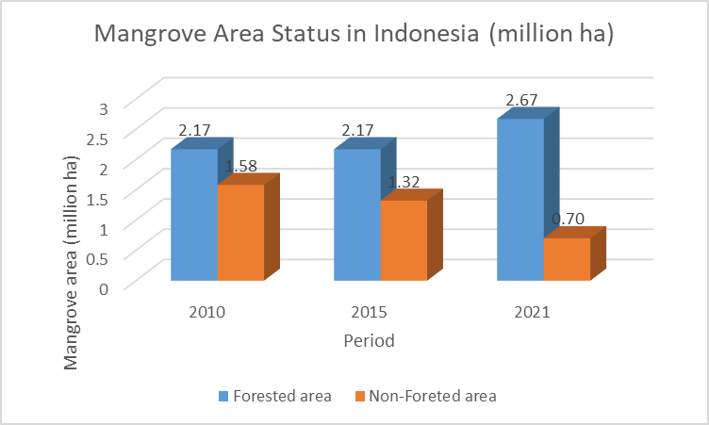
Highlights of key achievements
3/ Reform of laws/regulations or management approach for ecosystem sustainable use and land-based pollution prevention
Strengthening the status of mangrove areas
Mangrove status area | Mangrove area (x 1,000,000 ha)
 | Year 2010 | Year 2015 | Year 2021
Forested area | 2.17 | 2.17 | 2.67
Non-Foreted area | 1.58 | 1.32 | 0.70
Total | 3.75 | 3.49 | 3.37
Figure 1. Comparison of the area of ​​mangroves inside and outside the forested area ii Indonesia

Slide 5
Highlights of key activities for conservation & sustainable use of coastal habitat and/or fisheries & land-based pollution management
4/ Engagement of related stakeholders
In Indonesia, the main stakeholders in mangrove management are the MoF, MoE, MoFA, and MoIA
2006-2012 (KKMN/National Mangrove Working Group : MoF, MoE, MoFA, MoIA, NGO, University, etc)
Dec 2020-Dec 2024: BRGM/Peatland and Mangrove Restoration Agency
2025 : Environment/Environmental Control Agency Ministry decree No.8/2025: Peat and Mangrove Ecosystem Management Agency: Located: Jambi, Pontianak, and Sorong.
5/ Enforcement mechanism and effectiveness
Law enforcement : The Indonesian Navy and the Kalimantan Regional Forestry Law Enforcement Agency arrested a mangrove charcoal transport vessel (2 units) in July 2025.
6/ Financial mechanism for sustaining conservation and management
Financing support by: Central Government, Provincial Government, Regency, Private Company (forest concession, plantation), NGO, Universities and other sources

Slide 6
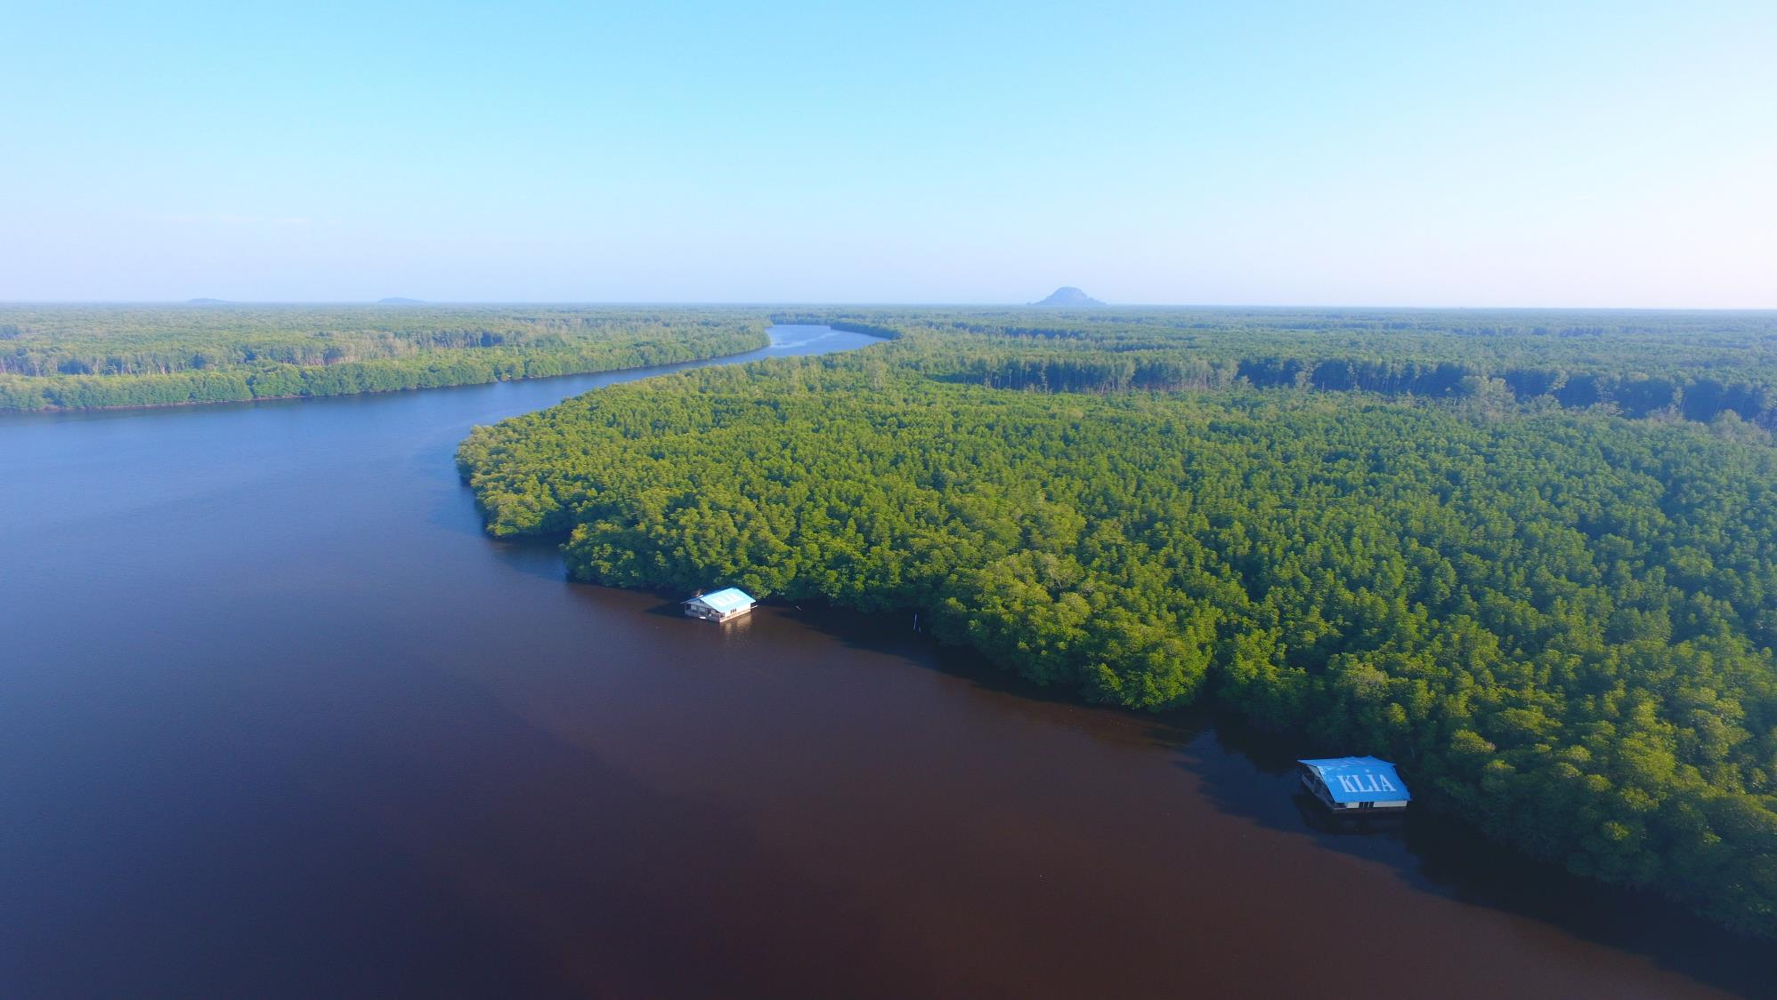
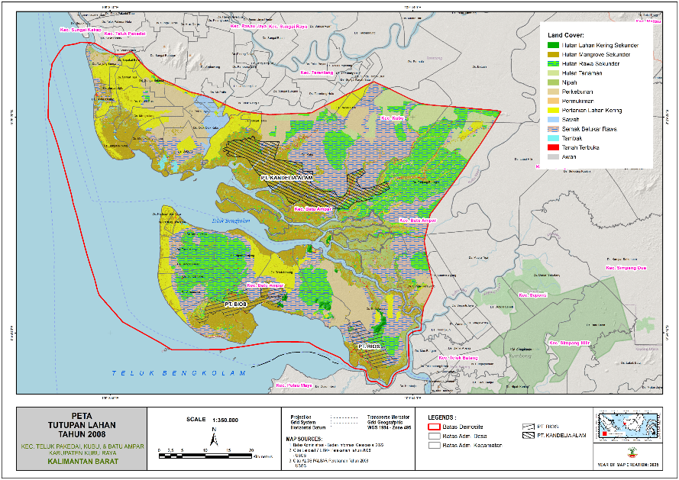
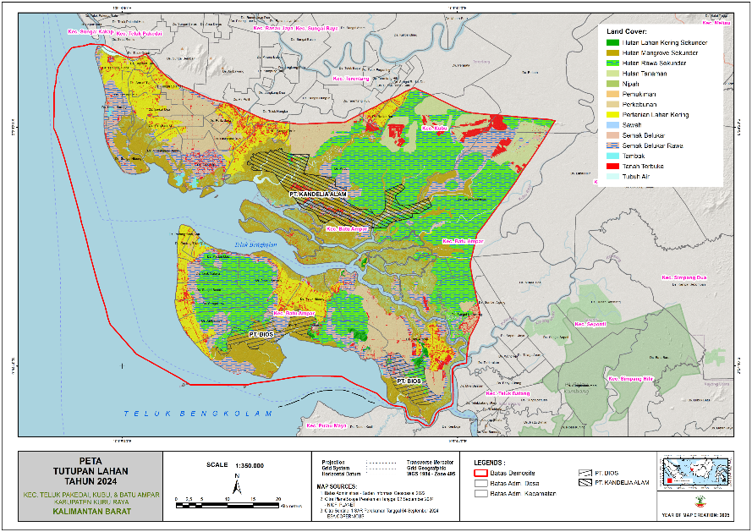
IMPLEMENTATION OF BATU AMPAR MANGROVE SITE ACTIVITIES (QUARTER 1ST / JUNE-AUGUST 2025)
Act 1.1.2.1. Improving the quality of data and information on mangrove ecosystems (physical, chemical, biological and socio-economic)
Land Cover Analysis
Initial Survey of Flora dan Fauna Inventory
July-August 2025

Slide 7
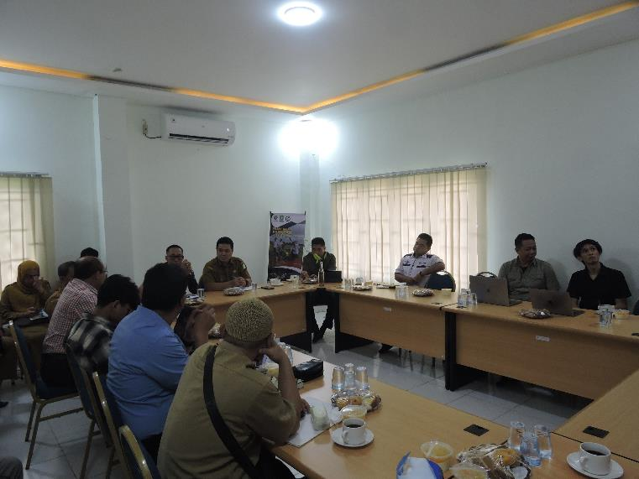
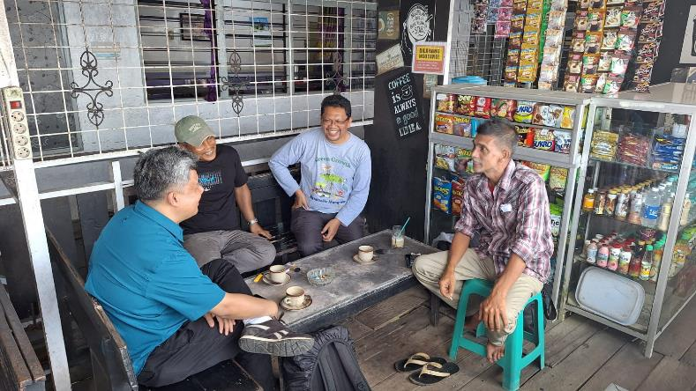
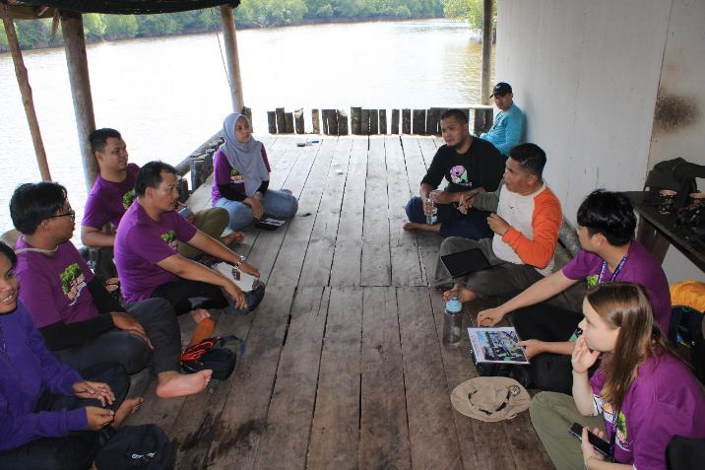
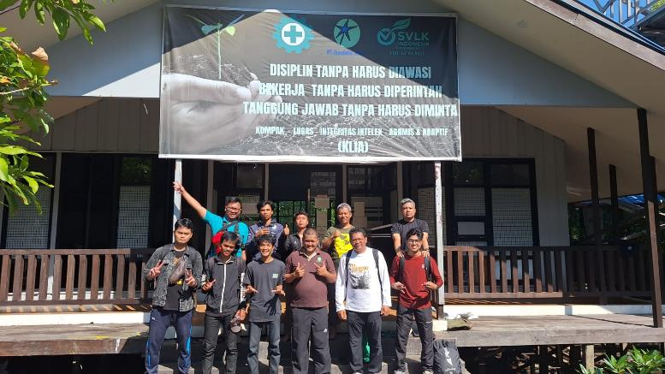
Act 1.1.2.1. Improving institutional coordination mechanisms for the management of the Batu Ampar mangrove ecosystem
Forest Management Unit (KPH) of Kubu Raya, West Kalimantan Provincial Forestry and Environment Office
Regional Development Planning, Research, and Development Agency of Kubu Raya Regency
Environmental Agency of Kubu Raya Regency
Marine and Fisheries Agency of Kubu Raya Regency
Cooperative, Microenterprise, Trade, and Industry Agency of Kubu Raya Regency
Faculty of Forestry, Tanjungpura University
Kanopy Foundation
Batu Ampar Sub-district
Community Group of Kubu Village and Kubu Sub-district
Focus Group Discussion with Related Institution
Date: 28 July 2025, Participants: 25 person
FGD With Forestry Community Group leaders in Batu Ampar Village
FGD With Fishermen Community Group leaders in Kubu Village
FGD With Private Company

Slide 8
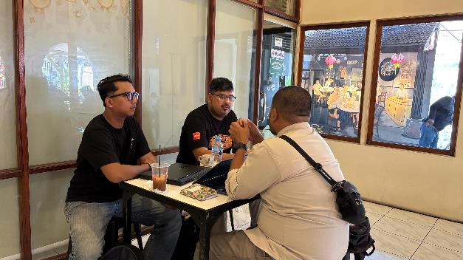
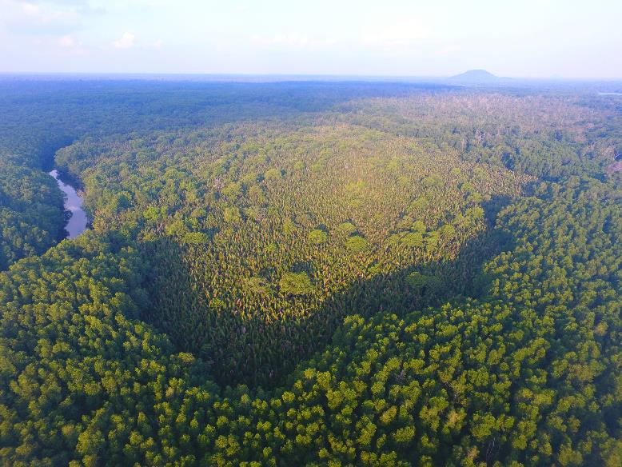
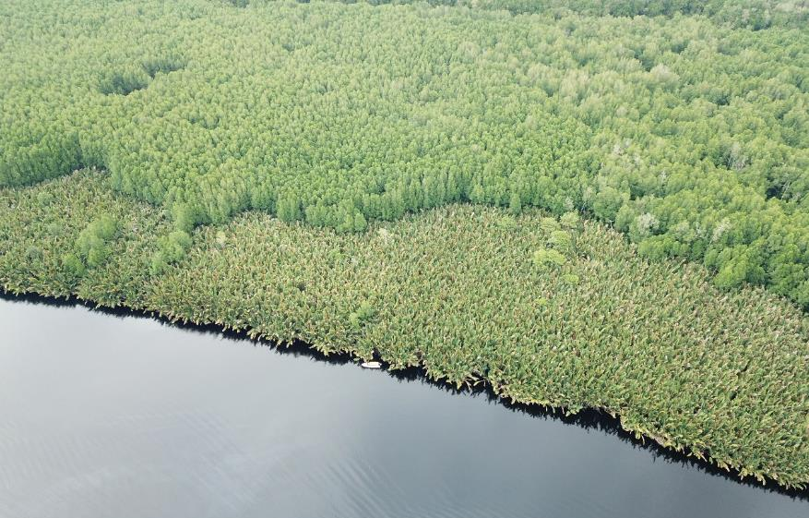
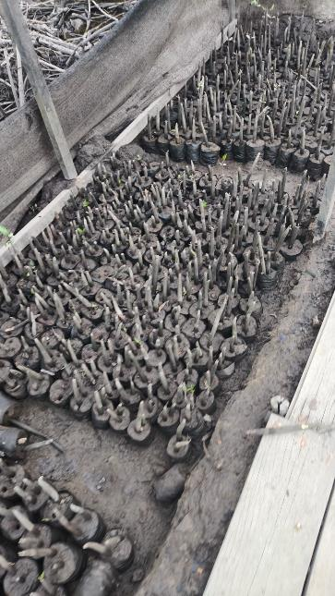
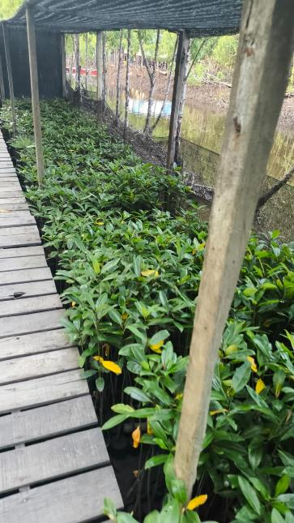
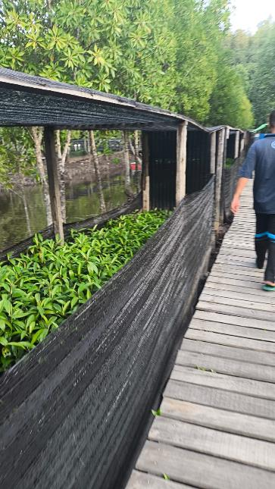
Act 1.1.4. Replanting of 10 ha of deforested mangrove land
Act. 1.1.4.1. Preparation of Training on mangrove restoration
Date: July-August 2025
Act 1.1.4.2. Mangrove planting site survey
Date: 26th July-2nd August 2025
Alternative Location 1: Sei Sepada Kanan-Kubu Village
Total Area : > 10 ha
Nipah Invasion
Alternative Location 2: Sei Keluang-Batu Village
Total Area : > 10 ha
Nipah Invasion
Act 1.1.4.2. Mangrove planting preparation (Mangrove Nursery)

Slide 9
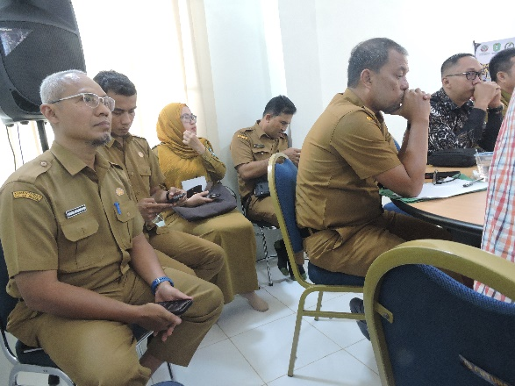
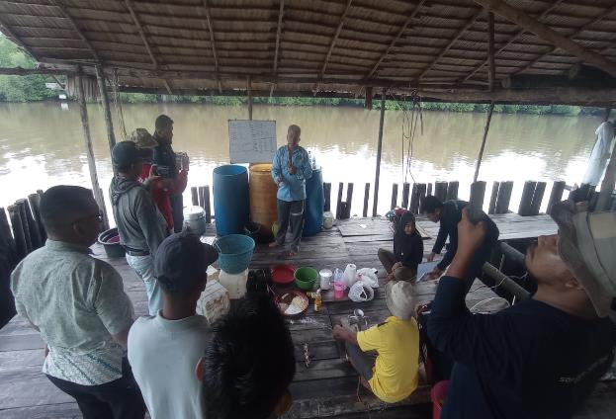
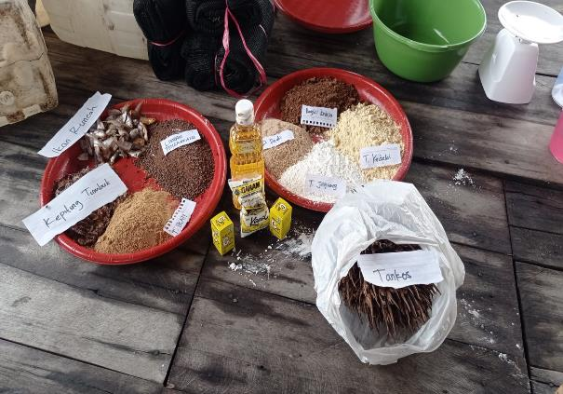
Act 1.1.2.4. Optimizing village forest management in the Batu Ampar mangrove ecosystem
Act. 1.1.6.1. Annual monitoring of management, ecological and socio-economic in the Batu Ampar mangrove forest
Training on Tirus Fish (Otolithoides pama) and Mangrove Crab (Scylla serrata) Cultivation
Implemented in 9-10 August 2025
Participant: Kubu Bersatu Forest Famer Group-Kubu Village (12 person)
Forest Management Unit (KPH) of Kubu Raya, West Kalimantan Provincial Forestry and Environment Office
Regional Development Planning, Research, and Development Agency of Kubu Raya Regency
Environmental Agency of Kubu Raya Regency
Marine and Fisheries Agency of Kubu Raya Regency
Cooperative, Microenterprise, Trade, and Industry Agency of Kubu Raya Regency
Faculty of Forestry, Tanjungpura University
Kanopy Foundation
Batu Ampar Sub-district
Community Group of Kubu Village and Kubu Sub-district

Slide 10
Lesson learnt (challenges and solution to address challenges)
1. Mangrove degradation (Private company and local communty)
a. Business Changed : Mangrove wood cutting for wood industry → environmental service utilization (ecotourism and carbon trade).
In 2003-2008 (SCS Project Phase I), there were still 2 permits for wood utilization for charcoal and chip industry raw materials, namely: (1) PT Kandelia Alam with a concession of 16,250 ha, and PT BIOS with an area of ​​10,100 ha.
Since 2022, there has been no more logging activities in the mangrove production forest, and the concession permits have been shifted to environmental service utilization (ecotourism and carbon trading).
Limiting the charcoal industry carried out by local communities.
c. Providing alternative livelihoods for local communities (non-timber forest products, fisheries and their processing, agriculture, plantations, tourism, etc.)
2. Land conversion, limitations in management institutions and human resources.
Providing alternative livelihoods for local communities (non-timber forest products, fisheries and their processing, agriculture, plantations, tourism, etc.)
Increase awareness and the active roles of various parties in the protection and sustainable use of mangrove ecosystem services and non-timber forest products (Socialization, advocation, training, etc)

Slide 11
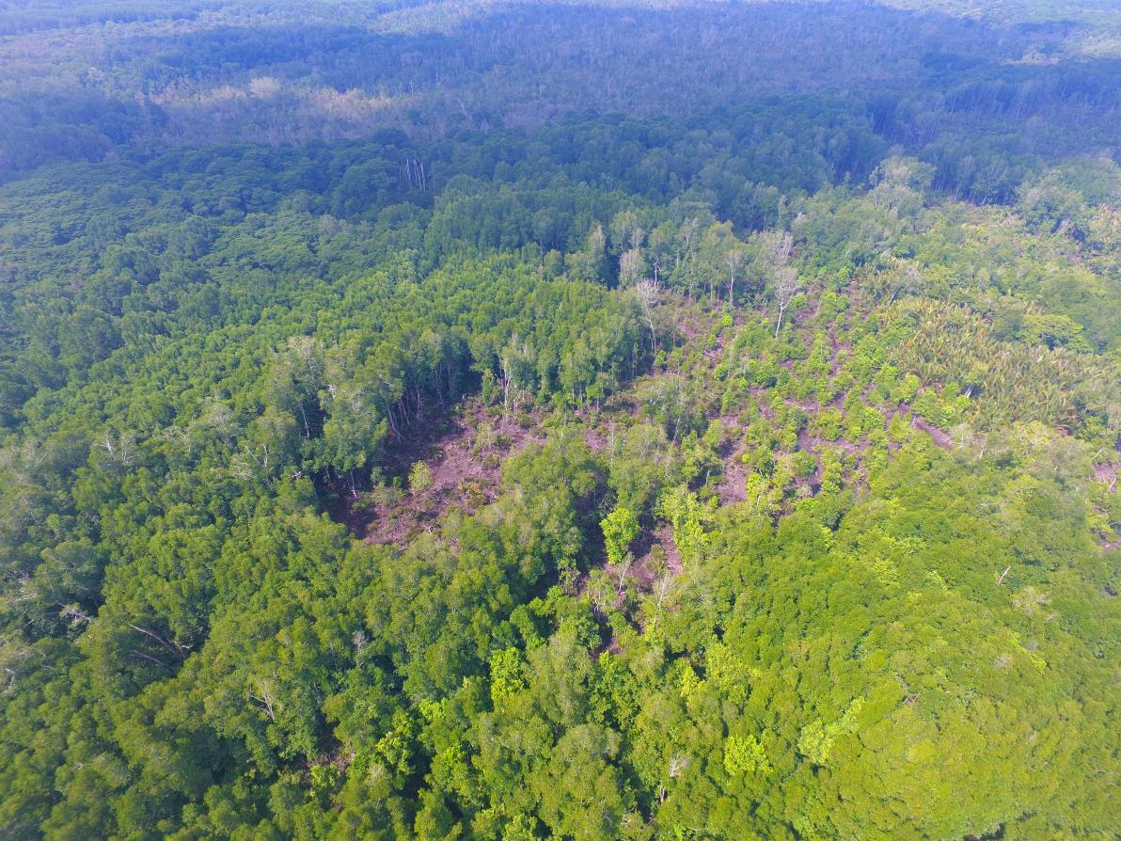
3. Changes in the composition of mangrove vegetation.
In degraded mangrove locations, there is a change in the composition of mangrove vegetation types from native mangrove plants to nipah plants, which are invasive plants.
From 2008 to 2025, it was identified that there was an increase in nipah palm from 1000 to 4000 ha.
Mangrove rehabilitation has been carried out by various parties, including the Mangrove and Peat Restoration Agency (BRGM), IMReD, etc.

Slide 12
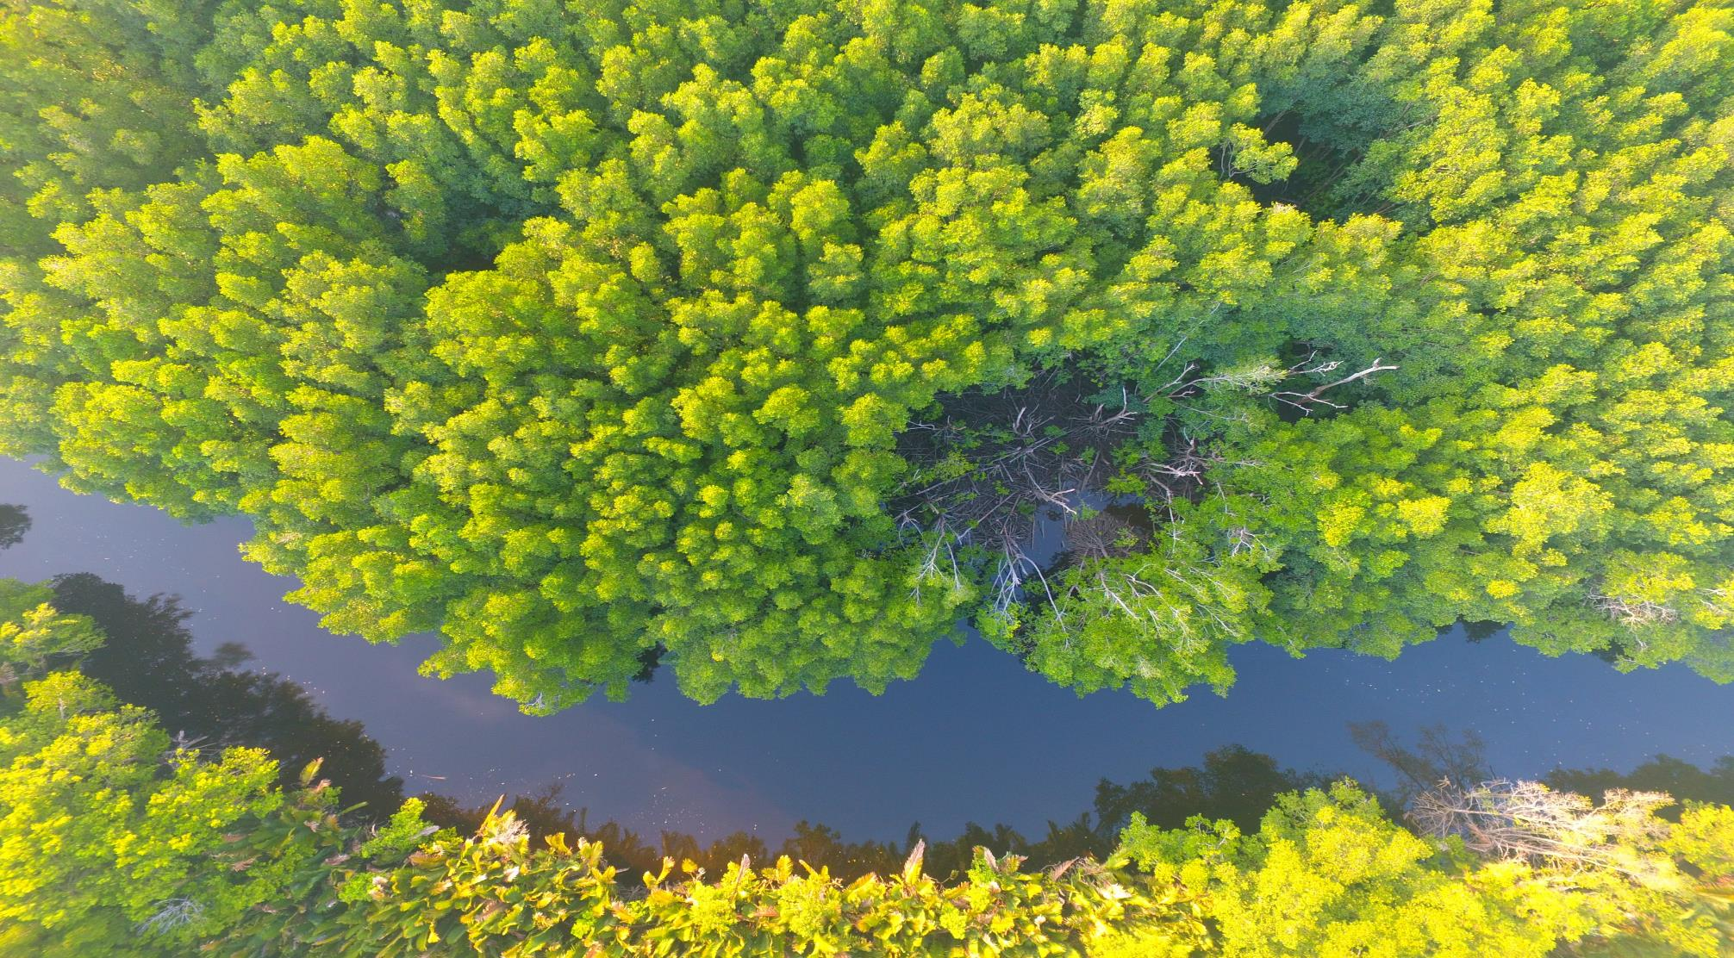
THANK YOU

