Slide 1

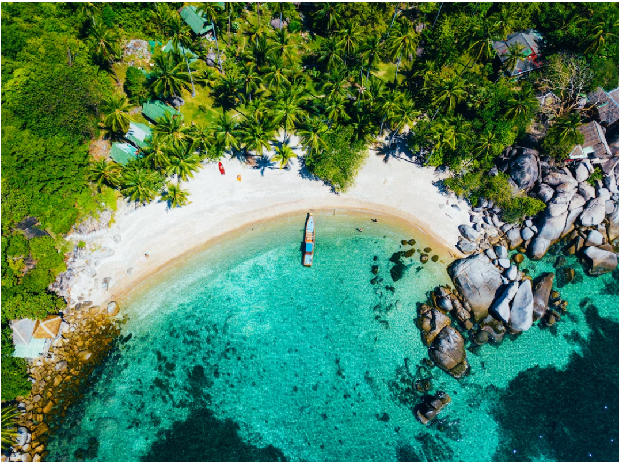
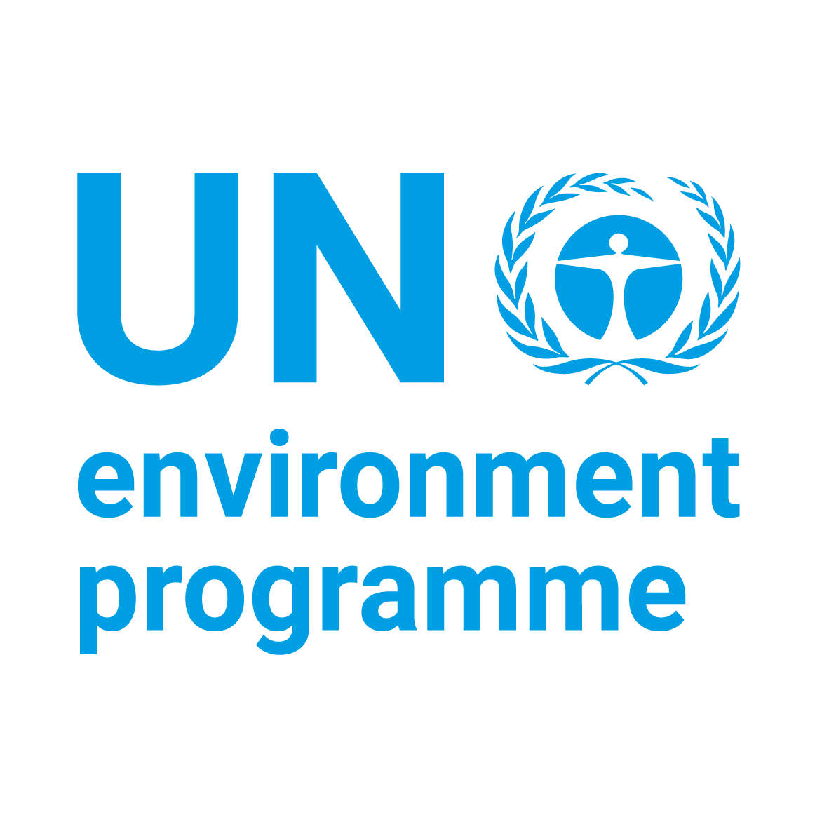


Implementing the Strategic Action Programme for the South China Sea and Gulf of Thailand (SCS SAP) Project
Second Meeting of the Regional Working Group on Land-Based Pollution (RWG-LBP)
11-12 November 2024, Shenzhen, China
Status of Preparation and Implementation of
Land-Based Pollution Activities
THAILAND
Dr. Wilawan Thanatemaneerat, Pollution Control Department

Slide 2
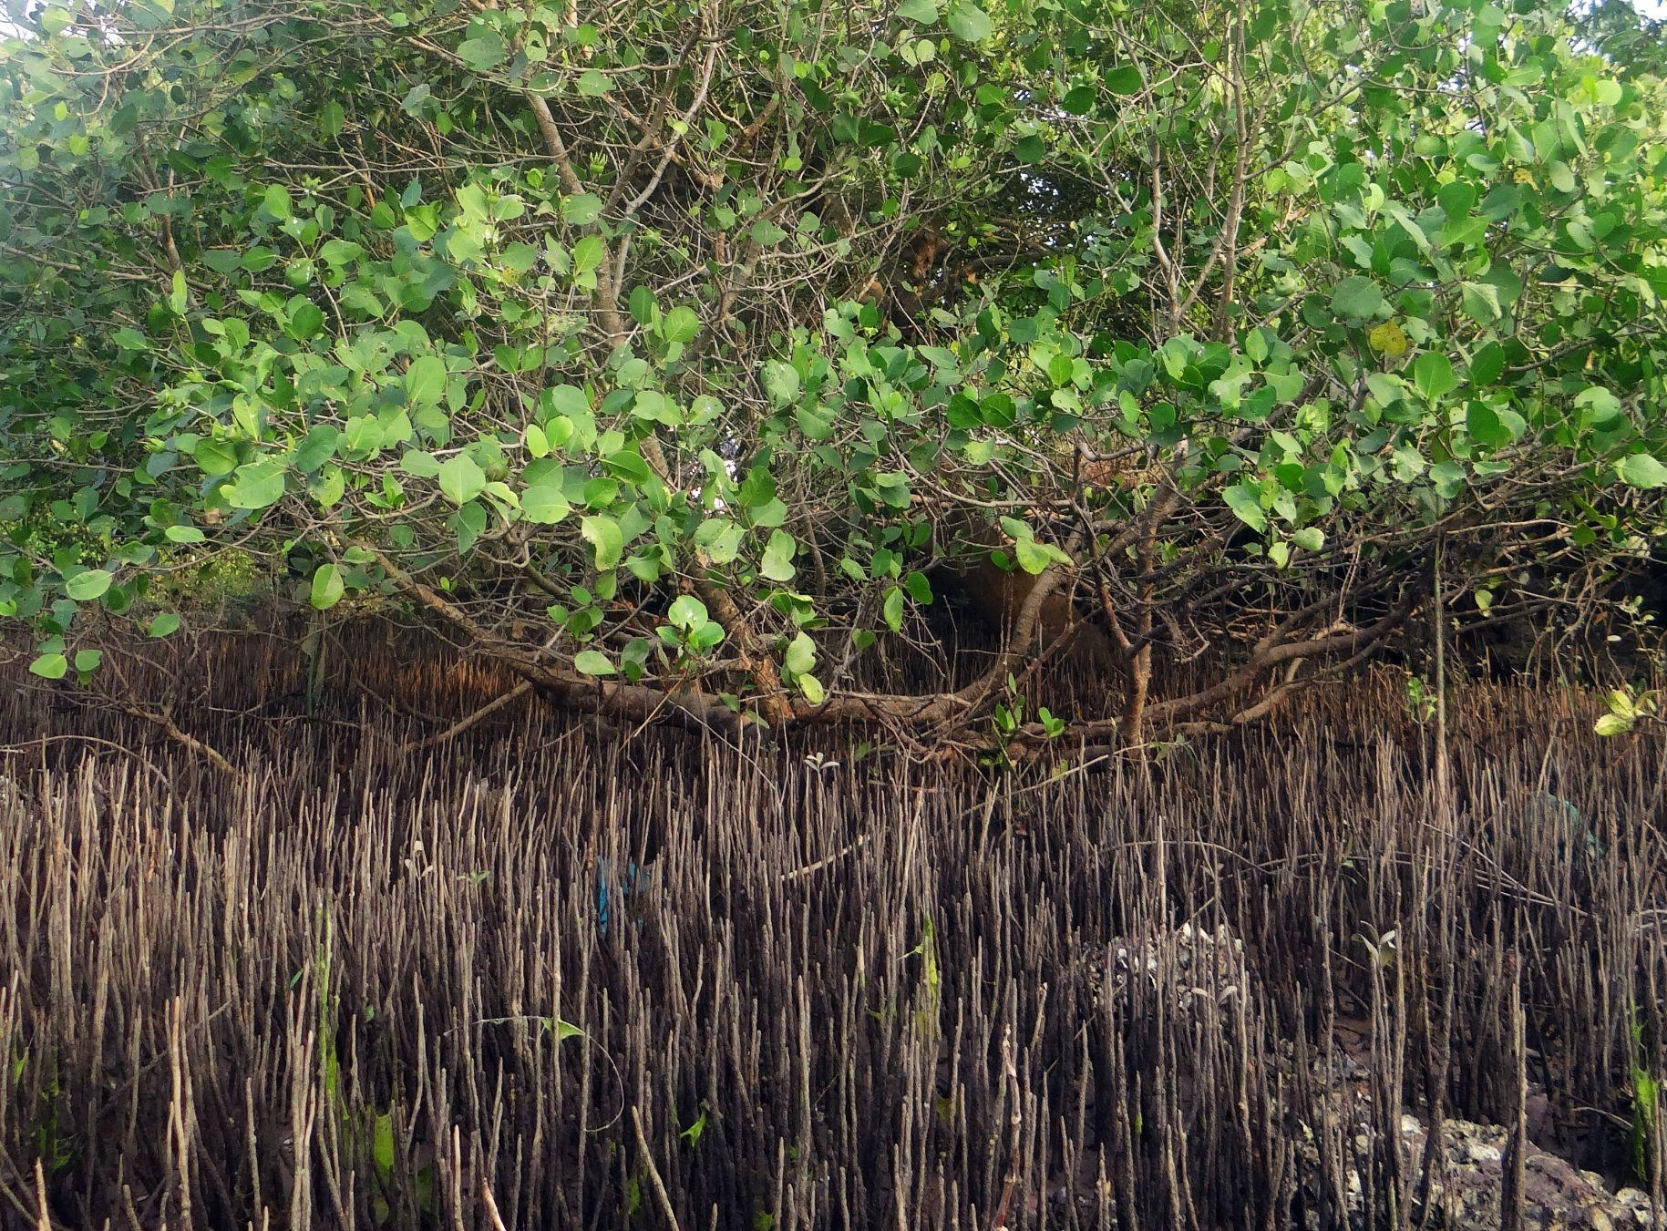
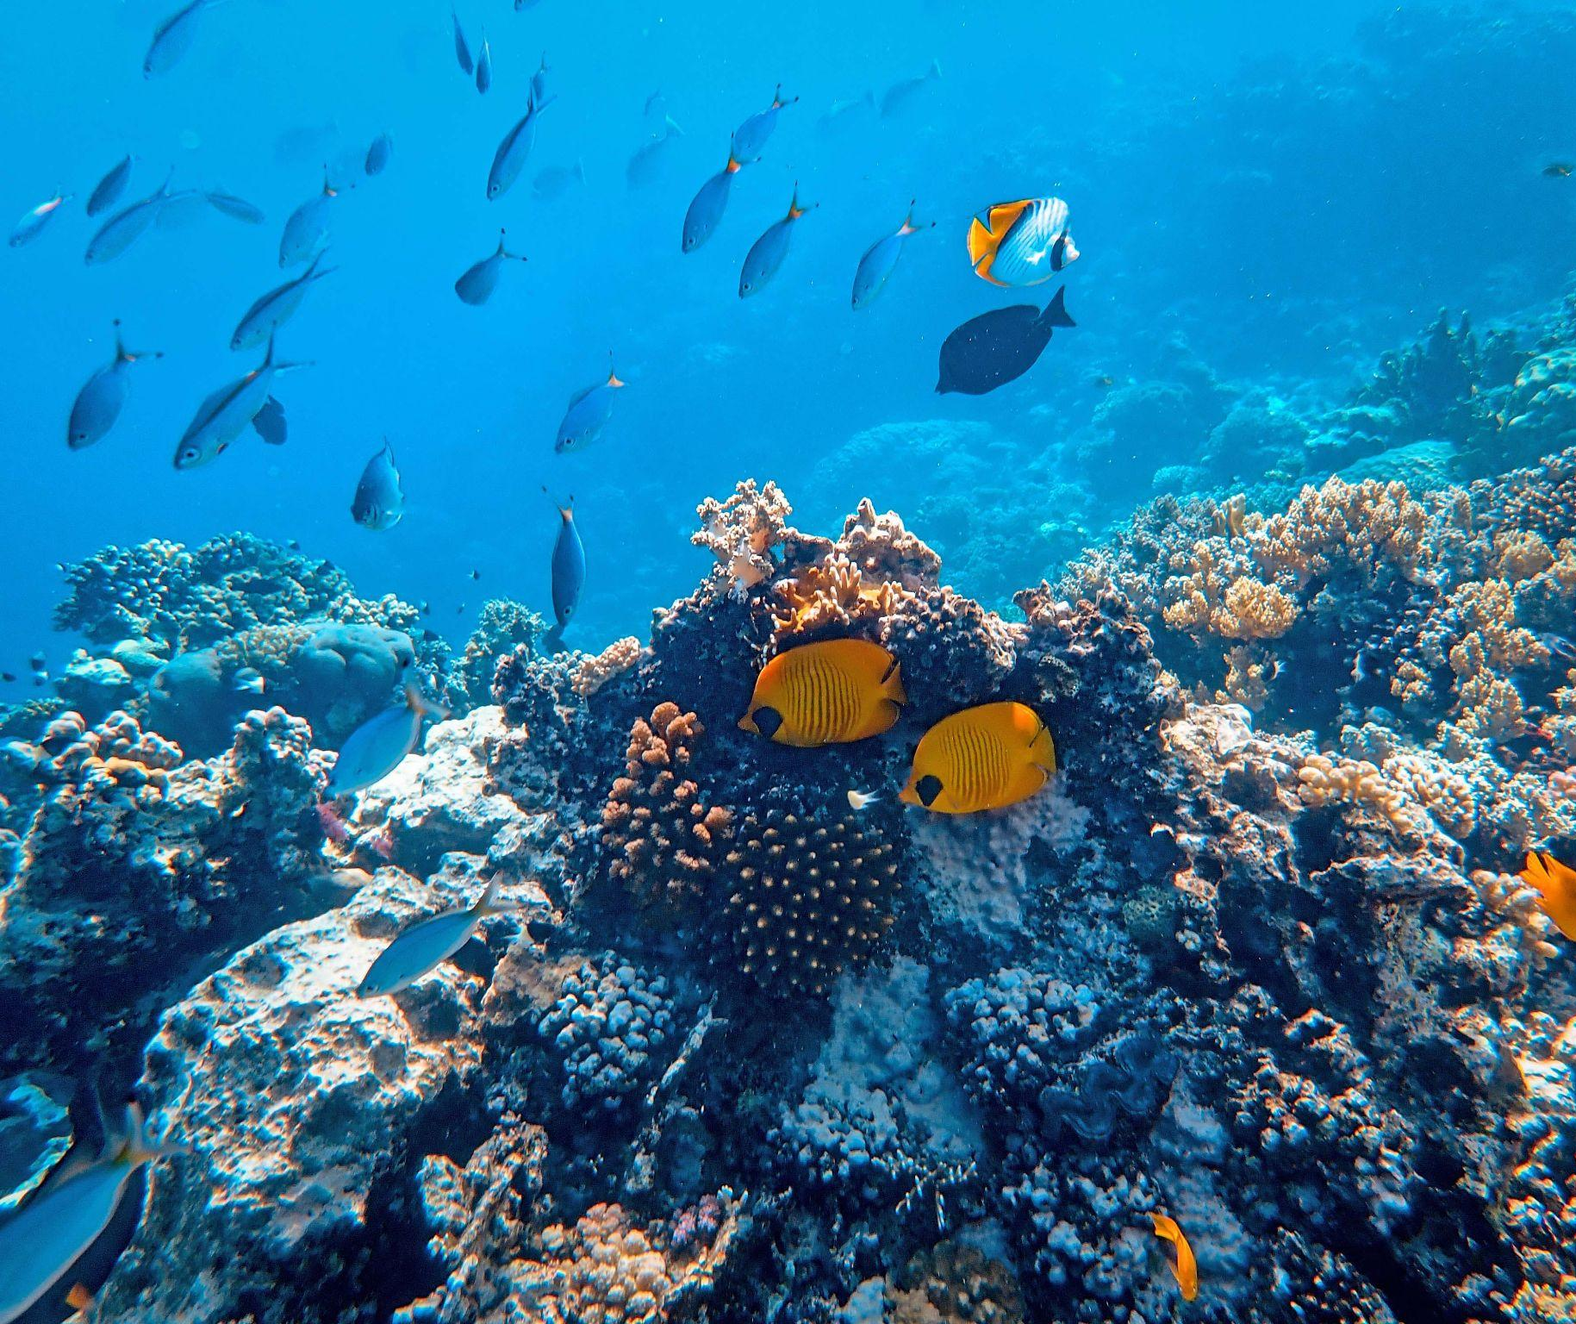
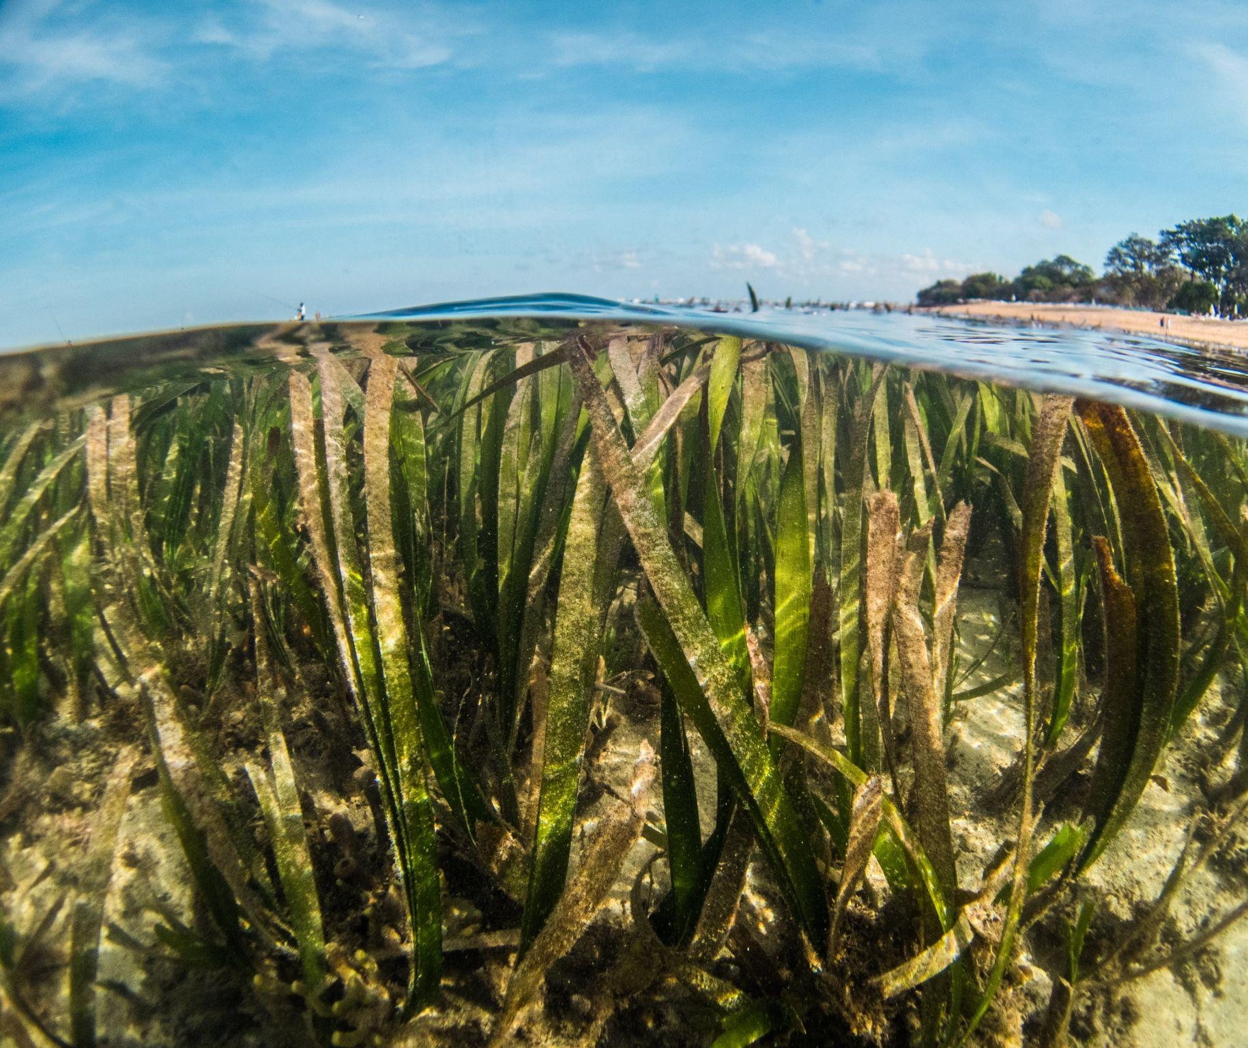
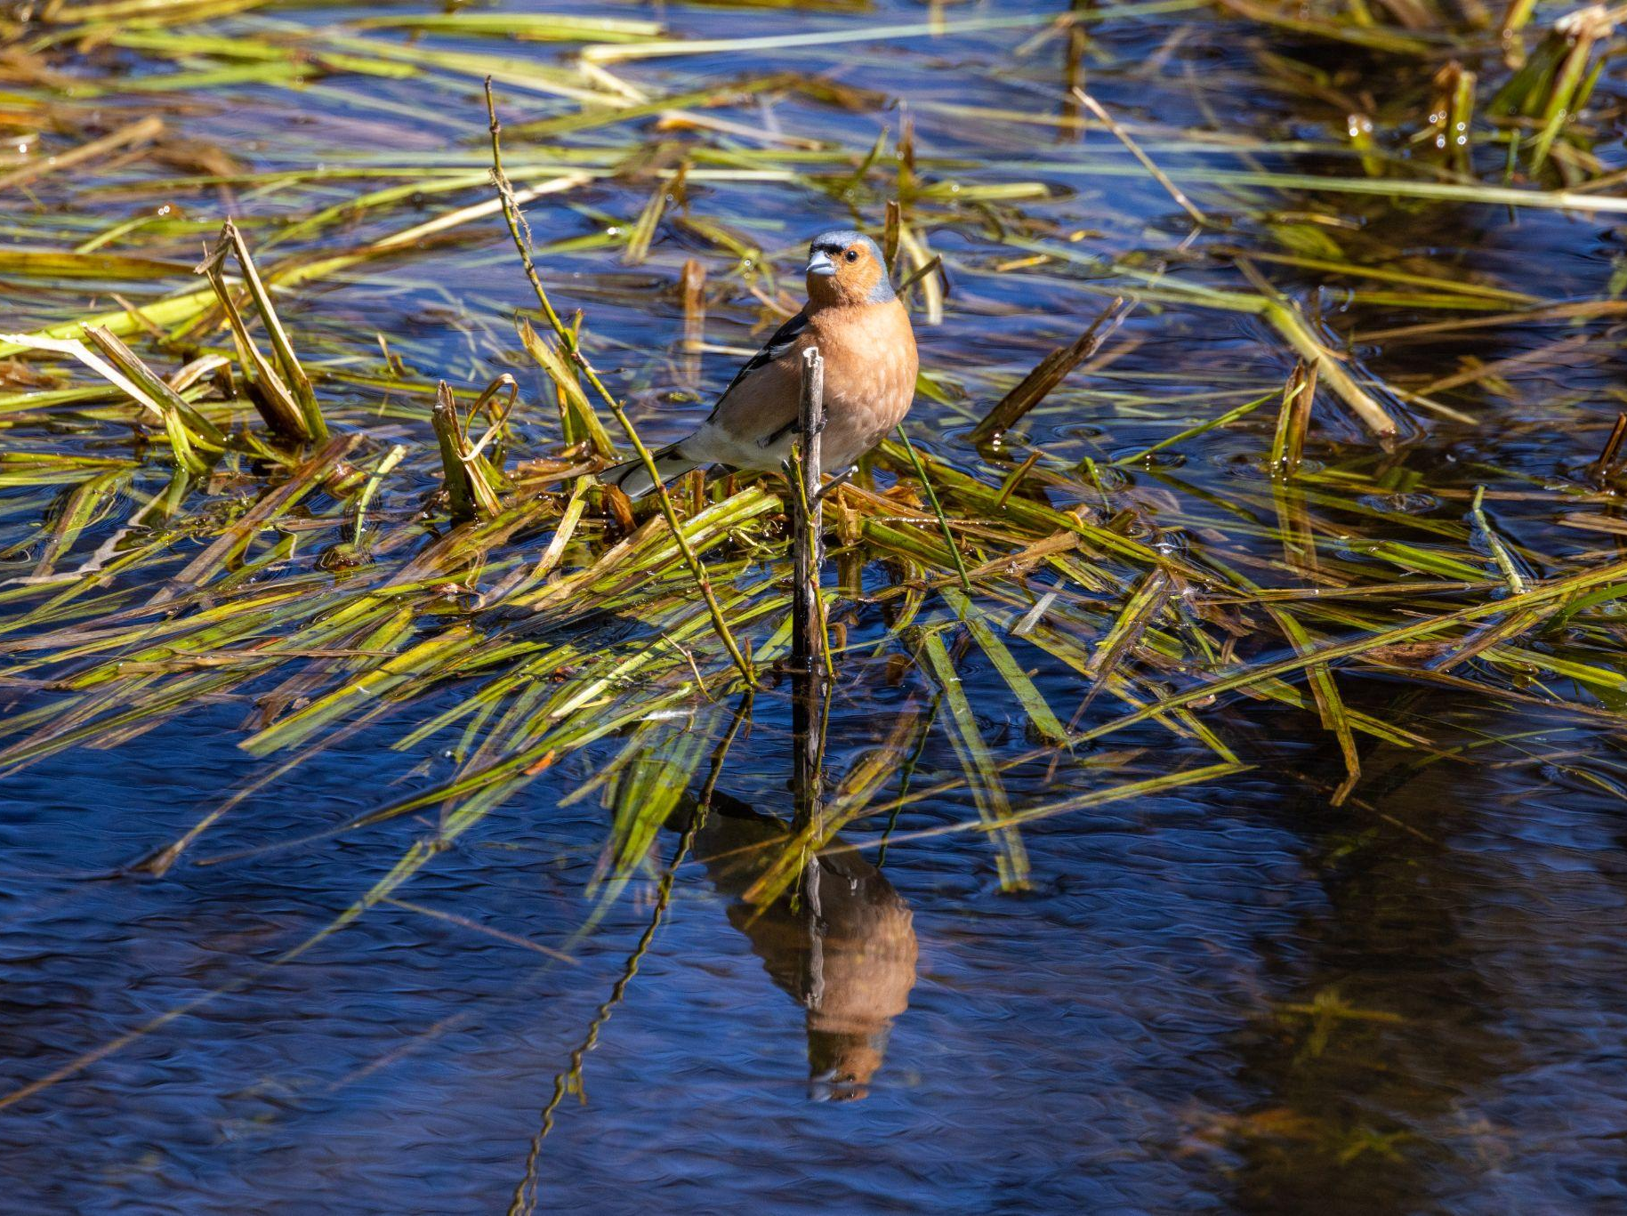
Updates on LbP related activities & achievements for 2023-2024 (following the 1st RWG-LbP meeting)
Legal & institutional matters (new or revised/updated policies, regulation and institutional/financial arrangement…)
Ambient Standards of:
1. Marine Water Quality Standards
2. Surface Water Quality Standards
3. Coastal Sediment Quality Guideline
Effluent Standard of Wastewater from:
1. certain types and sizes of buildings
2. power generation plants
3. landfill sites
4. certain types of fishing piers
5. pollution sources such as pig farming
6. small businesses that produce certain types of goods or services
7. pulp and paper mills
8. establishments related to desalination from seawater
9. industrial factories, industrial estates and industrial zones that are engaged in tanning, polishing or coating of animal skins
10. industrial factories, industrial estates and industrial zones
11. fuel service stations
12. allocated land
13. central Wastewater Treatment Plant
14. coastal Aquaculture, Brackish Aquaculture, Inland Aquaculture

Slide 3
Updates on LbP related activities & achievements for 2023-2024 (following the 1st RWG-LbP meeting)
Research and Assessment
1. "The Expansion of Inland Shrimp Farming and Its Environmental Impacts in Songkhla Lake Basin" (2001)
Authors: Tanavud, C., Yongchalermchai, C., Bennui, A., and Kasetsart, O.D.
Summary: This study examines the environmental consequences of the rapid expansion of inland shrimp farming in the Songkhla Lake Basin, highlighting issues such as habitat destruction, water pollution, and soil degradation.
2. "Rural Male Leadership, Religion and the Environment in Thailand's Mid-South, 1920s–1960s" (2011)
Author: Reynolds, C. J.
Summary: This research explores the interplay between rural leadership, religious practices, and environmental management in Thailand's mid-southern regions during the mid-20th century.
3. "A Conceptual Framework for Assessment of Governance Performance of Lake Basins: Towards Transformation to Adaptive and Integrative Governance" (2016)
Authors: Cookey, P.E., Darnswasdi, R., and Ratanachai, C.
Summary: The paper proposes a framework for evaluating governance in lake basins, emphasizing the need for adaptive and integrative approaches to address environmental challenges.
4. "Land Use Impact on the Water Quality of Large Tropical River: Mun River Basin, Thailand" (2019)
Authors: S. S. Babel, S. Shrestha, and N. Kawasaki
Summary: This study assesses how different land-use practices affect the water quality of the Mun River Basin, identifying key pollutants and their sources.
5. "Recovery of Plastics from Dumpsites and Landfills to Prevent Marine Plastic Pollution in Thailand" (2019)
Authors: Avi Sharma, Vincent Aloysius, and Chettiyappan Visvanathan
Summary: The research investigates the potential for recovering plastic waste from dumpsites and landfills as a strategy to mitigate marine plastic pollution in Thailand.

Slide 4
Updates on LbP related activities & achievements for 2023-2024 (following the 1st RWG-LbP meeting)
Research and Assessment
6. "Land Use Impacts on Coral Reef Health: A Ridge-to-Reef Perspective" (2019)
Authors: Asner, G. P., and others
Summary: This paper reviews the connections between land use and coral reef health, emphasizing the importance of managing land-based pollution to protect marine ecosystems. Frontiers
7. "Trace Elements in Marine Sediment and Organisms in the Gulf of Thailand" (2018)
Authors: S. S. Babel, S. Shrestha, and N. Kawasaki
Summary: This study analyzes the concentration of trace elements in marine sediments and organisms in the Gulf of Thailand, linking findings to land-based pollution sources. MDPI
8. "Issues of Microplastics Pollution in Tap and Drinking Water Sources in Thailand and Health Impacts" (2023)
Authors: Various
Summary: This recent research addresses the prevalence of microplastics in Thailand's drinking water sources and discusses potential health implications. ResearchGate
9. "Thailand Makes an Effort to Protect Marine Environment from Marine Debris and Land-Based Pollution" (2020)
Organization: Department of Economic and Social Affairs, United Nations
Summary: This report outlines Thailand's initiatives to combat marine debris and land-based pollution, detailing strategies and partnerships aimed at environmental protection. UN Sustainable Development Goals
10. "The Designation of Geographical Entities in This Book, and the Presentation of the Material Therein, Do Not Imply the Expression of Any Opinion Whatsoever on the Part of IUCN Concerning the Legal Status of Any Country, Territory, or Area, or of Its Authorities, or Concerning the Delimitation of Its Frontiers or Boundaries" (2020)
Organization: International Union for Conservation of Nature (IUCN) - Summary: This publication provides a comprehensive overview of marine plastic pollution in Thailand, discussing sources, impacts, and management strategies. IUCN
These studies offer valuable insights into the various facets of land-based pollution in Thailand, encompassing water quality, marine debris, agricultural impacts, and policy responses.

Slide 5
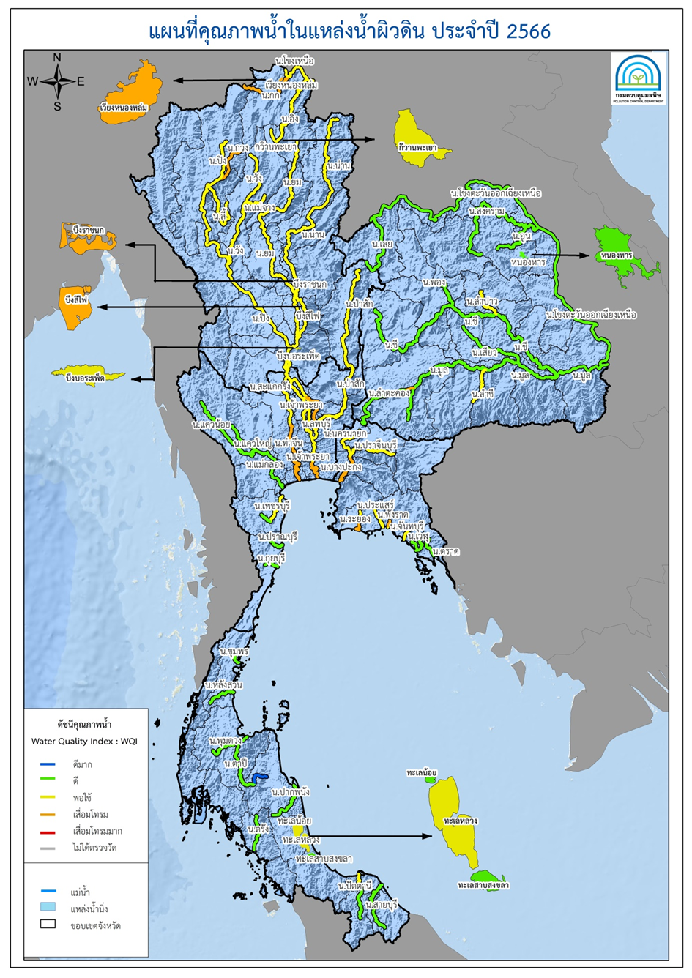
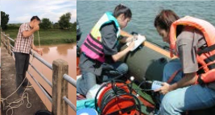
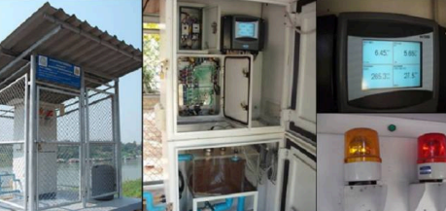
Updates on LbP related activities & achievements for 2023-2024 (following the 1st RWG-LbP meeting)
Pollution Control Department monitors water quality of 61 main rivers and 9 water bodies across the country total 398 stations and 76 automatic monitoring station
By monitoring water quality 4 times in a year.
Data from 2023 reveals that the majority of surface water bodies have water quality ranging from fair to good, with no water bodies falling into highly deteriorated category.
Map of Surface Water Quality for the Year 2566
Notes:
เพิ่ม WQI ลงไป

Slide 6
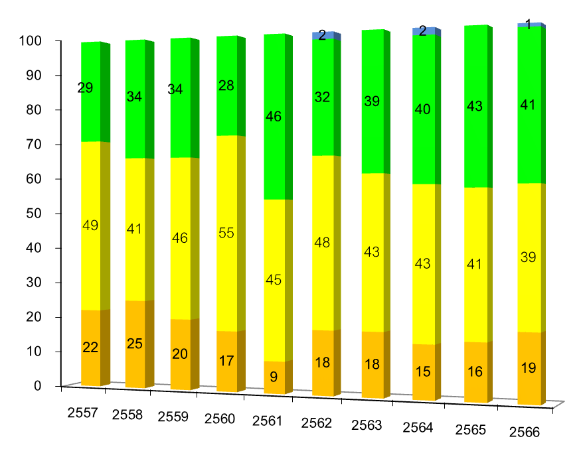
Updates on LbP related activities & achievements for 2023-2024 (following the 1st RWG-LbP meeting)
The situation of surface water quality over the past 10 year (2014 – 2023)
Percentage
Water bodies that continuously show a declining trend in water quality and require ongoing monitoring and remediation efforts include
Lower Chao Phraya River (Samut Prakan, Bangkok, Nonthaburi provinces)
Lower Tha Chin River (Samut Sakhon, Nakhon Pathom provinces)
Lopburi River
Lower Rayong River (Muang Rayong district)
Upper Phangrad River (Nayayom subdistrict, Nayayom district, Chanthaburi province)
Kuang River
Lower Lam Takhong River (Nakhon Ratchasima municipality)
Year
Excellent Good Fair Deteriorated
HOT SPOT

Slide 7
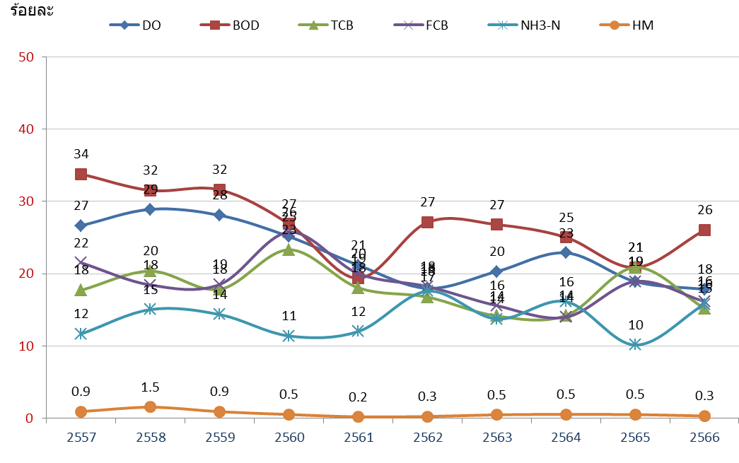
Updates on LbP related activities & achievements for 2023-2024 (following the 1st RWG-LbP meeting)
The situation of Surface Water Quality compared to designated water body classifications
The surface water quality compared to designated water body classifications reveals parameter that exceeded the standard include
Biochemical Oxygen Demand (BOD)
Dissolved (DO)
Total Coliform Bacteria (TCB)
Fecal Coliform Bacteria (FCB)
Ammonia (NH₃-N)
Heavy Metals (HM)
A graph show the Percentage of water qualiparameters that exceeded standards (2014 – 2023)

Slide 8
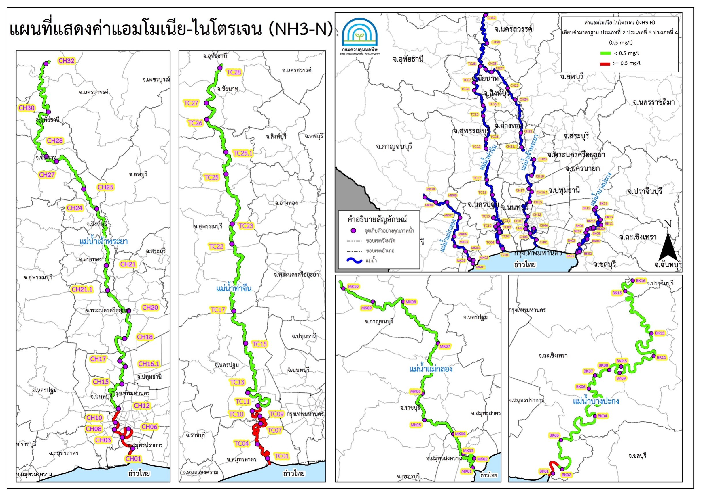
10 years
NH3-N
Inland water
from 2014 - 2023

Slide 9
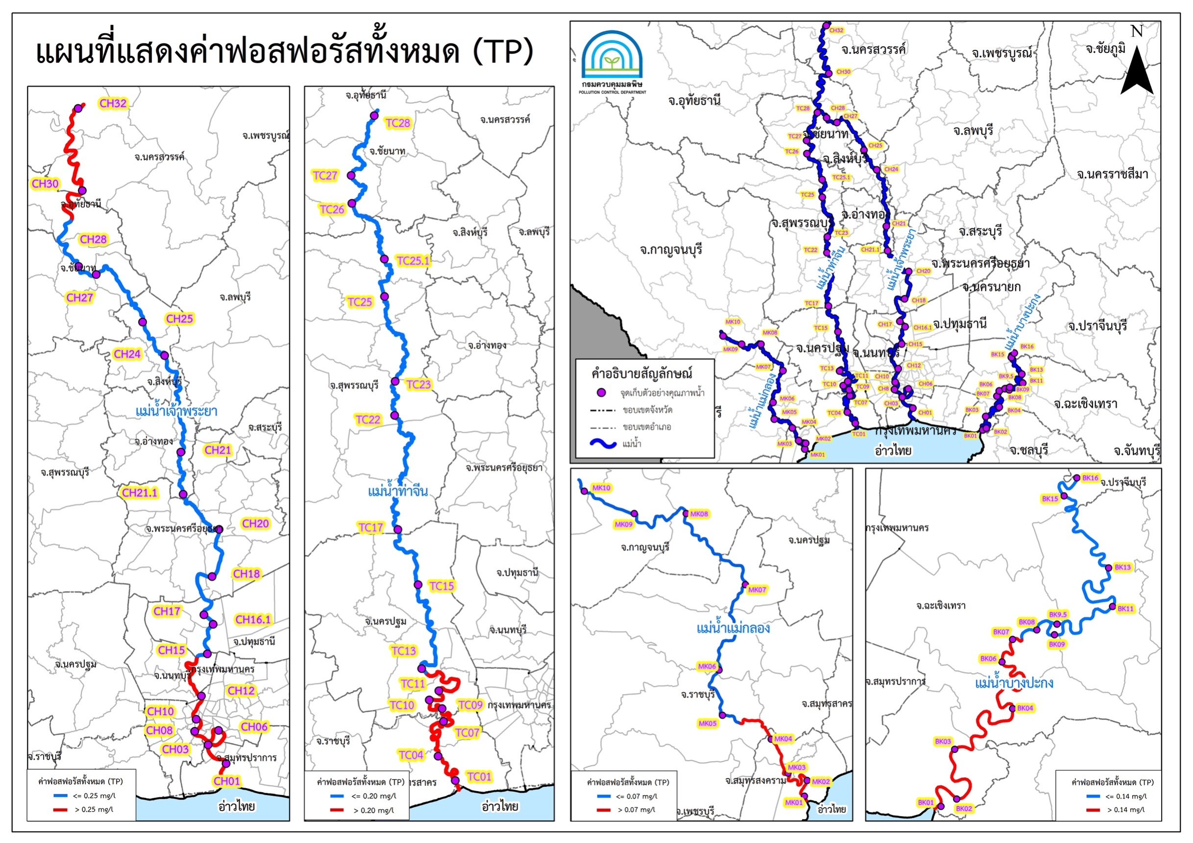
10 years
TP
Inland water
from 2014 - 2023

Slide 10
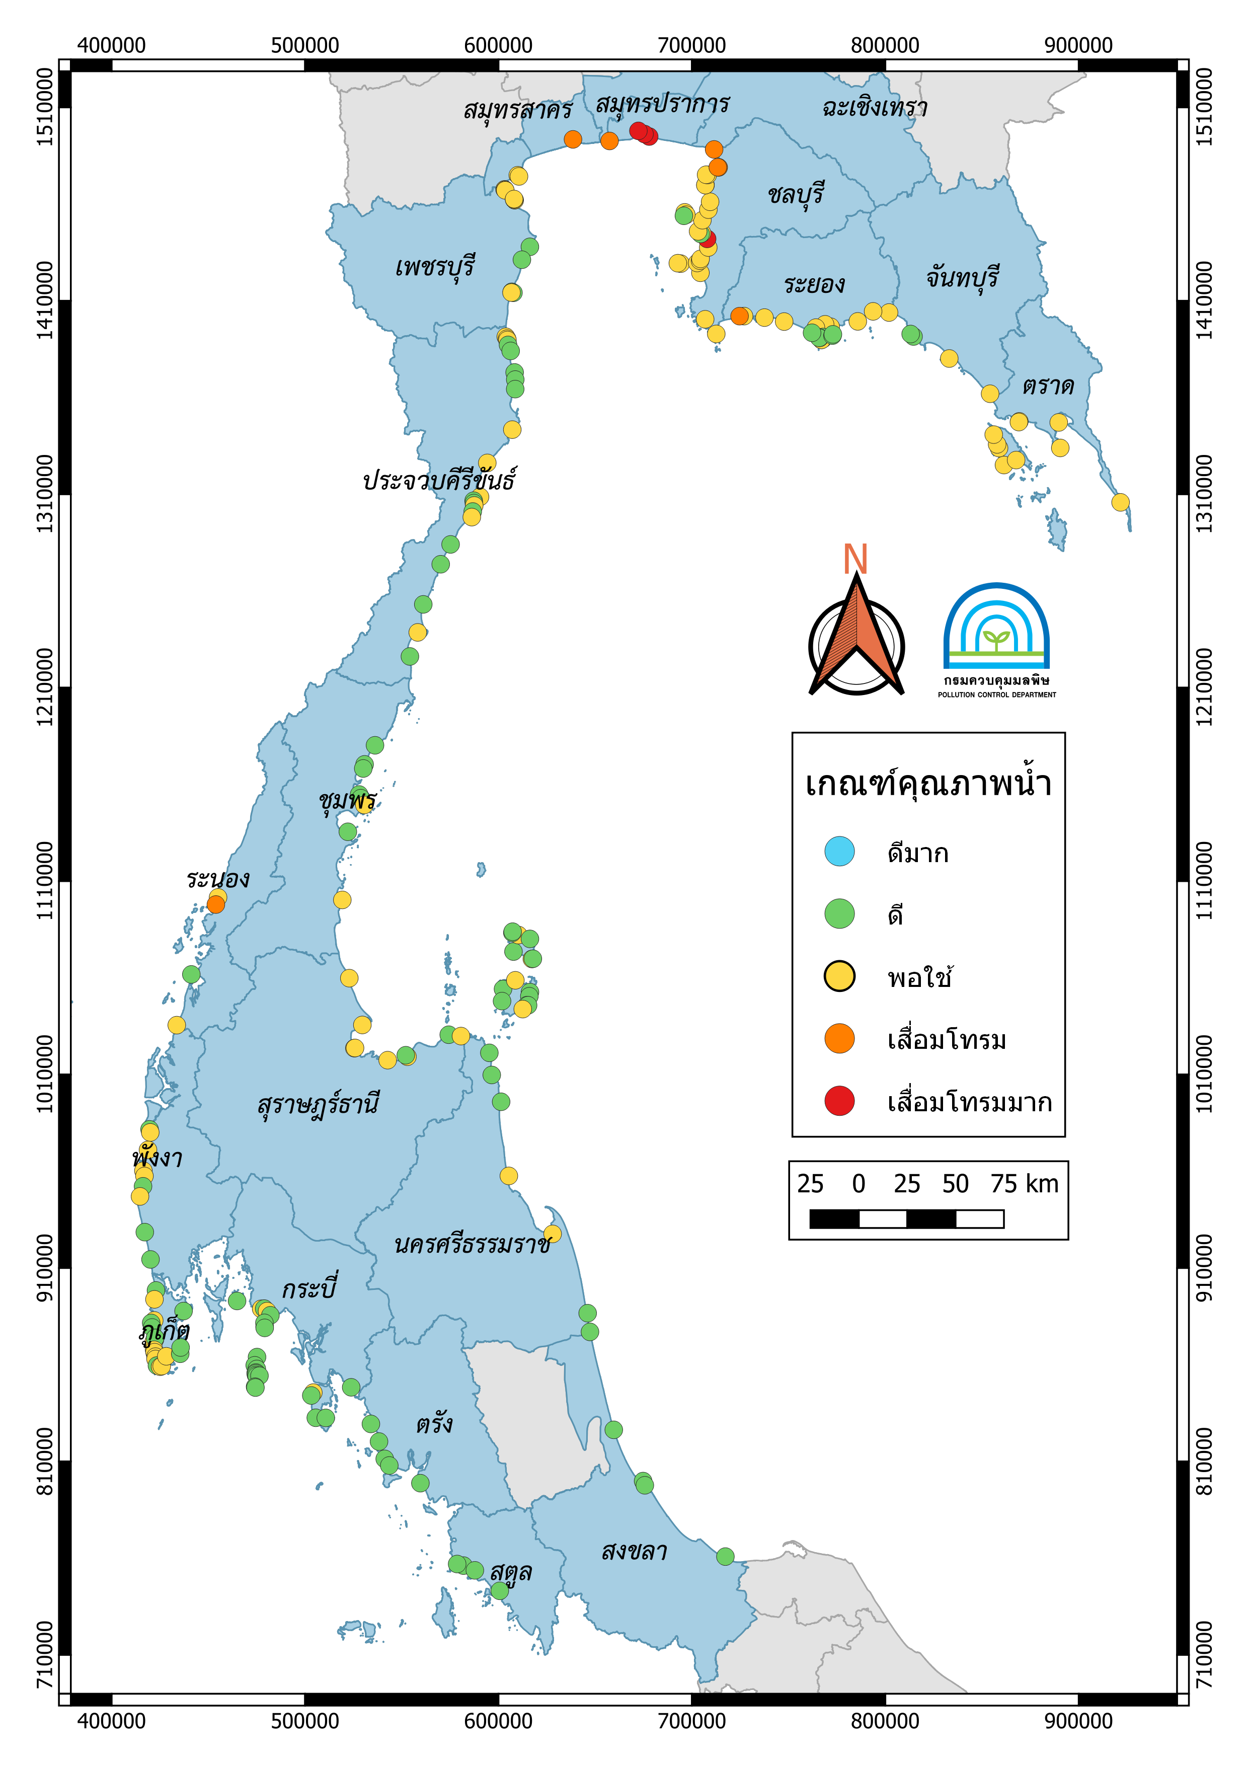
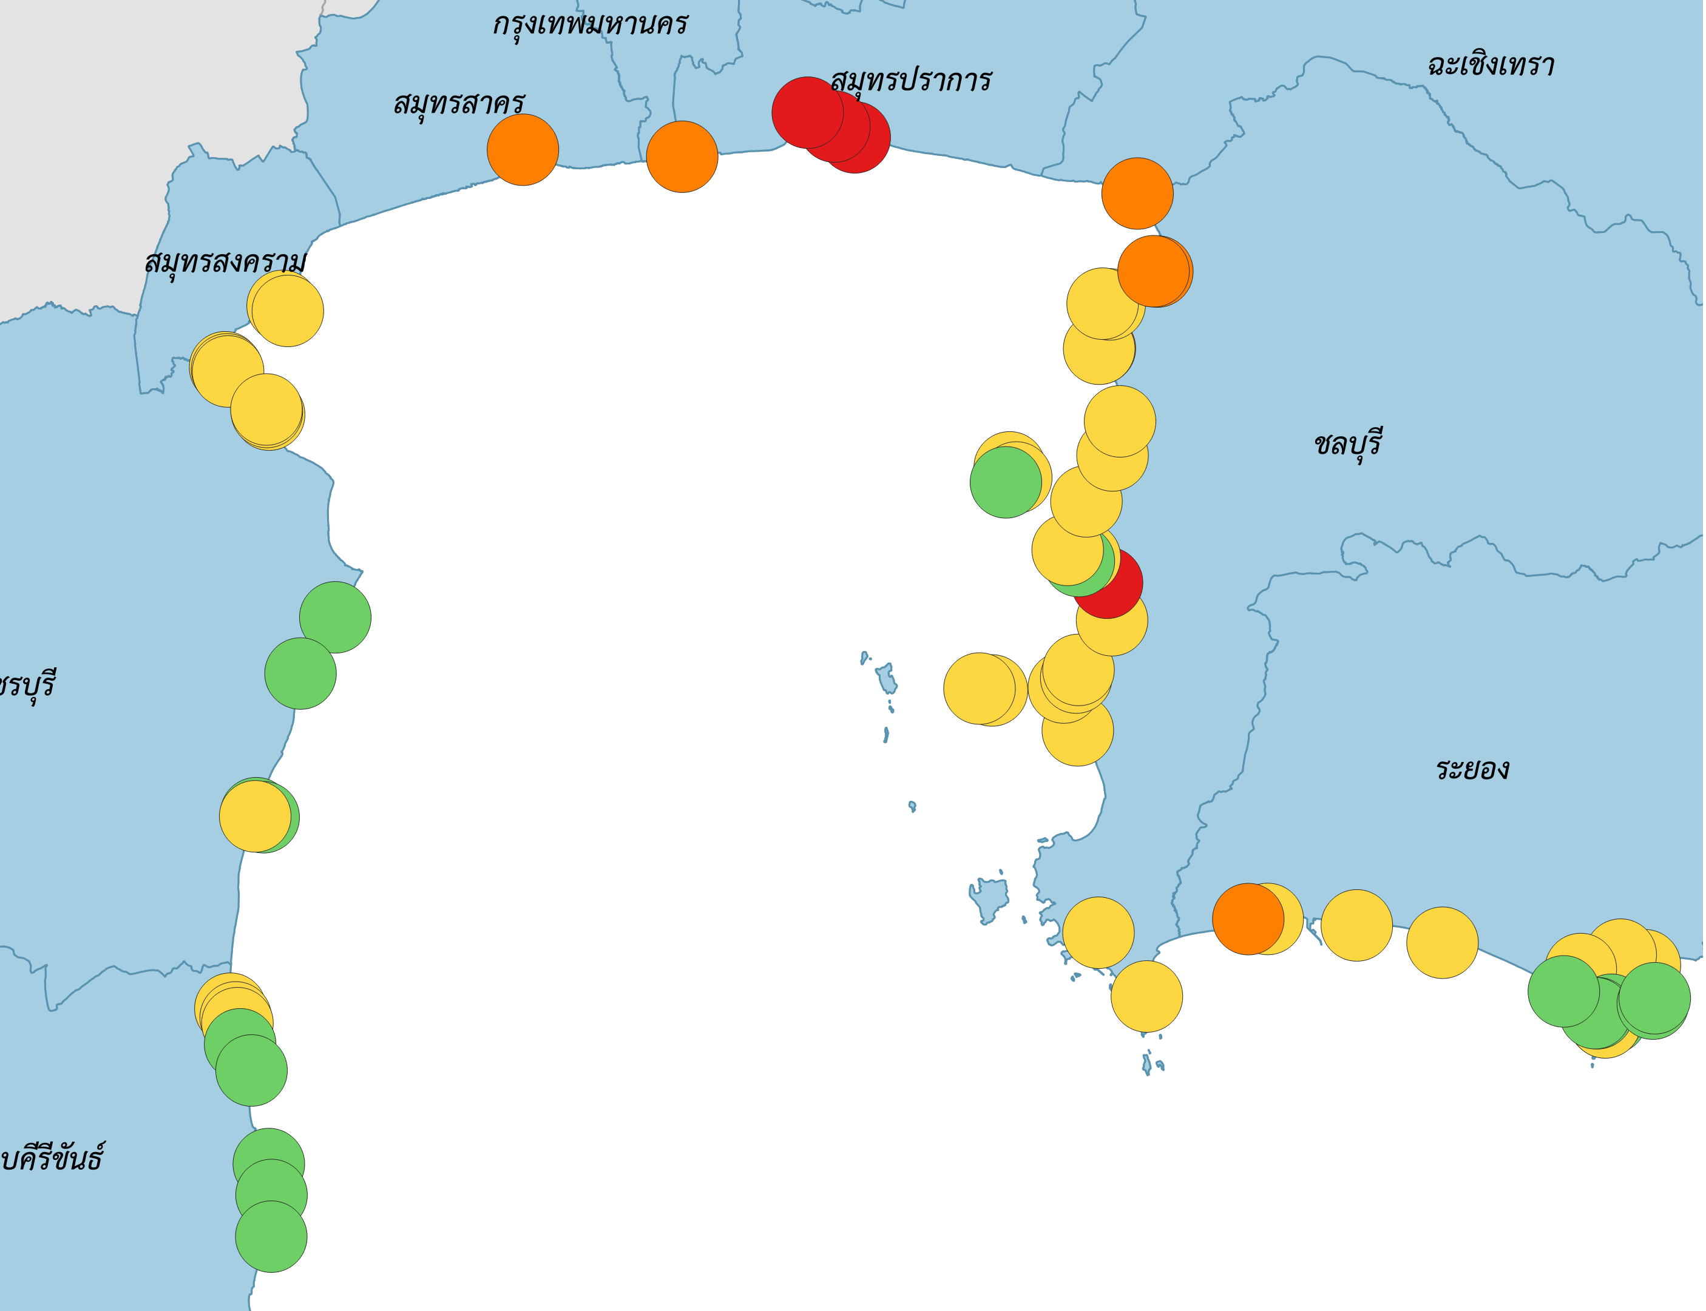
Updates on LbP related activities & achievements for 2023-2024 (following the 1st RWG-LbP meeting)
- Monitoring coastal water about 210 stations along the coast of Thailand
- status and trends of changes, specially in identified hot spots and monitoring stations
Data/Database
Hot spot
1. Chonburi , Laem Chabang, Southern Region
2. Samut Prakan, Dyeing factory Km35
3. Samut Prakan , Pak Khlong 12 Tanwa
4. Samut Prakan , Chao Phraya River
Marine Water Quality Index ; MWQI 2024

Slide 11
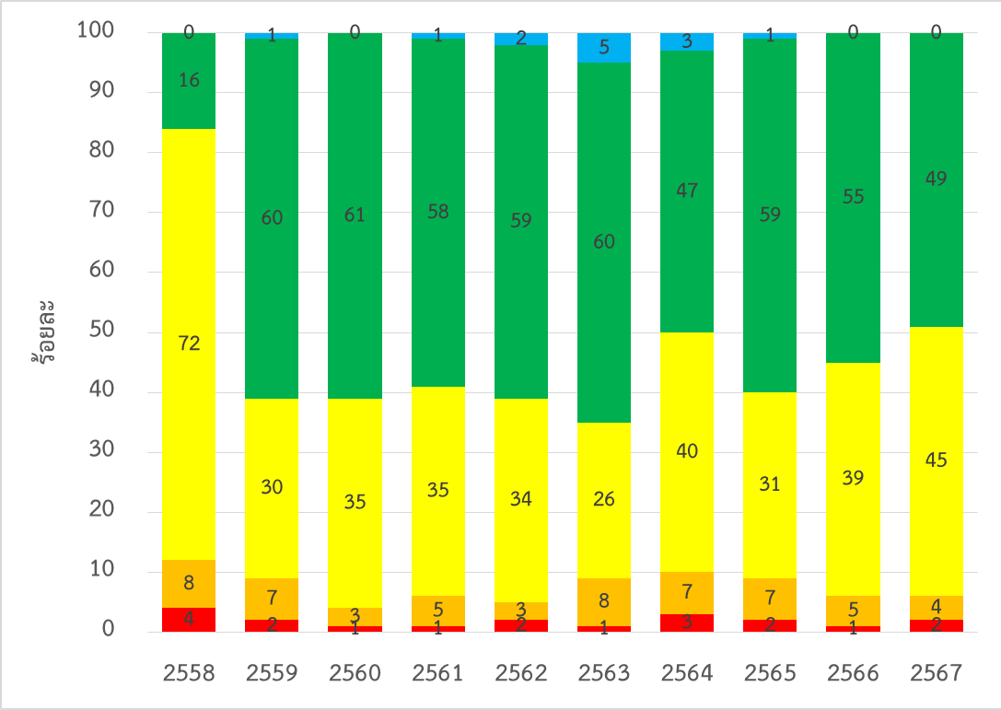
Updates on LbP related activities & achievements for 2023-2024 (following the 1st RWG-LbP meeting)
Monitoring status and trends of changes, specially in identified hot spots and monitoring stations
The situation of marine water quality over the past 10 year (2015 – 2024)
Percentage
Very Good
Good
Fair
Poor
Very Poor

Slide 12
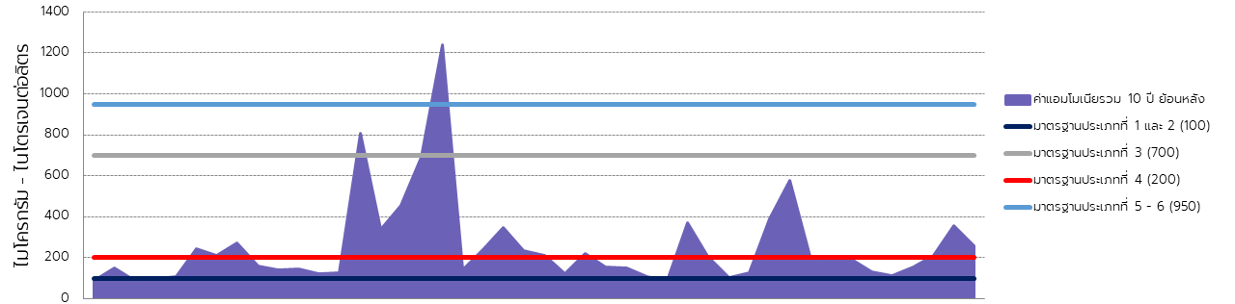
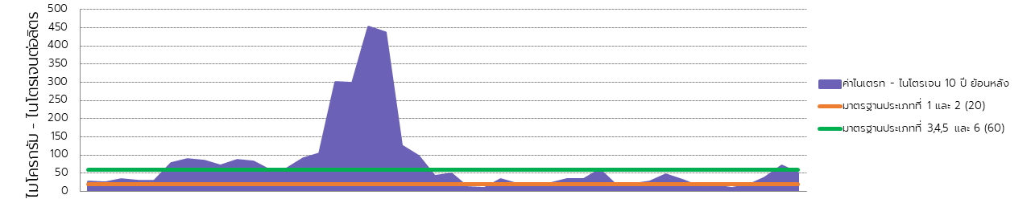
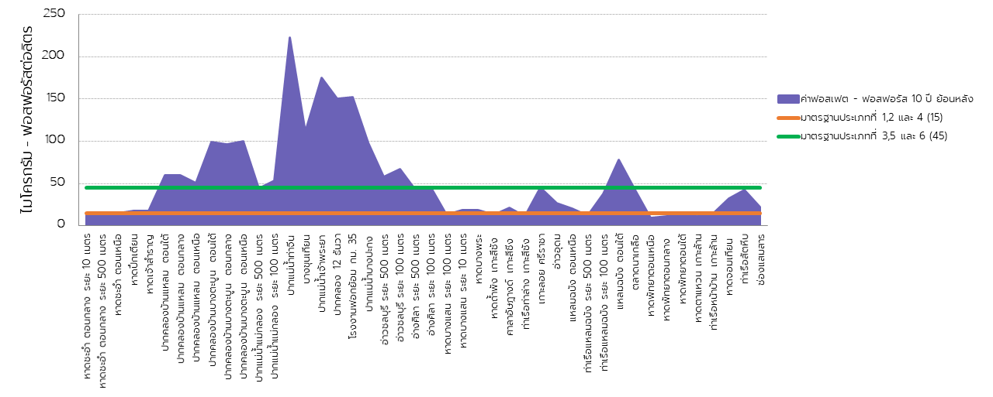
Total NH3
10 years
NO3 - N
Nitrogen
Coastal Water
from 2014 - 2023
HotSpot
Mae Klong River Mouth
Tha Chin River Mouth
Chao Phraya River Mouth
PO4 - P

Slide 13
Status on coordinating national activities and contributing regional activities for 2025-2026
Introduction of specialized executing agency on LBP
Specialized Executing Agency for LBP is Pollution Control Department (PCD)
Outline on National Working Group on LBP (members, organizations)
DG of PCD
(MNRE)
DG of Department of Marine and Coastal Resources
Ministry of Natural Resources and Environment (MNRE)
National Technical focal Point
Local Government
Experts
Civil Society Organizations/Community Groups
PCD
Special Executing Agency

Slide 14
Status on coordinating national activities and contributing regional activities for 2025-2026
Expert/s to join TDA team
Team Members:
1) Marine habitats/ ecosystems
Associate Professor Dr. Thamasak Yeemin
Marine Biodiversity Research Group: MBRG
E-mail : thamasakyeemin@hotmail.com
2) Fish and Fisheries
Dr. Pavarot Noranarttragoon
Senior Expert on Marine Fisheries
Department of Fisheries
E-mail : pavarotn@gmail.com
3) Pollution - Nutrients, Waste water, Plastics
Dr. Wilawan Thanatemaneerat
Environmentalists Senior Professional Level
Pollution Control Department
E-mail : aristrotle@gmail.com
4) Socioeconomics and Livelihoods - Blue economy,
Vulnerabilities to climate change and natural extreme
events
Assistant Professor Dr. Monissa Srisomwong
Department of Fishery Management,
Faculty of Fisheries, Kasetsart University
E-mail : ffisjts@ku.ac.th
5) Governance
Professor Dr. Suvaluck Satumanatapn
Mahidol University
Email : suvaluck.nat@mahidol.ac.th

Slide 15
Status on coordinating national activities and contributing regional activities for 2025-2026
Expert/s to join TDA team
Overall lead to coordinate:
1) Ms. Varain Vongpanich
Biodiversity Expert, DMCR
Email: khunvara@yahoo.com
2) Ms. Chanokphon Jantharakhantee
Fishery Biologist (Senior Professional Level), DMCR
Email: chanokphon_017@windowslive.com

Slide 16
Challenges and recommendations for implementing LbP activities for 2024-2026
Time schedule for signing and implementing new/amended PCA/GSAs
Waiting for final approval from PCD
Aiming to have the PCA signed by December 2024 and start implementing in Q1-2025.
Challenges:
1) Regulatory and Enforcement Issues
Weak Enforcement of Regulations: Although Thailand has laws on pollution control, enforcement can be inconsistent due to limited resources and oversight, especially in remote areas.
Fragmented Jurisdiction: Multiple agencies share responsibilities, leading to overlapping mandates and inefficiencies in coordinating land-based pollution management activities.
Lack of Standardized Guidelines: Varying standards for pollution across regions make uniform application challenging, and inadequate monitoring compounds the issue.
2) Economic Constraints
High Costs of Pollution Control Technology: The installation and maintenance of pollution control technology, especially for small businesses and local governments, can be financially prohibitive.
Dependence on Agriculture and Tourism: Many of Thailand's economic activities, like agriculture and tourism, have pollution-related impacts, making it hard to implement stringent policies without affecting livelihoods.
Funding and Resource Limitations: Limited financial resources restrict the capacity to develop infrastructure, conduct regular monitoring, and train personnel for pollution control.

Slide 17
Challenges and recommendations for implementing LbP activities for 2024-2026
Challenges:
3) Environmental Factors
Natural Disasters and Climate Change: Thailand’s susceptibility to floods, landslides, and tropical storms complicates pollution control, as such events can lead to uncontrolled waste discharge and erosion.
Geographic Challenges: Coastal regions, rural areas, and major rivers are at high risk of pollution but are often far from urban centers, making monitoring and intervention logistically difficult.
4) Public Awareness and Social Behavior
Limited Awareness and Participation:
  While environmental awareness is rising, a substantial part of the population remains uninformed about the impacts of land-based pollution, particularly in rural areas.
  Many citizens may not fully understand the impact of land-based pollution on water quality. Without strong public awareness, behavior change and community involvement are challenging to achieve.
Resistance to Change in Wastewater and Waste Management Practices: Shifting away from traditional practices, like open dumping and burning of waste, requires changing deeply ingrained habits, which can be slow without robust community engagement.
Lack of Incentives for Businesses: Small and medium enterprises may lack incentives to adopt pollution control measures, especially when immediate economic gains are prioritized over environmental stewardship.

Slide 18
Challenges and recommendations for implementing LbP activities for 2024-2026
Challenges:
5) Industrial and Agricultural Practices
Pollution from Industrial Activities: Industrial expansion, especially in urban and semi-urban areas, contributes significantly to soil and water pollution. Poor regulation of industrial effluents and inadequate waste disposal practices worsen the situation.
Agricultural Runoff: Thailand’s agriculture sector uses significant amounts of fertilizers and pesticides, which often end up in water bodies, contributing to nutrient pollution and soil degradation.
Difficulty in Monitoring and Regulating Small Polluters: Small-scale farms and businesses are harder to regulate, yet collectively, they can have substantial environmental impacts.
6) Wastewater and Waste Management Infrastructure
Inadequate Waste Disposal Facilities: Many areas lack proper waste disposal facilities, leading to illegal dumping in forests, rivers, and coastal areas.
Challenges in Plastic Waste Management: Thailand is one of the larger contributors to marine plastic pollution in Asia, and the sheer volume of plastic waste complicates management efforts.
Recycling System Constraints: Limited recycling facilities and low recycling rates increase the pressure on landfills and contribute to land-based pollution.
Inadequate wastewater treatment system, with rapid urbanization increases wastewater from households and commercial establishments. Waste treatment infrastructure often can't keep up, leading to untreated or partially treated sewage entering water bodies.

Slide 19
Challenges and recommendations for implementing LbP activities for 2024-2026
Recommendations
1. Strengthen Regulatory Framework and Enforcement
Enhance Law Enforcement: Increase funding and resources for regulatory bodies to enforce existing pollution control laws effectively. Implement stricter penalties for non-compliance, especially for industries and businesses that contribute significantly to pollution.
Standardize Guidelines: Develop consistent, nationwide guidelines for pollution levels, monitoring methods, and mitigation strategies to ensure uniformity across regions.
Streamline Government Coordination: Establish clearer roles among agencies involved in land-based pollution control to reduce overlapping responsibilities and improve coordination.
2. Invest in Wastewater and Waste Management Infrastructure
Expand Wastewater and Waste Treatment Facilities: Develop additional wastewater and waste treatment and recycling facilities, particularly in areas lacking proper disposal infrastructure, such as rural and coastal areas.
Improve Recycling Systems: Increase investments in recycling facilities and introduce incentives for businesses to adopt recycling practices, especially for plastics and electronic waste.
Upgrade Landfill Standards: Ensure that existing landfills meet environmental standards to prevent leakage of hazardous substances into the soil and groundwater.
3. Promote Sustainable Agricultural Practices
Reduce Chemical Inputs: Promote sustainable farming practices that reduce the reliance on synthetic fertilizers and pesticides, which contribute to soil and water pollution through runoff.
Introduce Organic Farming Incentives: Offer financial incentives and training programs to encourage farmers to adopt organic and regenerative agriculture practices, reducing pollution from agricultural runoff.
Implement Buffer Zones: Establish vegetative buffer zones around agricultural fields to absorb excess nutrients and prevent them from entering nearby water bodies.

Slide 20
Challenges and recommendations for implementing LbP activities for 2024-2026
Recommendations
4. Strengthen Industrial Pollution Control
Encourage Cleaner Production Technologies: Support industries in adopting cleaner production technologies and practices to reduce emissions, effluents, and waste. Provide incentives for industries that achieve pollution reduction targets.
Mandate Waste Treatment: Require all industries to treat their waste before disposal, with specific guidelines for industries known to generate hazardous or high-volume waste.
Enhance Monitoring and Reporting: Install real-time monitoring systems for major industrial sites and enforce regular reporting on emissions and waste disposal.
5. Enhance Community Engagement and Awareness
Educational Campaigns: Implement nationwide educational campaigns about the impacts of land-based pollution and the importance of waste reduction, recycling, and sustainable practices. Target campaigns in schools, communities, and public spaces.
Promote Local Initiatives: Encourage community-based waste management programs, such as recycling centers, composting sites, and cleanup campaigns, empowering residents to participate actively.
Offer Waste Segregation Training: Educate households and businesses on waste segregation to improve the quality of recyclables and reduce the burden on waste processing facilities.

Slide 21
Challenges and recommendations for implementing LbP activities for 2024-2026
Recommendations
6. Develop and Implement a Plastic Waste Reduction Strategy
Reduce Single-Use Plastics: Introduce and enforce policies to reduce single-use plastics, such as plastic bag bans, incentives for reusable packaging, and partnerships with businesses to minimize plastic waste.
Promote Alternative Materials: Support research and development of biodegradable or alternative materials to replace conventional plastics, especially in packaging and consumer goods.
Improve Collection and Recovery: Enhance plastic waste collection and sorting systems to improve recycling rates and prevent plastics from entering the environment.
7. Strengthen Data Collection, Research, and Monitoring
Enhance Pollution Data Collection: Develop a robust system for regular monitoring and data collection on pollution levels across regions, focusing on both soil and water quality.
Research and Development: Invest in R&D for innovative pollution control technologies, such as bioengineering for soil remediation or efficient waste treatment methods.
Implement an Early Warning System: Establish an early warning system for areas at high risk of pollution incidents, enabling quick responses to prevent further environmental damage.
8. Promote Public-Private Partnerships (PPPs)
Collaborate with Private Sector: Foster partnerships between government agencies and private companies to co-finance pollution control infrastructure and develop sustainable business practices.
Corporate Social Responsibility (CSR) Programs: Encourage industries to integrate environmental responsibility into their business models, promoting CSR initiatives focused on reducing and managing pollution.
Incentivize Green Investments: Provide tax breaks, subsidies, or other financial incentives for companies that invest in green technologies and pollution control measures.

Slide 22
Challenges and recommendations for implementing LbP activities for 2024-2026
Recommendations
9. Integrate Pollution Control in Urban Planning
Incorporate Green Spaces: Include parks, forests, and green belts in urban planning to reduce pollution and enhance natural filtration.
Zoning Regulations: Use zoning laws to control where industries, agricultural areas, and residential zones are located, minimizing the impact of pollution on populated areas.
Promote Eco-Friendly Urban Development: Encourage sustainable building practices and waste management in new developments, especially in rapidly growing cities.
10. Engage in Regional Cooperation
Collaborate with Neighboring Countries: Engage in regional dialogues and initiatives to address transboundary pollution issues, as many environmental impacts span borders, particularly with river and coastal pollution.
Share Knowledge and Resources: Exchange knowledge, technology, and resources with neighboring countries facing similar land-based pollution challenges to develop collaborative solutions.
Participate in Regional Environmental Programs: Actively participate in regional environmental programs and frameworks to tackle broader pollution issues and gain access to funding and expertise.

Slide 23
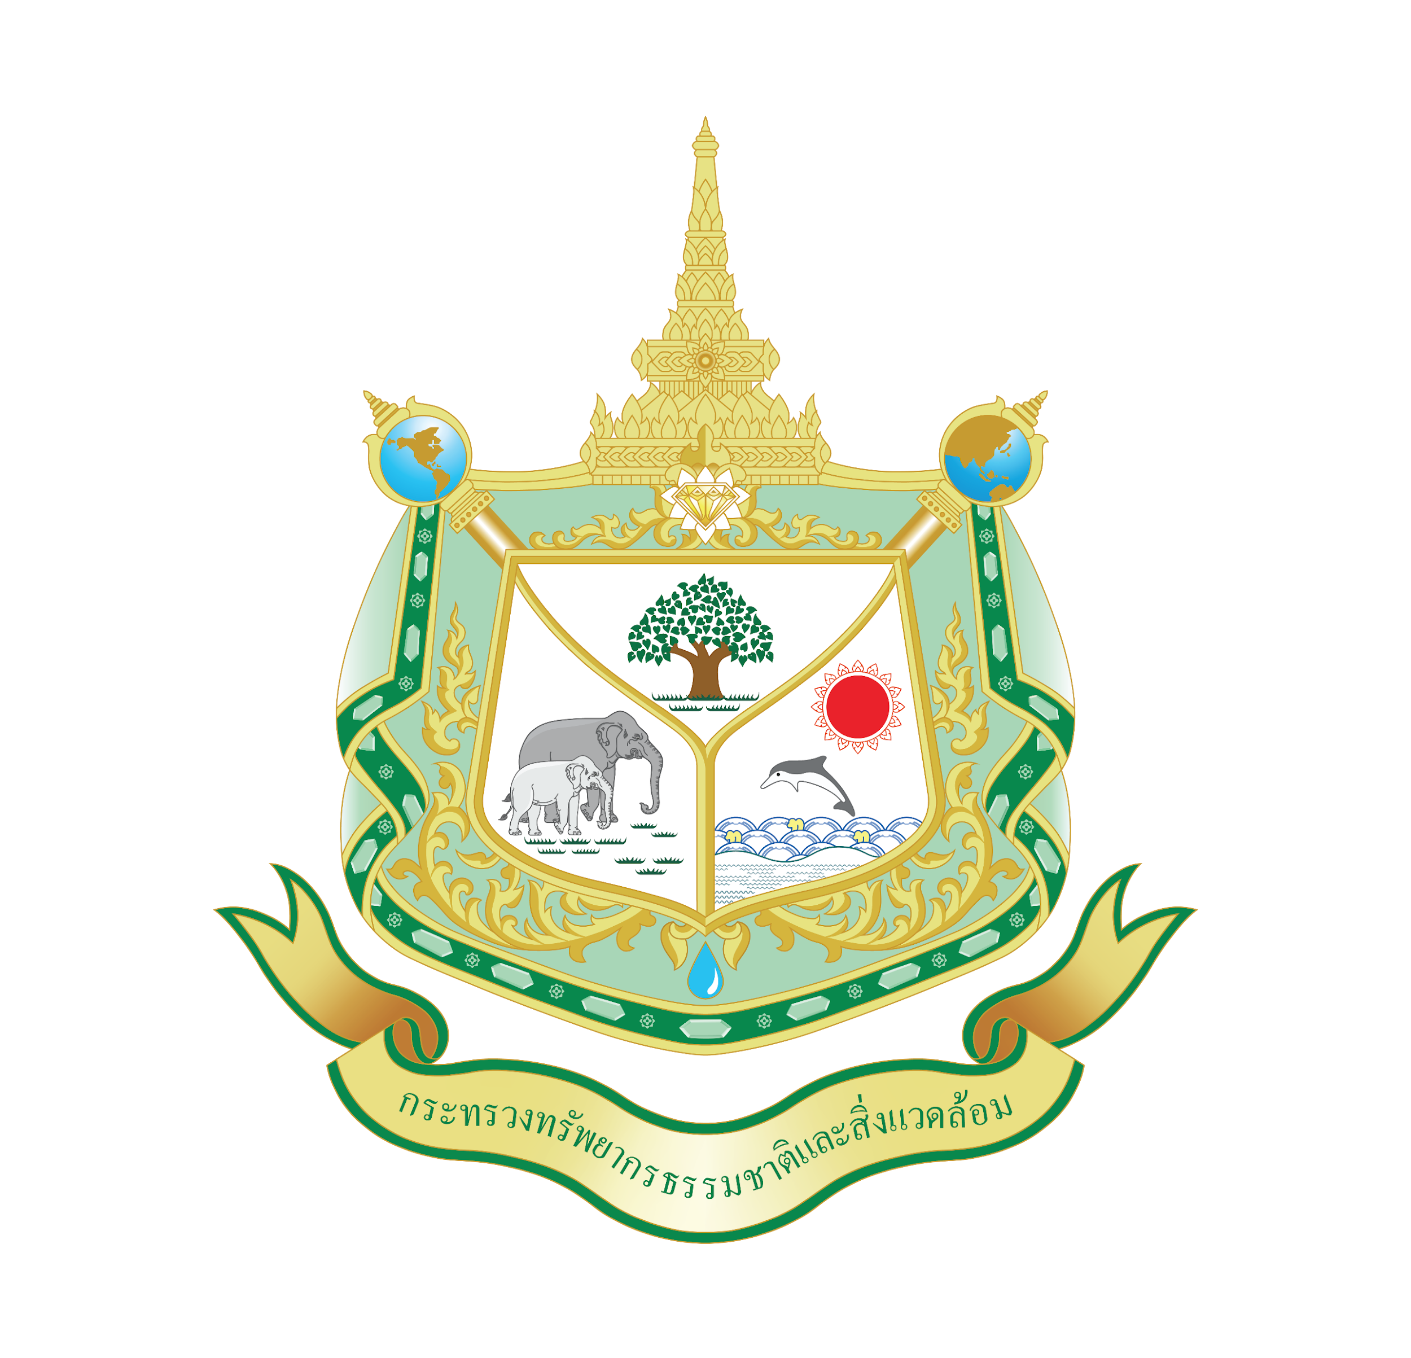

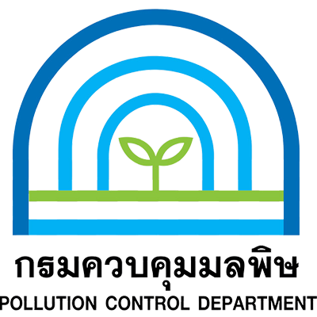
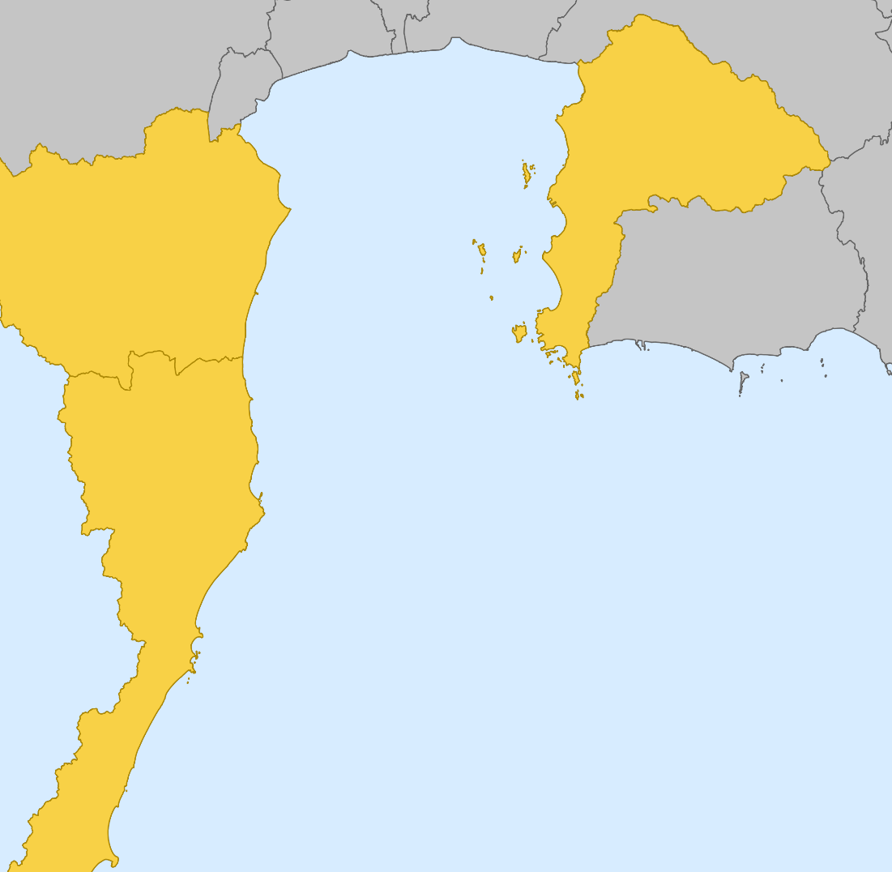
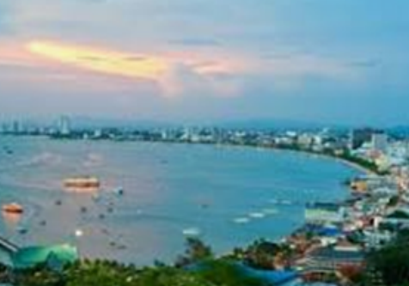


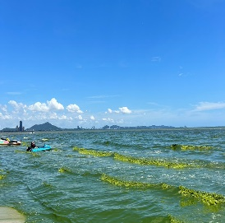
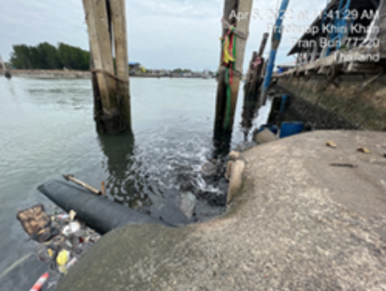
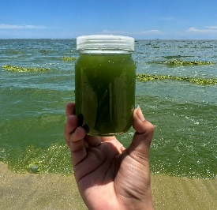
Seeding a Nutrient Pollution Reduction Strategy
for the coastal waters of Thailand
1. Agriculture
Goal : Reduce excess nutrients from source to sea in Thailand, particularly in the Gulf of Thailand, resulting in improved marine and coastal health while contributing to regional and global targets, fostering a sustainable blue economy.
Ban Laem District Phetchaburi Province
โครงการได้แบ่งออกเป็น 3 องค์ประกอบ
2. Tourism
Component 1 | Component 2
Solutions to reduce nutrients from source to sea with active engagement by local communities. Best management practices to address nutrient pollution coming from the agricultural, tourism, and fishing port sectors are applied to reduce excess nutrients feeding to the sea | Policies and implementation frameworks on nutrients pollution management in Thailand. Sustainable nutrient pollution management national policies are strengthened, contributing to a comprehensive source to sea approach across several pollution sources in Thailand.
Component 3 | Component 4
Knowledge and awareness on nutrients pollution at different scales. Knowledge and information platforms, awareness and capacity building related to nutrients pollution are established for Thailand. | Ensuring knowledge management and learning, communications, gender and stakeholder engagement are integrated across the IP, including programmatic coordination and reporting
Bang Sean/Pattaya Chonburi Province
3. Fishing Port
Pranburi Sub-district Prachukireekun Province
Project Status:
2024: Project Preparation Grant stage; PPG 2025 – 2029: Implement the project (5 years)

